Slide 1


Family Learning – understanding the picture
A short introductory programme for partners involved in Family Learning
Created through the North Alliance with the Northern Alliance and supported by Education Scotland

Slide 2
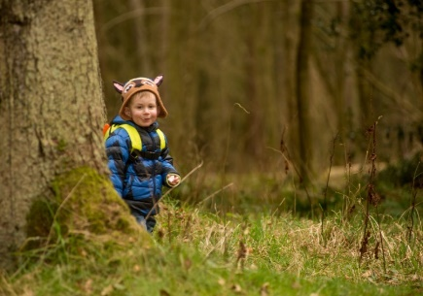
Vision
The vision for education is to deliver both excellence and equity:
Excellence through raising attainment: ensuring that every child achieves the highest standards in literacy and numeracy, set out within Curriculum for Excellence levels, and the right range of skills, qualifications and achievements to allow them to succeed; and
Achieving equity: ensuring every child has the same opportunity to succeed, with a particular focus on closing the poverty-related attainment gap.

Slide 3
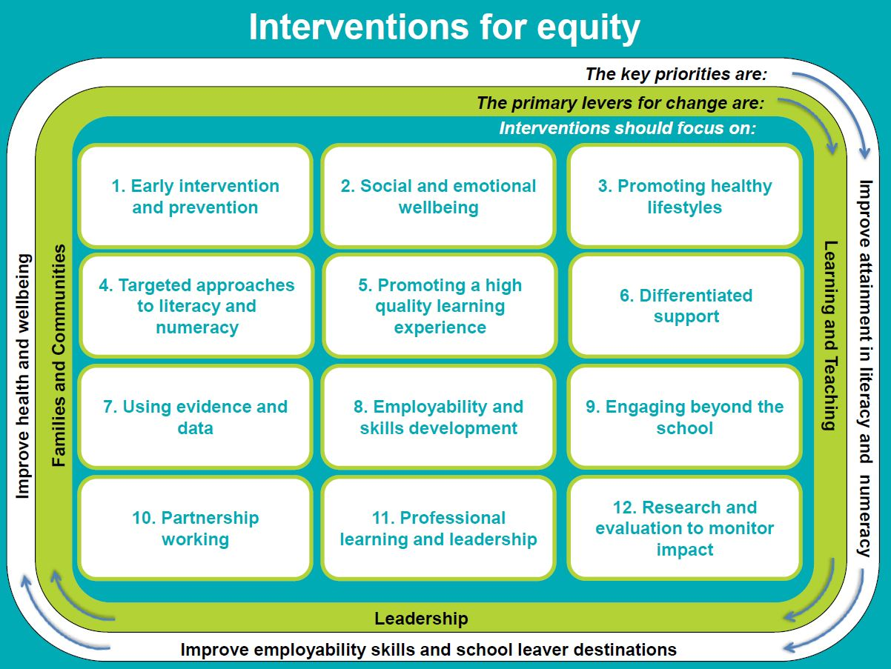
Interventions for Equity

Slide 4






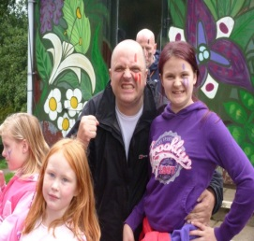
Legislation / Policies
2019 National Improvement Framework and Improvement Plan
National Parenting Strategy (2012)
Delivering Excellence and Equity on Scottish Education (2016)
Scottish Schools (Parental Involvement) Act(2006)
Guidance
Review of the Impact of the Parental Involvement Act (2006) 2017
Adult Learning in Scotland,
a Statement of Ambition (2014)
Learning at
Home
Home/School
Partnership
Parental
Representation

Slide 5
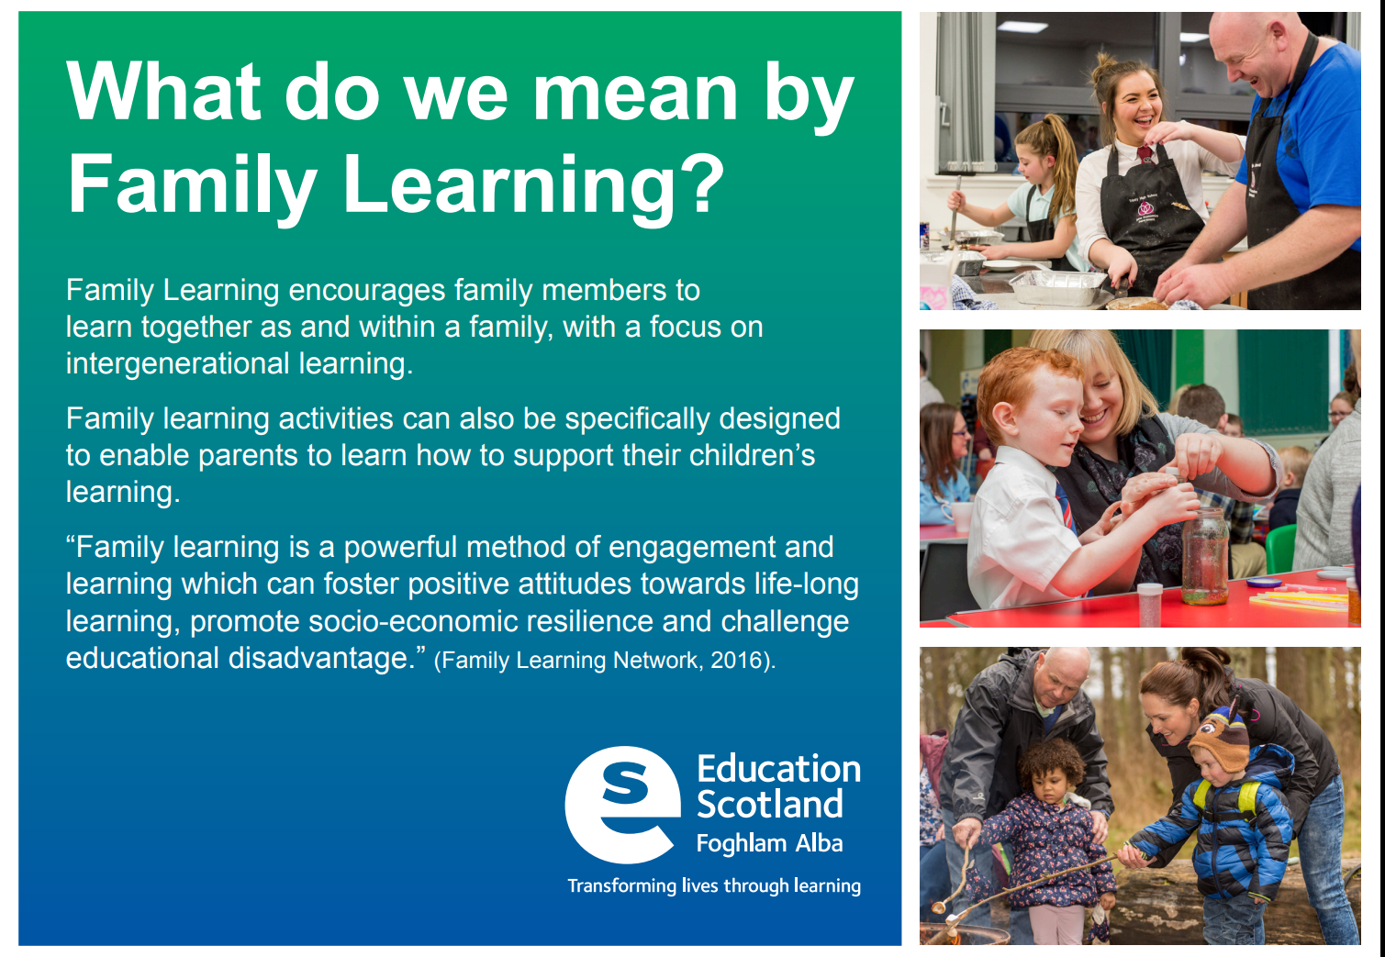
Defining Family Learning

Slide 6
Family Learning Principles
Parent is the first educator
Inclusive
Recognises and values diversity
Equal partnerships
Change and empowerment
Mutual respect
Raising aspirations and outcomes

Slide 7
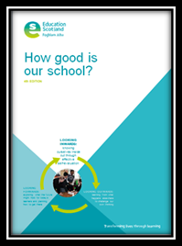
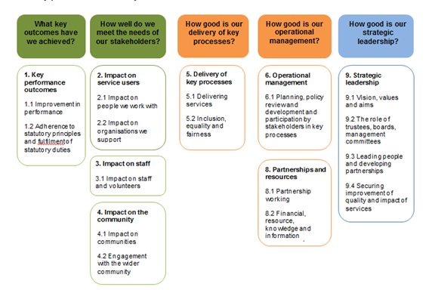

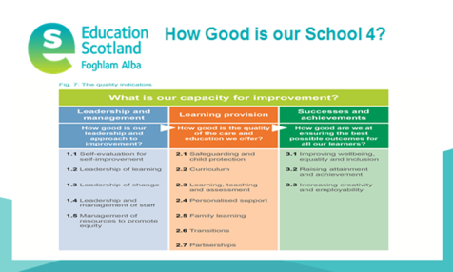
Using the How good is our…..frameworks
Self-evaluation resources which support establishments, organisations and partnerships to evaluate progress, strengths and areas for development
How Good Is Our Third Sector Organisation?

Slide 8
Governance Review
Local authorities will:
Ensure that LA provision such as … Community Learning and Development and third sector partners work effectively with schools and regional improvement collaboratives to provide care and education to children and their families

Slide 9

Regional Improvement Collaboratives

Slide 10








The Northern Alliance - RIC
Notes:
There are 8 local authority areas that make up the Northern Alliance.
Action plan with the improvement priority for family learning
Ensure consistent understanding of and application of Family Learning – through Family Learning programme under development"

Slide 11

The North Alliance
A partnership of Community Learning and Development (CLD) organisations and providers, across the public and third sectors in the North of Scotland - working to strengthen practice through professional development and supporting the work of the Regional Improvement Collaborative

Slide 12
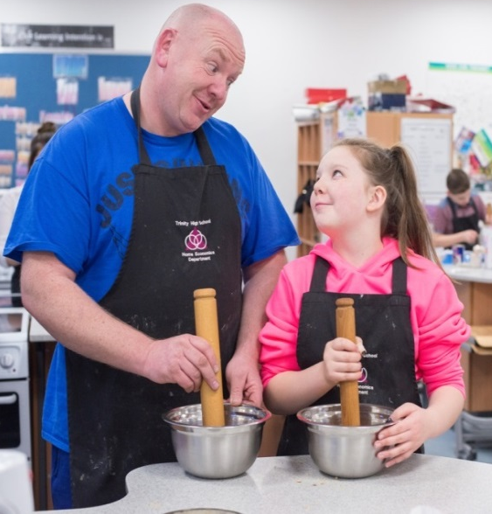
Question
What do we understand Family Learning to be?

Slide 13

Question
What do you think your role brings to a Family Learning setting?
Notes:
Ensure consistent understanding of and application of Family Learning – through Family Learning programme under development" we should ask them first at that slide how they are currently defining Family Learning to establish a baseline.

Slide 14
Question
Which policies / guidance are most relevant in your practice when you work with families?

Slide 15
Question
Please identify existing practice where you work with others to deliver services with and for families through learning

Slide 16

Effective Practice slides
use on screen or as cards at tables

Slide 17
Question
What helps us to identify good practice in Family Learning?

Slide 18
Question
What career long professional learning (CLPL) would be useful to develop or improve Family Learning in your organisation / service?
Brief discussion – record on individual evaluation sheets

Slide 19
Websites / Blogs
National Improvement Hub - https://education.gov.scot/improvement
Parentzone Scotland - https://education.gov.scot/parentzone/
Family Learning and Partnership Blog Posts
https://familylearningscot.wordpress.com/
https://blogs.glowscotland.org.uk/glowblogs/eslb/
https://www.parentclub.scot/

Slide 20
Comments and questions

