Slide 1

Child poverty, adverse childhood experiences, and ‘A Trusted Adult’.
Gillian Amos, Senior Health Promotion Specialist
NHS Lothian

Slide 2
Inequalities:
Inequalities are the unfair and avoidable differences in people’s health (learning & economic circumstance) across social groups and between different population groups.
Notes:
Inequalities are unfair because these inequalities do not occur randomly or by chance, but are socially determined by circumstances largely beyond an individual’s control. These circumstances disadvantage people and limit their chance to live a longer, healthier life.
Inequalities are avoidable because they are rooted in political and social decisions and priorities that result in an unequal distribution of income, power and wealth across the population and between groups.

Slide 3
People in more equal societies live longer, have better mental health and have better chances of a good education regardless of their background.
International research shows that where the income gap is narrower:
  community life is stronger
  children do better at school
  children are less likely to become teenage parents
  people trust each other more
  there is less violence and
  rates of imprisonment are lower

Slide 4




Inequalities account for a significant element of the increasing demands on our public services because of a persisting cycle of deprivation: children and young people brought up in deprived circumstances are more likely to be deprived in later life, which affects the life chances of their children.

Slide 5
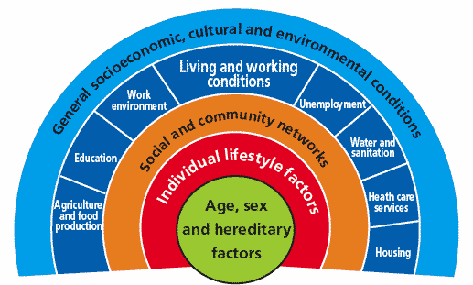
Notes:
Dalgren and Whitehead – all the influences.

Slide 6
The Chief Medical Officer’s Ten Tips for Better Health
1 Don’t smoke. If you can, stop. If you can’t, cut down
2 Follow a balanced diet with plenty of fruit and vegetables
3 Keep physically active
4 Manage stress by, for example, talking things through and making time to relax
5 If you drink alcohol, do so in moderation
6 Cover up in the sun, and protect children from sunburn
7 Practise safer sex
8 Take up cancer screening opportunities
9 Be safe on the roads: follow the Highway Code
10 Learn the First Aid ABC – airways, breathing and circulation
Source: DoH (1999) Saving Lives: Our Healthier Nation. London: The Stationery Office

Slide 7
Townsend Centre's alternative tips for better health
Don’t be poor. If you are poor, try not to be poor for too long
Don’t live in a deprived area. If you do, move
Don’t be disabled or have a disabled child
Don’t work in a stressful low-paid manual job
Don’t live in damp, low quality housing or be homeless
Be able to afford to pay for social activities and annual holidays
Don’t be a lone parent
Claim all benefits to which you are entitled
Be able to afford to own a car
Use education as an opportunity to improve your socio-economic position
Source: Source: Townsend Centre for International Poverty Research, University of Bristol

Slide 8
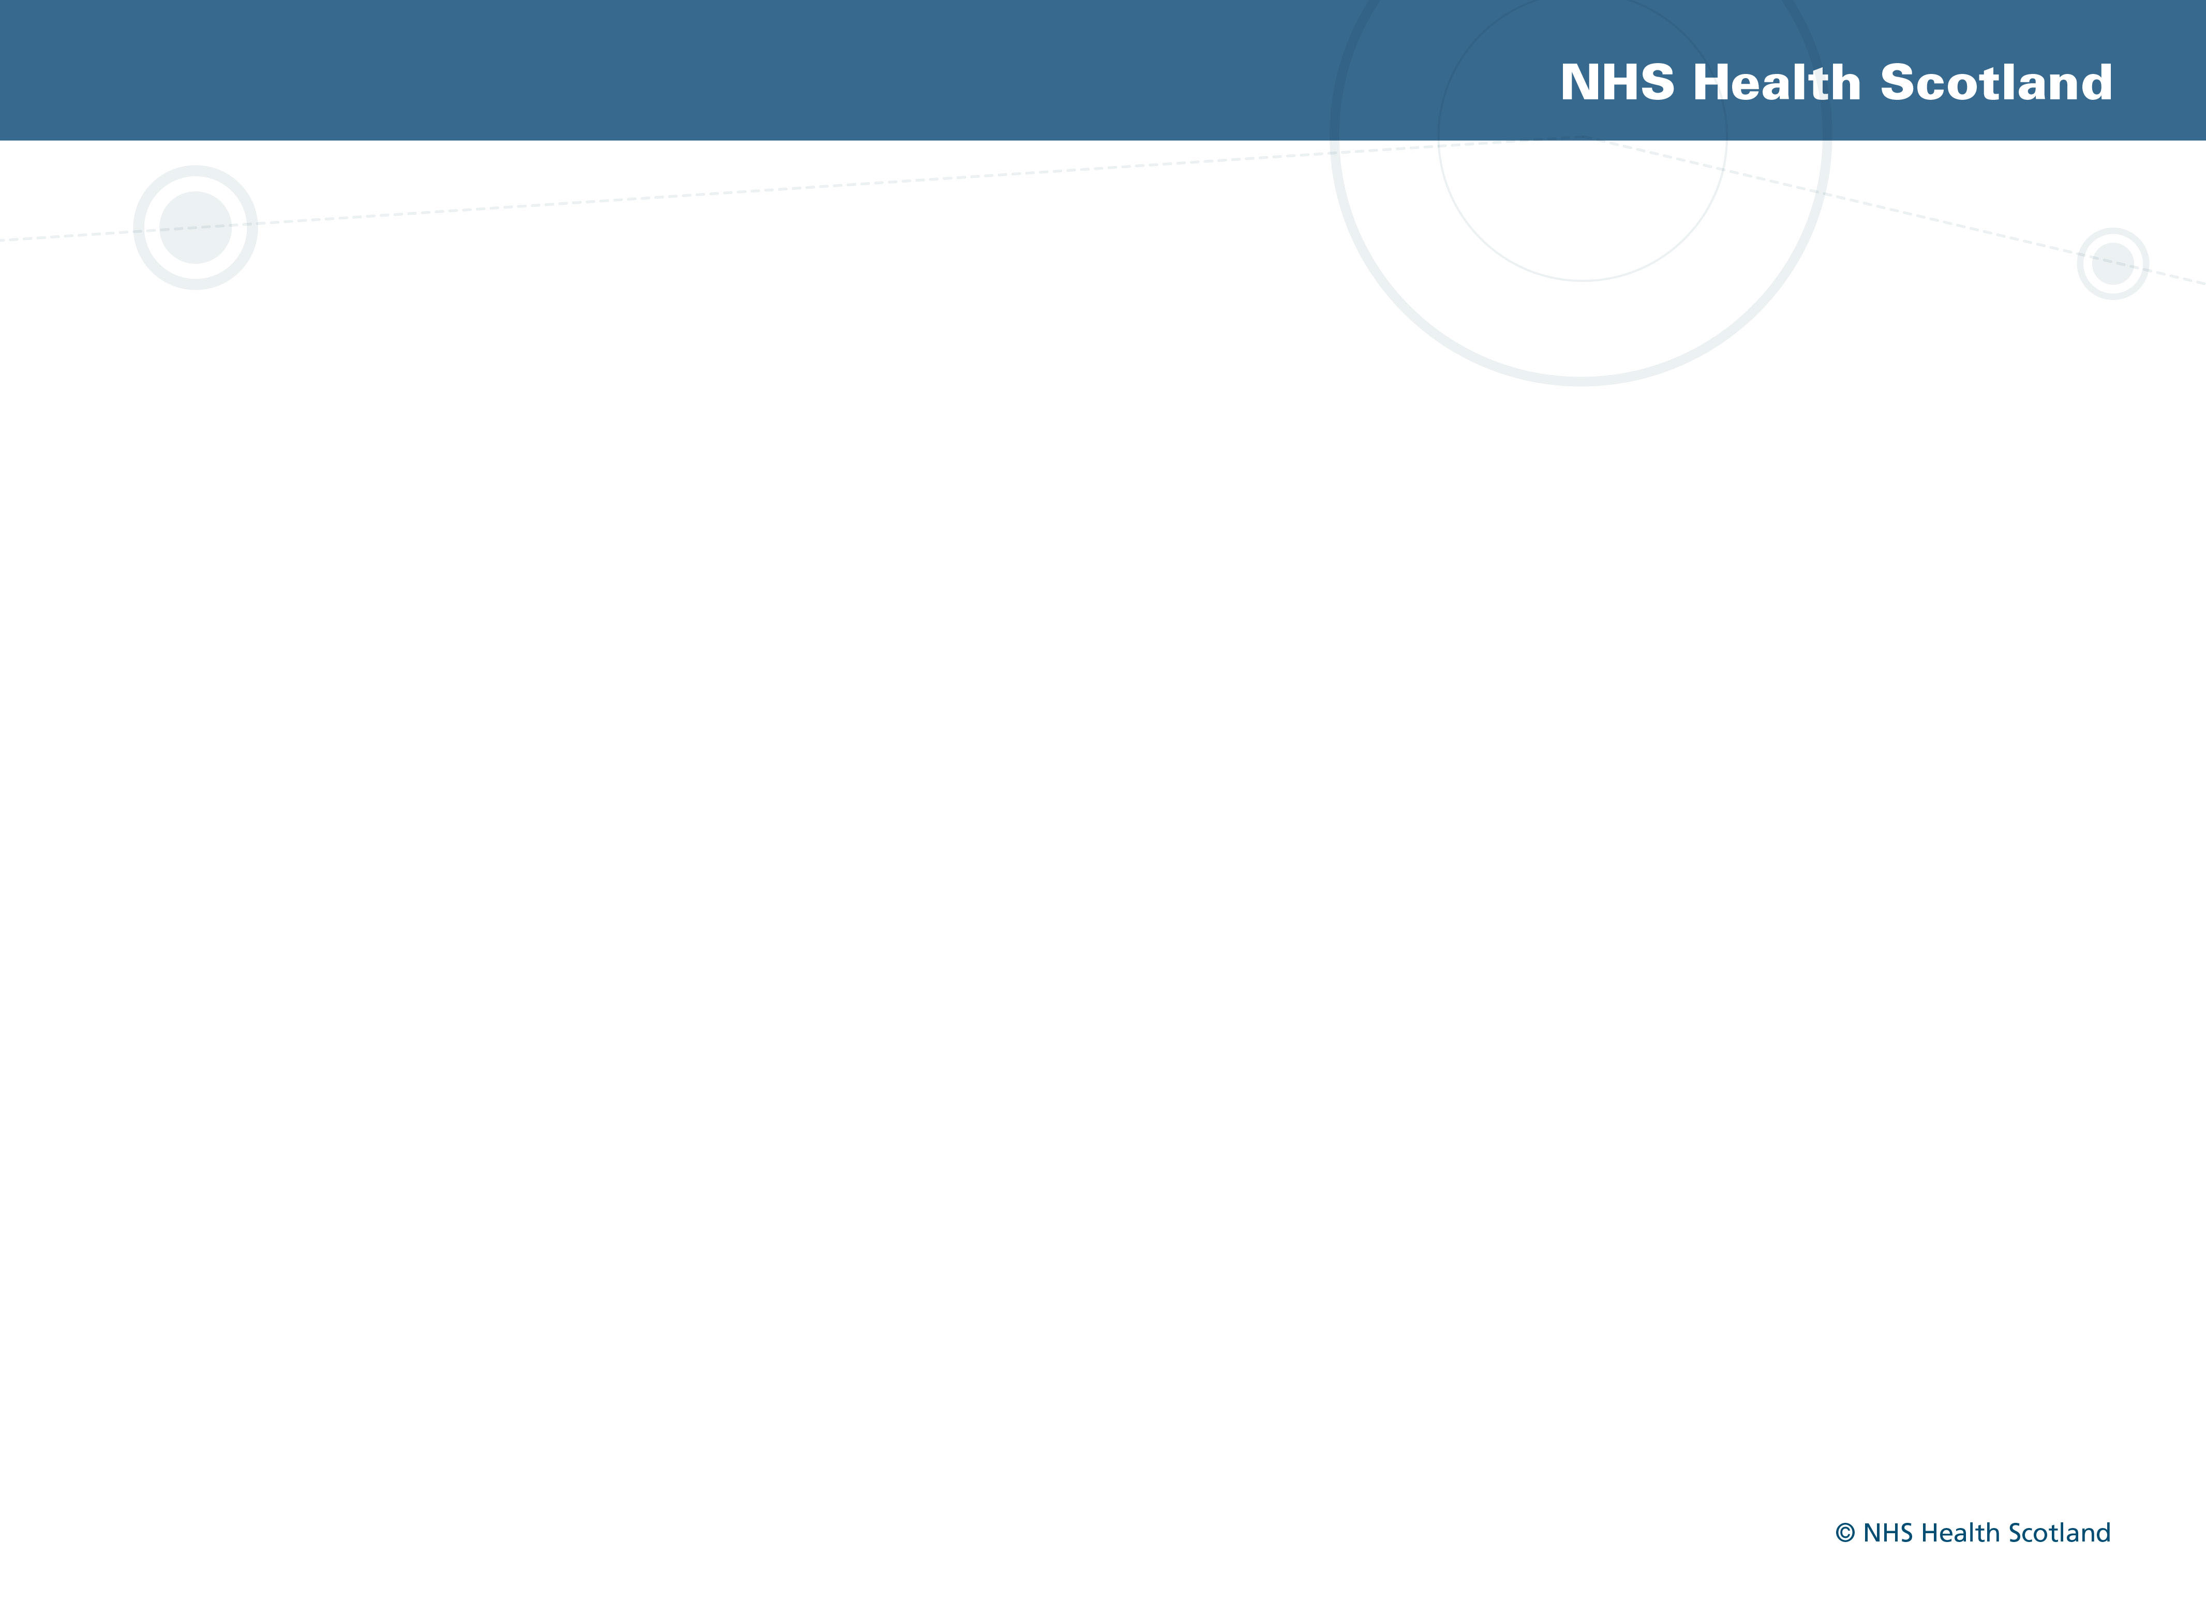
“Having insufficient money to lead a healthy life is a highly significant cause of health inequalities.”
Professor Sir Michael Marmot
Marmot Review, England 2010.
http://www.instituteofhealthequity.org/projects/fair-society-healthy-lives-the-marmot-review

Slide 9
Relationship between child poverty, health & inequalities
Children’s early life experiences and the social circumstances in which they live strongly influence their outcomes in later life.
Inequalities begin before birth, can adversely impact health throughout adult life, and can persist across generations.
There is a link between socio-economic disadvantage during the early years and health inequalities.
The opportunity to reduce the impact of these inequalities is likely to decline as children age.
Income matters for child health & wellbeing

Slide 10
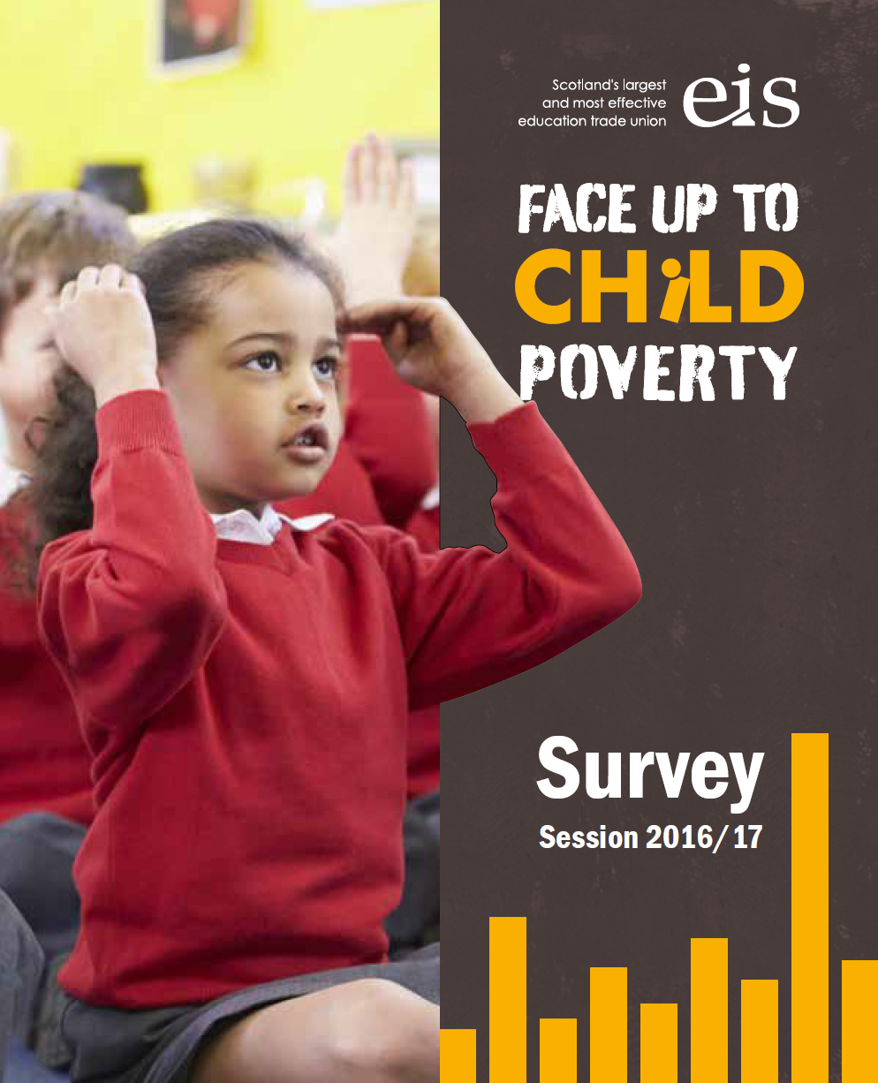
Impact on physical and mental health and wellbeing of pupils
pale skin, thin, stress & anxiety, no hot water or heating, no money for snacks/don’t bring a snack, inappropriate clothing for winter, homelessness, hungry, uniforms are worn out
Attendance affected
Social exclusion from extra-curricular activities
Impact on concentration and ability to learn
EIS members survey 2016/17
Notes:
EIS surveyed their members last year on the impact of poverty that they were seeing in their schools.

Slide 11
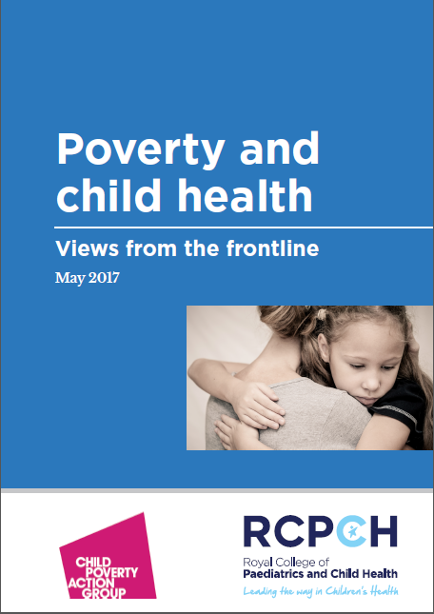
Themes
Food insecurity
Financial stress and worry
Homelessness / poor housing
Poverty exacerbating poor health
‘Poverty makes children sick’
Notes:
In a similar vein, Paediatricians from across the UK were surveyed on the impact of poverty in their hospital and clinic settings. They too reported seeing children impacted by
food insecurity
Financial stress and worry
Homelessness / poor housing
And poverty exacerbating poor health
One quote sums it up: Poverty makes children sick

Slide 12
Educational attainment and inequality
Differences in educational attainment are both a driver and a consequence of poverty
Individuals with higher qualification levels and skills are much more likely to be in employment, and have better employment prospects and higher earnings.
This reduces the risk of poverty for more highly qualified individuals and their children
Evidence that increases in parental income levels directly leads to increases in educational attainment of children living in poverty, and contributes to a substantial narrowing of the attainment gap
Income matters to educational outcomes
Notes:
But back to educational attainment, differences in educational attainment are both a driver and a consequence of poverty
Individuals with higher qualification levels and skills are much more likely to be in employment, and have better employment prospects and higher earnings.
This reduces the risk of poverty for more highly qualified individuals and their children
Evidence that increases in parental income levels directly leads to increases in educational attainment of children living in poverty, and contributes to a substantial narrowing of the attainment gap
Income matters to educational outcomes

Slide 13
Educational inequality
In general, children from poorer families have poorer educational outcomes compared to those from more affluent families
Pre-school children from low income families were about 13 months behind in vocabulary skills and 10 months behind in problem solving skills compared to their affluent peers
Early cognitive development is linked with educational attainment, which, in turn, influences longer-term employment prospects
Notes:
And, these messages will be familiar to you:
In general, children from poorer families have poorer educational outcomes compared to those from more affluent families
Pre-school children from low income families were about 13 months behind in vocabulary skills and 10 months behind in problem solving skills compared to their affluent peers (Growing Up in Scotland data)
Early cognitive development is linked with educational attainment, which, in turn, influences longer-term employment prospects

Slide 14
Mental Wellbeing ...the 6 box model
Source: NHS GGC
A Trusted Adult
Responding to Distress
Whole School Approach /
School Connectedness
Peer Help and Social Media
Resilience Development in Communities
Guiding Thru the Service Maze

Slide 15
A Trusted Adult....
The concept of ‘A Trusted Adult’ is to
emphasise the importance of a dependable adult who can support and protect the mental well-being of a child and/or a young person.
My World Survey - national study of youth mental health in Ireland. Launched in May 2012 by Headstrong, in collaboration with the University College Dublin (UCD) School of Psychology, it revealed a number of findings about the real mental health needs of our young people.

Slide 16
My World Survey snapshot of results
1 in 3 young people have experienced mental health problems
1 in 5 have engaged in self harm
7 per cent of young adults had reported a suicide attempt
Suicidal thoughts, attempts, and rates of self-harm were higher amongst those who did not discuss their distress with others, the survey found

Slide 17
“What is A Trusted Adult?”
It’s that person you can talk to when there’s something on your mind; someone you can rely on, and trust to help you out in times of difficulty.
The presence of One Good Adult has been found to be a key indicator of how well a young person copes with their struggles.
Although it’s important for young people to have One Good Adult, it is equally important to be that One Good Adult.

Slide 18
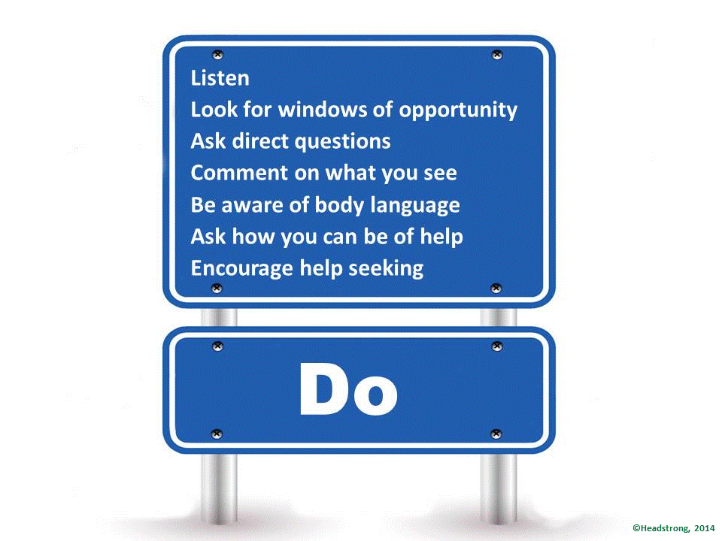
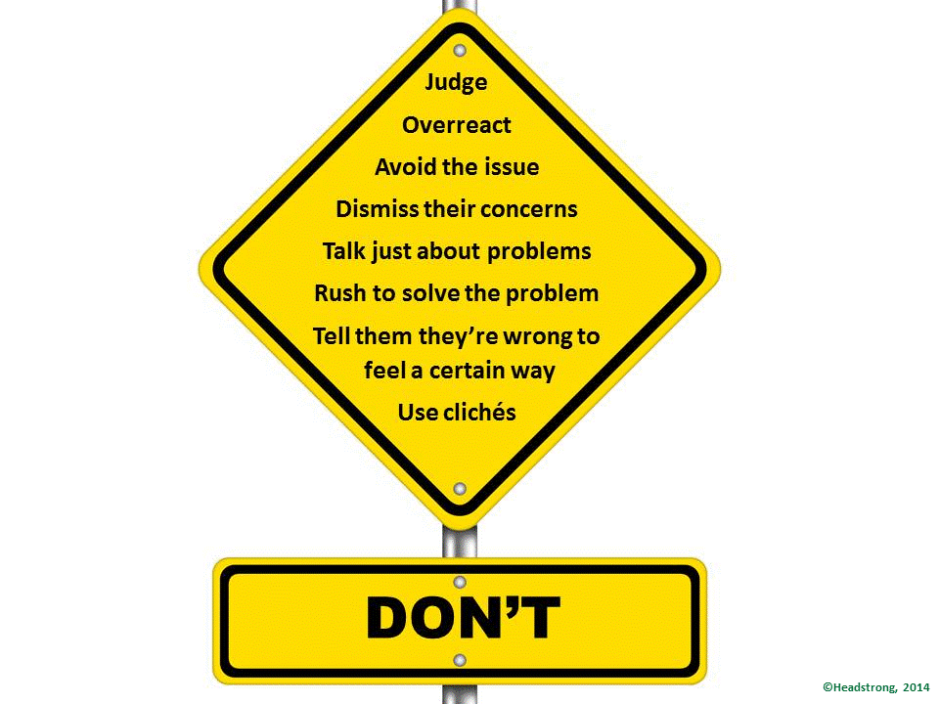
How to be that Trusted Adult
Do’s and Don’ts

Slide 19
Skills Required
Good Listener
Compassionate
No Jumping to Conclusions
Open Minded
Don’t Judge

Slide 20

Supports for One Good Adult
Access to training:
  Growing Confidence Training
  Scottish Mental Health First Aid Training
Access to Resources:
  Resilience Toolkit
  Bereavement Toolkit
Digital support
  ‘Aye Mind’

Slide 21
Adverse Childhood Experiences
“intra-familial events or conditions causing chronic stress responses in the child’s immediate environment. These include notions of maltreatment and deviation from societal norms” (Kelly-Irving et al., 2013).
Notes:
Stressful experiences during childhood that directly hurt a child or can affect them through the environment they live in.
Categories of ACE
Abuse (emotional, physical, sexual)
Neglect (emotional and physical)
Houshold adversity (domestic violence, substance misuse, household mental ill health, criminality, separation, living in care)
In 1985, Vincent Felitti, Chief of Kaiser Permanente Medical Care programme in San Diego noticed a pattern in patients in an obesity clinic – patients were losing significant amounts of weight but then withdrawing from the programme early – Felitti interviewed 286 patients and it turned out many had suffered childhood trauma, often sexual abuse, and eating soothed anxiety and depression whilst being overweight served as a shield against undesired attention. Felitti joined forces with Robert Anda, Medical epidemiologist at CDC and set up a national study with 17000 participants. Individuals were surveyed on different types of adversity. Patients included were not troubled or disadvantaged, they were on average 57 and 75% had attended college – they were ‘successful’ men and women, mostly white, middle-class with stable jobs and health benefits. Felitti and Anda were shocked – 64% of participants had experienced at least one adversity, with 87% of those having additional adversity. 40% had suffered two or more adversities and 12.5% had an ACE score greater than or equal to 4.
Questions to count an ACE score (Appendix 1 in report)
Did you live with someone who was a problem drinker or alcoholic or who used street drugs?
Was a household member depressed or mentally ill, or did a household member attempt suicide?
Did a household member go to prison?
Were your parents ever separated or divorced?
Did a parent or other adult in the household often or very often swear at you, insult you, put you down or humiliate you/act in a way that made you afraid that you might be physically hurt?
Did a parent or other adult in the household often or very often push, grab, slap or throw something at you/ever hit you so gard that you had marks or were injured?
Did an adult or person at least 5 years older than you ever touch or fondle you or have you touch body parts in a sexual way/attempt to actually have oral, anal or vaginal intercourse with you?
Did you often or very often feel that no one in your family loved you or thought you were important or special/your family didn’t look out for each other, feel close to each other, or support each other?
Did you often or very often feel that you didn’t have enough to eat, had to wear dirty clothes, and had no one to protect you/your parents were too drunk or high to take care of you or take you to the doctor if you needed it?
Was your mother or stepmother often or very often pushed, grabbed, slapped or had something thrown at her/sometimes, often or very often kicked, bitten, hit with a fist, or hit with something hard/ever repeatedly hit at least a few times or threatened with a gun or knife?

Slide 22
What harm does being exposed to ACEs cause?
  Associations between ACEs and health:
  Injury and death in childhood
  Premature mortality and suicide
  Disease and Illness
  Mental illness
Potential pathways from ACEs to poor health outcomes:
  Health-harming behaviours
  Social determinants of health
  Neurobiological and genetic pathways
Notes:
Injury and death during childhood:
Injury rates in childhood have been shown to be more common in areas in socioeconomic deprivation and therefore are also likely to be linked to the prevalence of ACEs. However, these are speculative associations as there is a lack of data in this area.
Premature mortality and suicide:
In 1957 a British Cohort Study examined the relationship between ACEs and premature mortality. Men who had experienced 2 or more ACEs had a 57% increased risk of death compared to men who have experienced no ACEs. Women had a 60% increased risk with one ACE and an 80% increased risk with 2 or more ACEs.
An increased suicide risk has been shown to be linked to the presence of childhood adversity by the age of 7.
Disease and illness:
Experiencing ACEs has been linked to a number of health harming behaviours and illnesses e.g. alcoholism, depression, illicit drug use, ischemic heart disease, sexually transmitted diseases, unintended pregnancies, smoking (graph on next slide).
Mental illness:
The impact of childhood adversity on the development of adult mental illness has been studied using data from WHO Mental Health Surveys (not including data from UK). It was estimated that eradicating childhood adversity would result in a 23% reduction in mood disorders, 42% reduction in behaviour disorders, 31% in anxiety disorders and a 28% reduction in substance disorders. ACEs have also been shown to have an impact on developing mental illness whilst still in childhood. A study of 12-17 year olds in Washington showed that prevalence of mental health problems rose from 11% in children with no ACEs to 44% in those having experienced 5 or more ACEs.
Health harming behaviours:
Similar data in England
Social determinants of health:
ACEs have been shown to have a negative impact on social determinants of health including income, education, employment, housing.
Neurological and genetic pathways:
Altered responses to stress can lead to physical changes in the way the brain develops. This is often referred to as ‘toxic stress’ and is thought to have an impact on how someone adapts to future adverse experiences and in the chance of developing health harming behaviours.
How does being exposed to ACEs cause harm?

Slide 23
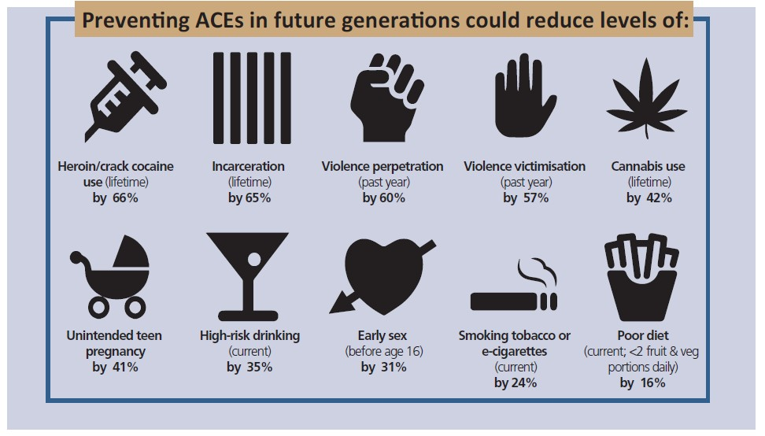
What is the economic impact of ACEs?
Notes:
This is estimates from the work of Mark Bellis based on English and Welsh survey data. Little UK data on exact impact of ACEs in society – but likely to be very large health and economic impacts form the prevention or reduction of aces.

Slide 24
Are some people more likely to be affected by ACEs than others?
ACEs are linked to inequalities, although evidence suggests there are other factors that influence susceptibility and resilience;
Children who have at least one stable, committed relationship with a supportive caregiver tend to be more resilient, being able to transform ‘toxic stress’ into ‘tolerable stress’.
Notes:
Resilience defined as ‘positive adaptive response in the face of significant adversity’.
Children with one stable relationship seem to build skills such as the ability to plan, monitor and regulate behaviour and adapt to changing circumstances.
Although there is data in Scotland about household dysfunction there is no published data on the prevalence of specific ACEs in the general population. However, an English study has found that 50% of people had experienced at least one ACE and 8% experienced four or more. A Welsh study suggest that 50% reported experiencing at least one ACE and 14% reported experiencing four or more.
This is about an “always available adult” from work done by Mark Bellis.

Slide 25
It’s all about relationships...
Children who end up doing well despite adversity have usually had at least one stable committed relationship with a supportive parent, caregiver or other adult. This buffers them from development disruption and builds skills such as the ability to plan, monitor and regulate behaviour and adapt to changing circumstances.
National Scientific Council on the Developing Child.

Slide 26
The importance of relationships...
‘…the quality of the relationships between children and the adults in their lives, along with children’s levels of emotional wellbeing, will largely determine the outcomes children realise.’
Children’s Parliament, ‘It’s all about relationships’

Slide 27
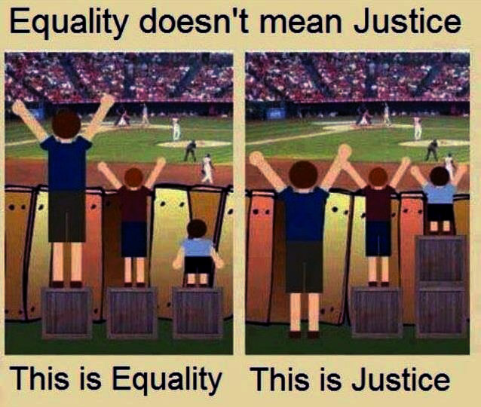
40% of our spending is currently accounted for by interventions that could have been avoided by prioritising a preventative approach.
COMMISSION ON
THE FUTURE DELIVERY
OF PUBLIC SERVICES

Slide 28
Full Cluster Feedback – Areas for Improvement
Staff training (on mental health awareness and managing conversations)
Consistency of positive behaviour management across the cluster
Parental support and engagement
Improving the ethos
Knowing school staff roles
Structure day in a way that enables teachers to be that one good adult (e.g. manage time constraints)
Financially friendly school day
System for improving communication between primary and secondary, school and health, school and parents, school and partner agencies, school and wider communi

Slide 29
St Margaret's Cluster – Learning to love loving to learn – Trusted Adult
Aim
Primary Driver
Secondary Driver
Test ideas
To increase X no of children who report as green on the wellbeing indicators by x
(data available January)
Mental Health & Wellbeing
Positive confident staff who have good conversations with CYP
SMHFA Training
Staff mental health awareness
Growing Confidence
Parental Awareness on mental health & Wellbeing
Info to parents via app/websites possibly group work
Pupil mental health awareness
Financially friendly school day
Financial advice in schools
Poverty
Access to opportunities
Basic needs are met
Building a positive ethos in the school
Resilience Package
Inclusion
Supporting attendance
Daily Check in
Positive staff – pupil relationships
Paul Dix Behaviour Challenge
Parental Engagement & Involvement
Family learning and involvement
Postive Parenting
Sleep Scotland Training

Slide 30
Key Learning Points
Full cluster on board to develop driver diagram – staff involved in the process
Improvement methodology useful tool to focus the work and divide up the tasks – very practical way of putting theory into practice
Partnership working
Brings all the policy agendas together (raising Attainment for All, CYPIC, Inequaliites.
Learner focused – brings family/community/school together.

Slide 31
Challenges
Capacity for developing the test ideas and carrying them out, releasing staff for training
Time - one hour per month dedicated to cluster meeting to discuss progress
Other clusters now interested – challenge is how we spread the learning – good or bad
How do we engage 3rd sector and CLD workforce

Slide 32
Group discussion
  What work is currently going on within the CLD workforce that supports mental health and wellbeing?
  How can we raise awareness about the importance of a trusted adult and help people recognise their role?
  How do we develop the capacity within the workforce to be a trusted adult?

