Slide 1

The Competent Practitioner Framework
Using the CLD Competencies
CLD West Alliance
Dr Marion Allison
23rd March 2018

Slide 2

Community Learning & Development
What is CLD?
Who are CLD practitioners?
What do CLD practitioners do?
Notes:
Aim:
To introduce you to the Competent Practitioner Framework and to talk about how we can use the Competencies to reflect, develop and progress our work.
What is CLD – practice, profession, movement? A field of professional practice
Who are CLD people? Helpers, volunteers, professionals, practitioners? Much debate, often by CLD people themselves. For me CLD is a professional practice. CLD activists don’t just help at the youth club, volunteer at the library. They are leaders whose professional skills and knowledge are vital to building a vibrant, equal and just society.
We have much to share – not just within the realms of youth work, adult learning or community development, but to other sectors such as health, justice, education and the arts.
As leaders and agents of change, we must therefore be at the top of our game and that is why CLD professional learning is central to ensuring that the communities and learners of Scotland are served by the highest quality professionals.

Slide 3
The CLD Practitioner
Social Change & Social Justice
Collaborative
Anti-discriminatory
Diverse
Challenge & Support
Connectors (social capital)
Critically reflective

Slide 4
CLD Attributes & Identity
Knowledge & understanding
CLD Values & Principles
  Self determination, inclusion, empowerment, collaboration and lifelong learning
Attitude & behaviour
Skills & processes
Reflection & Action

Slide 5
CLD Code of Ethics
Primary client
Social context
Equity
Empowerment
Duty of care
Transparency
Confidentiality
Co-operation
Professional Learning
Self Awareness
Boundaries
Self-care

Slide 6
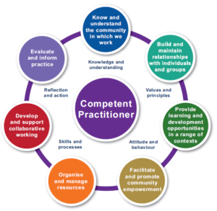
CLD Competences
7 CLD competences
Purpose
Context
Avg 8 abilities

Slide 7
Using the competences
Reflect
Develop & Progress
Self / Peer
H R Processes
i-develop
Audit

Slide 8
  Dr Marion Allison
  The CLD Standards Council Scotland
  9th Floor
  The Optima
  58 Robertson Street
  Glasgow G2 8DU
  Email: marion.allison@cldstandardscouncil.org.uk
  Web: http://www.cldstandardscouncil.org.uk/
  Twitter: @marionacldsc
  Hashtag: #BecauseofCLD

Slide 9
The Competent Practitioner Framework
Using the CLD Competencies
CLD West Alliance
Dr Marion Allison
23rd March 2018

