Slide 1
Empowering CLD Conference
Friday 23 March 2018

Slide 2
WELCOME
WEST CLD ALLIANCE CONFERENCE
EMPOWERING COMMUNITY LEARNING AND DEVELOPMENT
FRIDAY 23 MARCH 2018

Slide 3
Introduction
About West CLD Alliance…
About today and the theme…
About me…
KIRSTY ANDERSON
Policy Adviser, CPP Team, EDC
Chair of West CLD Alliance
Kirsty.Anderson@eastdunbarton.gov.uk

Slide 4
CPD Survey
Survey designed by West CLD Alliance – based on competences by CLDSC
Ran Jun – Dec 2017
200 completed responses (East Ren and Glasgow responses separately)
People rated competences 1-10 (one least confident)
Results by LA and overall report feeding into regional and national WFD plan.
Training calendar for West CLD Alliance – respondents keen to participate

Slide 5
National Standards of Community Engagement
Inclusion
Support
Planning
Working together
Methods
Communication
Inclusion
IMPACT

Slide 6
Survey Demographics
CLD / Development Worker most common job title
60% had undergrad degree or above
Comm. Ed. most common degree subject
15 years average experience
One third accessed formal / accredited training in last year – plus wide range of informal training

Slide 7
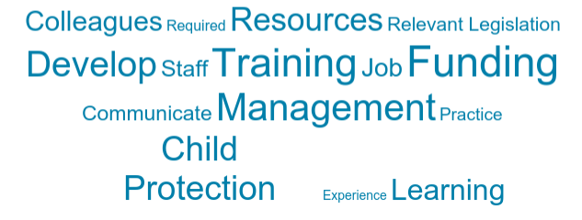
Organise and manage resources
One of the lowest scoring competences (6)
Training needs around making funding applications and ongoing awareness of what funding is available
Risk management in community settings e.g. around asset transfer
Project management (logic models), child protection/domestic abuse, equalities, record keeping, income maximisarion / benefits (e.g. via CAB), sustainability of funding and Excel were all areas of requested training

Slide 8
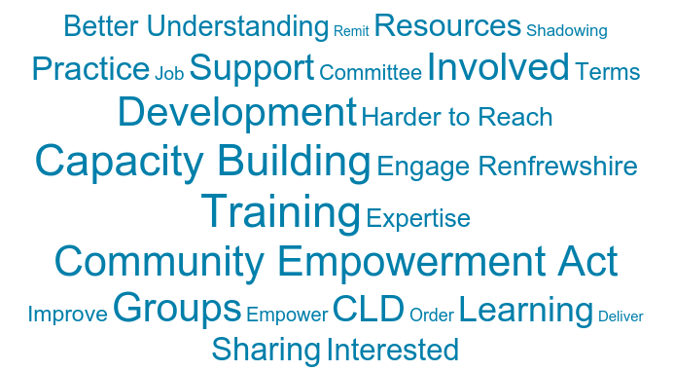
Facilitate and promote community empowerment
One of the lowest scoring competences (6)
Training needs on Community Empowerment Act and what it means for CLD
Co-production and how to facilitate community action / regeneration

Slide 9
Evaluate and inform practice
People were confident in this theme (7)
More training on the new HGILDOC Quality Indicators
Ease of access resources for this – time constraints
Innovative approaches to gathering impact evidence e.g. vlogging
How others are managing performance and measuring the impact of CLD plans including use of technology (and with partners / volunteers).
Peer reviews – leading to more robust data

Slide 10
Develop and support collaborative working
People were moderately confident in this competence (7)
Defining roles, responsibilities and tasks in a partnership
Communicating the benefits of collaboration
Developing stronger links with partner agencies
Effective partnership working – in teams and wider networks
Multi-agency training opportunities – understand what we are each doing

Slide 11
Provide Learning and development opportunities in a range of contexts
People were confident about this theme (7).
Training needs around engaging the ‘hard to reach’
Training on building confidence of individuals / groups – learner voide
Civic engagement using social media – digital marketing of learning
Different learning styles and meeting individual needs in groups – time!

Slide 12
Know and understand the community in which we work
People were confident about this theme (7)
Need for easy access up to date information on local communities
Joining up staff and teams internally – also networking externally
Feeling of disconnect between strategy and operations

Slide 13
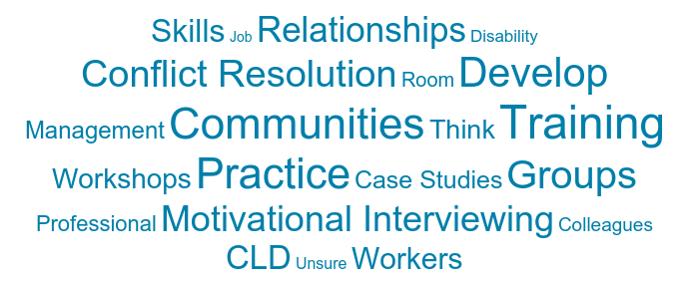
Build and maintain relationships with individuals and groups
Most confident competence (8)
Need for training for roles – leader, advocate, facilitator, coach
Need for training on conflict resolution
Capacity building techniques
Motivation and team building – group dynamics and structures

Slide 14
Other Questions
Out of 168 responses, 55 were full members, 21 associate and 90 non members of CLDSC
Idevelop not being utilised fully for variety of reasons
Time for reflection

Slide 15
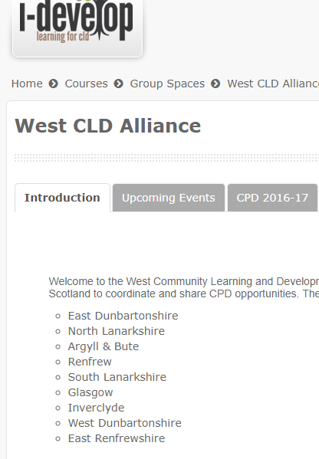
Next Steps
Huge appetite for collaborating on training
Joint training calendar to capitalise on our shared skills and resources
Quarterly West CLD Alliance meetings
Thanks to CLDSC for training grant!

Slide 16
Implementing Participatory Budgeting (PB Partners, Alan Budge) as outlined in the Community Empowerment (Scotland) act (2015). PB Partners have been instrumental in developing a number of successful PB schemes in practice in the west of Scotland. Local PB volunteer Champions have been nominated by PB Partners who will also be in attendance.
Milngavie Community Development Trust (East Dunbartonshire, Ruth and Wilson Blakey) – will outline what they have done to engage the population of their town and then develop an action plan. They have worked together and learned from good practice elsewhere to put on a number of successful events, gain funding for projects and progress initiatives with local partners.
National Learner Voice Working Group (Jane Logue and Sheila White) – this is a working group of the National Strategic Forum for Adult Learning, which produced the National Ambition Statement. The working group was focussed on the learner-centred part of the statement, in particular, the objectives around learners co-designing their learning and influencing national and local policy. The workshop will outline the survey and subsequent ‘starter pack’ produced looking at Learner Voice activities across Scotland, as well as an opportunity to discuss the recommendations arising from the work.

