Slide 1

Community empowerment and local democracy in Scotland
Dr Claire Bynner
Research Associate, University of Glasgow
Place-based Approaches Lead, What Works Scotland
@claire.bynner @WWScot

Slide 2

The purpose of WWS is to use evidence to inform public service reform and transform public services for all of Scotland’s communities to flourish

Slide 3


Prevention
Performance
Partnership
Participation
Place

Slide 4
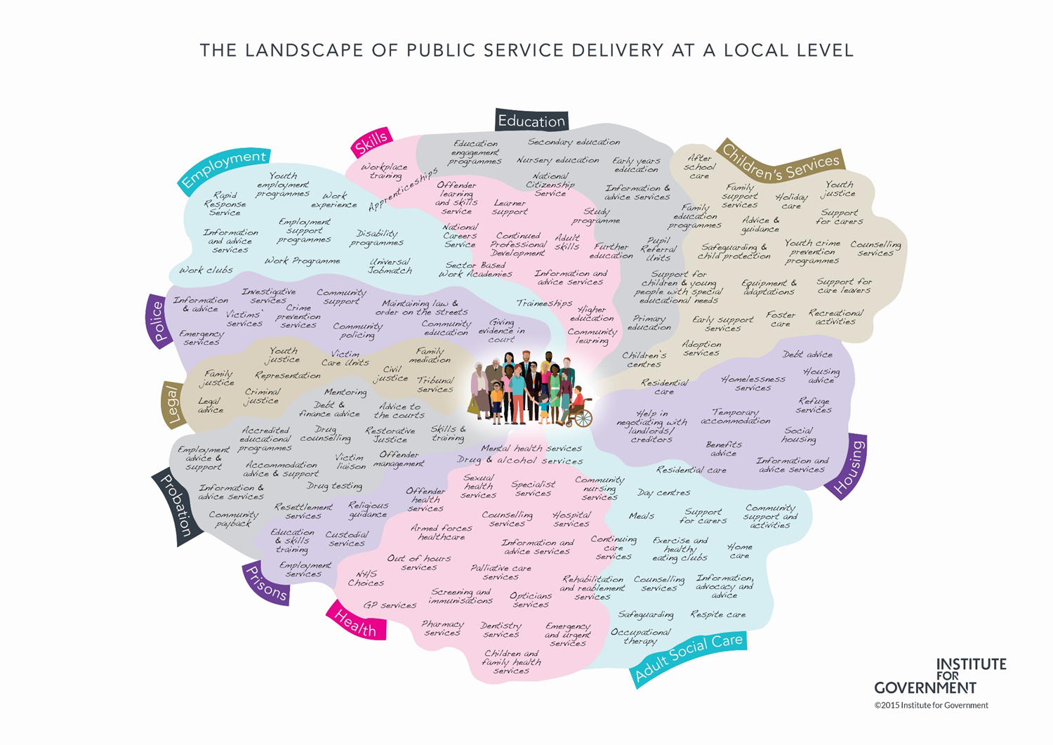

Slide 5
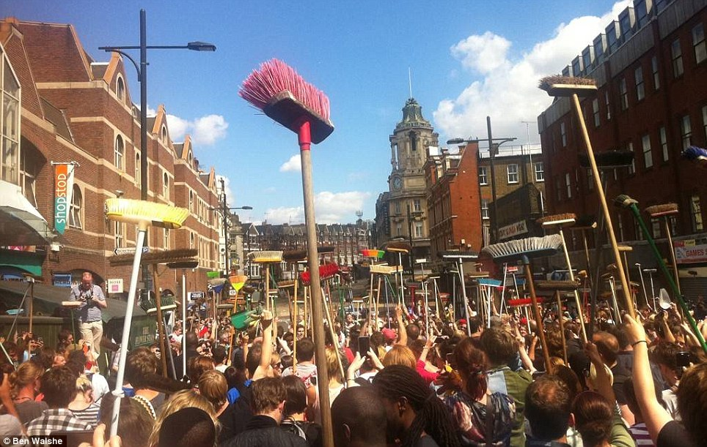

Slide 6
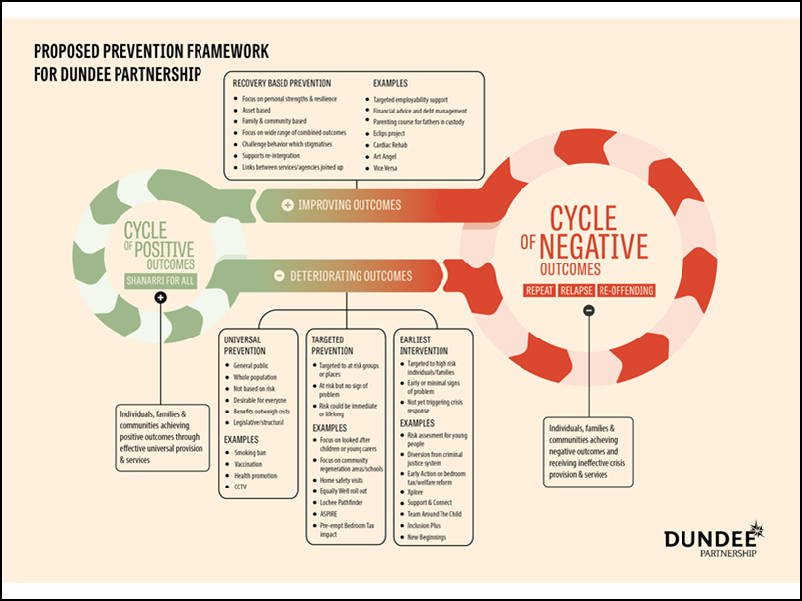

Slide 7
A ‘silent crisis’ of local democracy?
Scotland has the largest average population per basic unit of local government of any developed country (Keating 2005)
Average population per LAA:
  Finland=15,960; France= 1770; Germany= 7,080; Spain= 5.680; EU average= 5,630
  Scotland= 163,200
Alongside England, Scotland has some of the lowest voter turnout at local elections in the EU
Ratio Elected Members/ Citizens represented:
  Finland= 1/500; France 1/125; Germany:1/400; Spain 1/700; UK= 1/2860
  Scotland = 1/4270
A ‘silent crisis’ of local democracy? (Bort et al 2012)

Slide 8
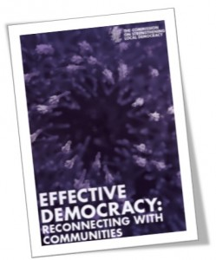
2014 COSLA Commission on Strengthening Local Democracy:
There is a link between the absence of strong local democracy and the prevalence of inequalities
It is communities that empower governments at all levels, not governments that empower people”

Slide 9
Skerratt, S.
Notes:
See also the proposals in Education (Scotland) Bill (consultation just launched 7th November) The Bill will improve parental and community engagement in school life and in learning outside of school, and strengthen the voice of children and young people, by actively promoting and supporting pupil participation

Slide 10
Evolving role of citizens: 2 stories can be told
Story of decline
Story of progress
Declining…
  Voter turnout in elections
  Trust in & legitimacy of traditional institutions of public life (e.g. government, media, parties, unions, community associations, etc)
  Social capital: community ‘ethos’ & networks
(Dalton 2005; Putnam 2001)
What’s happening is that citizens are becoming:
  better educated, more knowledgeable and critical;
  less deferential to traditional authority and elite-driven / hierarchical forms of governance;
  dismissive of conventional channels and engaged in alternative mechanisms of political expression;
The myth of public apathy
(Norris 2002;Castells 2012;Eliasoph1998)

Slide 11
Participation in local decision-making in Scotland deficits and aspirations
(Scottish Social Attitudes Survey 2015 + Ipsos Mori 2014)
35% of Scottish citizens feel part of how decisions affecting their community are made
96% said that people should be involved in making decisions about how local services are planned and run
80% said that people should be involved in deciding how money is spent on local services
77% would get more involved in their community if it was easier to participate in decisions that affect it

Slide 12
In the last 12 months, have you participated in a local forum to discuss policy or community issues?

Slide 13
Stay standing if at that forum there was a reasonable…
…gender balance
…mix of personal and professional backgrounds
…range of perspectives and opinions
… age range (i.e. 3 generations)
… income range
…sense that most participants felt included and influential
…sense that most participants enjoyed it
… sense that their participation would have a clear impact

Slide 14
Key challenges in organising public participation processes
Inclusion and diversity
Quality of dialogue and deliberation
Impact: clear link to decision making

Slide 15
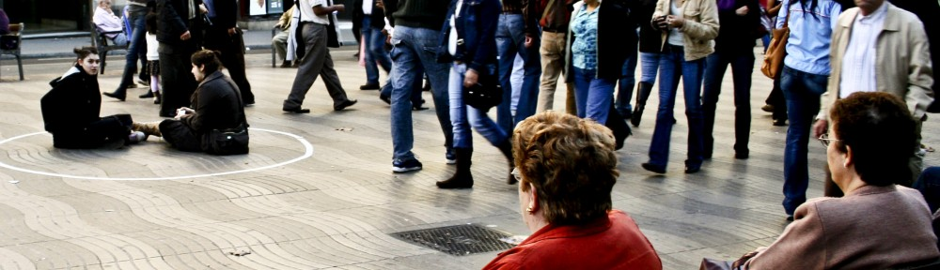
  What Works in public participation?

Slide 16
3 components of ‘what works’ in public participation
Multi-channel
Inclusive & deliberative
Empowered & consequential

Slide 17
Multi-channel
Developing a variety of channels for participation:
  online, face to face, combined
  light-touch vs. intensive
  crowdsourcing
  Open Government
Notes:
Also – Ireland’s citizens assembly, Better Reykjavik, Madrid Listens

Slide 18
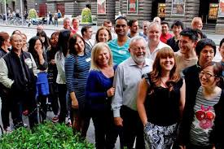
Inclusive AND deliberative
Inclusion and diversity are crucial for meaningful, legitimate and effective participation
  demographics AND perspectives
  lowering barriers to participation
Deliberative engagement is about:
  assessing evidence
  hearing & scrutinising different views
  then, making informed decisions
Examples of ‘mini-publics’/ citizens juries:
  Community bonfire in Aberdeenshire
  Community policing in Peterhead
  Wind farm development in Coldstream, Aberfeldy & Helensburgh
  North Marr Rural Partnership

Slide 19
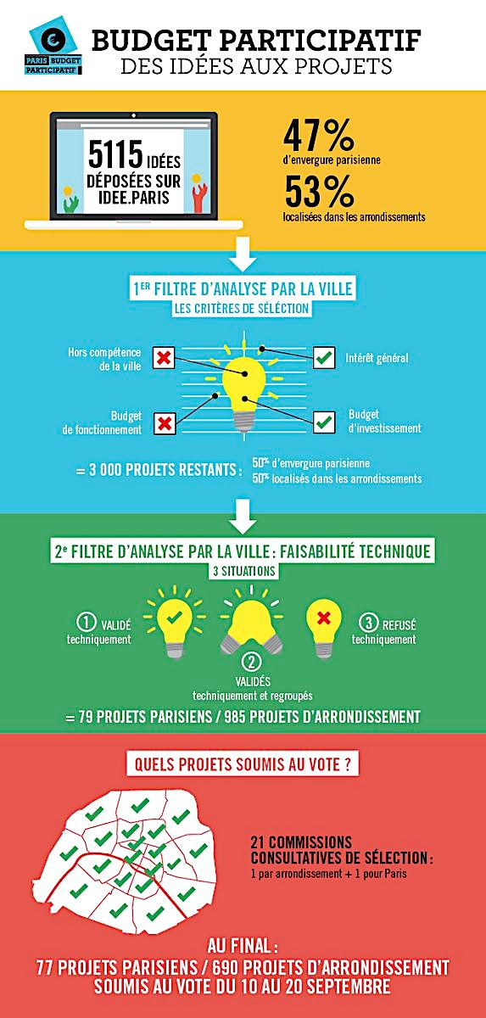

Empowered and consequential
Participation thrives when important issues and resources are at a stake, and citizens feel their contribution can actually make a difference
Example:
  Participatory Budgeting, from Porto Alegre (Brazil) to 2,700 localities around the world

Slide 20

But is all participation good?
Paradox of growing participation and growing inequalities (Walker, McQuarrie & Lee 2015)
unless corrective measures are taken “participation of all varieties will be skewed in favour of those with higher socioeconomic status and formal education”
(Ryfe & Stalsburg 2012)

Slide 21
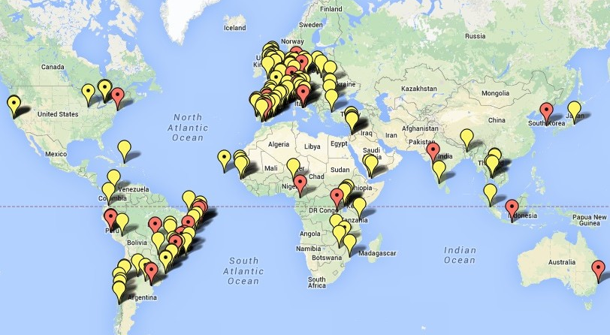
Participatory Budgeting around the world
Thousands of PB processes have taken place around the world
since the 2001 World Social Forum in Porto Alegre

Slide 22
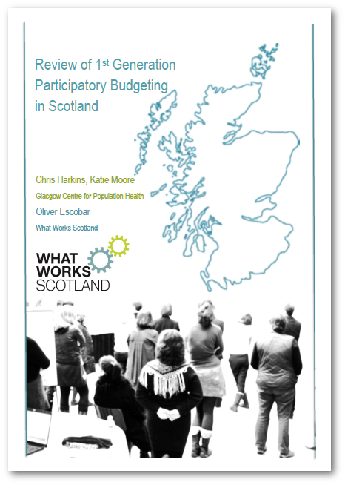

Review of 1st Generation
Participatory Budgeting in Scotland with Chris Harkins and Katie Moore
(Glasgow Centre for Population Health)
Notes:
PB in Perth and Kinross – 7,000 cast votes, 90 projects funded. Increased cohesion and community networking

Slide 24
Scotland in transition?
1st Generation PB (2009-2016) – experimenting | 2nd Generation PB (2016 onwards) – mainstreaming?
Organic development of PB, predominantly small scale, driven by local champions and ad hoc funding | Unprecedented policy, legislative, capacity building and investment framework from which to embed PB
Predominance of community grant-making model; PB as a community engagement tool; no need for substantial changes in the institutional system | Towards a variety of sustainable PB models, including mainstream budgets and services? Reorienting the relationship between citizens, politicians, civil society, and the state?
Positive impacts, but limited evaluation Limited focus and impact on tackling inequalities | Towards robust evaluation of short and long term outcomes? Stronger focus and impact on tackling inequalities – social justice agenda?
Notes:
Milestones in the transition to 2nd generation PB:
2016-17 Community Choices Fund and implementation phase of the Community Empowerment (Scotland) Act
The development of the 1st Generation of PB in Scotland can be characterised as organic and grassroots –in the sense that it wasn’t the product of national policy, which is poised to have a stronger influence on 2nd Generation PB. This developmental, iterative and generative growth of PB in Scotland has proven particularly adept at embodying bespoke PB processes and projects driven by local people alongside services and facilitators, and fuelled by a genuine desire and energy to try this new way of working and explore the potential of grant-making via PB.
The review makes clear that the majority of processes and projects (for which there was available information) have taken place within disadvantaged areas. The review also suggests, however, that only a minority of 1st Generation PB has been articulated as having the explicit goal of improving services, opportunities or conditions within disadvantaged areas and addressing inequalities.
The main impacts of this type of PB are most likely to be related to increasing participants’ confidence and social connections resulting from the PB process, as well some other immediate local benefits resulting from the funded projects. If the 2nd Generation of PB in Scotland is ‘mainstreamed’ in a fashion similar to Brazil, and its application is as a policy instrument then this means a fundamental shift in the way public services are delivered. PB in this form means structural and governance change and redistribution of public resource to disadvantaged regions and communities alongside tailoring service delivery based on community priorities and contexts. The system wide application of PB as a policy instrument is long-term and is more likely to foster the reduction of social and health inequalities in terms of life-course outcomes for disadvantaged communities.

Slide 25
  Designing strong institutions of local democracy

Slide 26
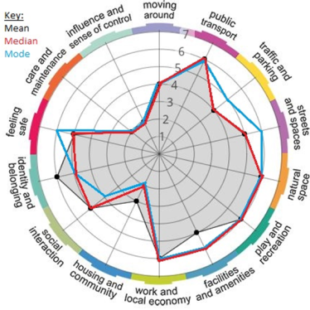
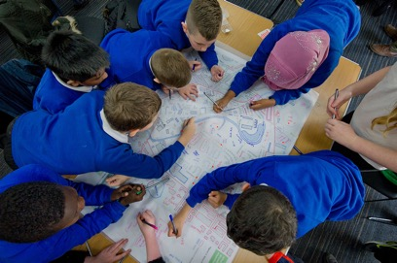
We have new and innovative methods and techniques …

Slide 27
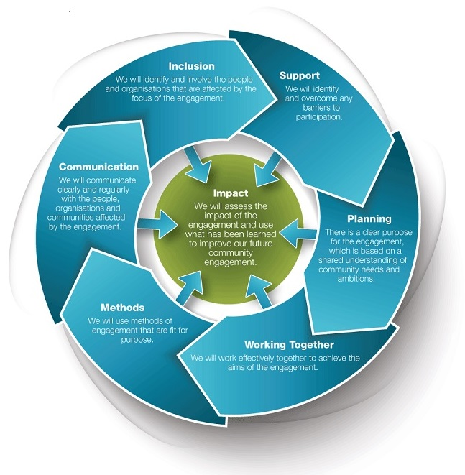


We have high standards for processes….

Slide 28
Strengthening local democracy will require…
But…….. we must invest in new institutions and infrastructure for local democracy
democratic innovation
  new approaches, processes and institutions that enable inclusive forms of decision-making through co-production and deliberation
and facilitative leadership

Slide 29
21st Century Politician
Traditional leader | Facilitative leader
Hierarchies | Networks
Certainty (knows everything) | Openness (constant learning)
Leads others | Helps others to lead themselves
Good at talking | Good at listening
Knows the direction | Knows how to help others to work out the direction
Commanding and controlling | Facilitating and mediating
Builds alliances to win policy battles | Builds alliances to find workable policies and solutions

Slide 30
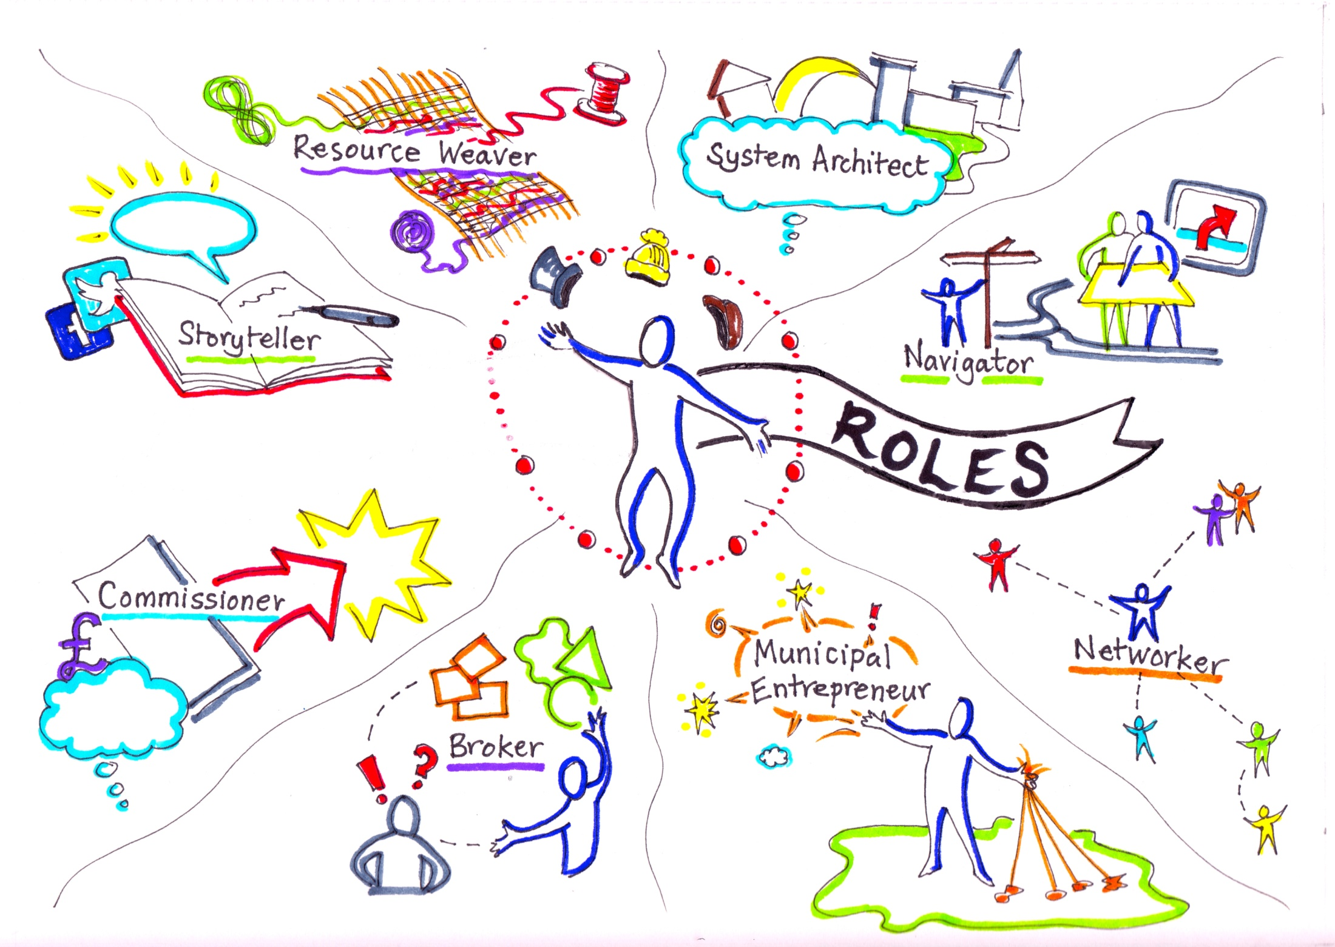
21st Century Public Servant
Notes:
Slide replicated from work by Catherine Mangan, Catherine Needham and Helen Dickinson (University of Birmingham) –Project: The Twenty-first Century Public Servant/
Important role of these professionals as boundary spanners and democratic innovators

Slide 31
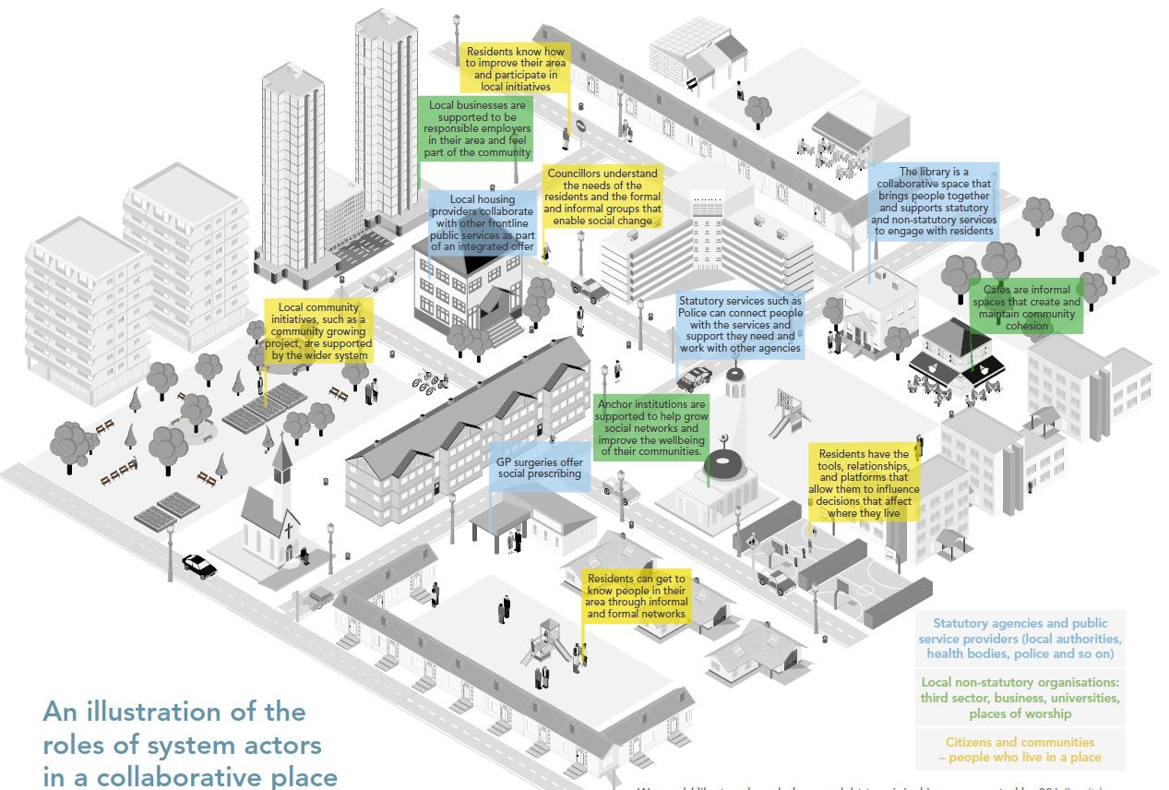
Collaborative Places
Randle, A. & Anderson, H. 2017
Notes:
There is currently a sense of public participation being a disjointed activity. This is where we want to be – coherent connected collaborative places – supported by the wider system

Slide 32
Key challenges
Reshaping mindsets and ways of working
  commitment to democratic innovation from officials, elected representatives, community groups and citizens
  facilitative leadership
Inequalities of power and influence within communities
  local authorities have a key role in lowering barriers to participation and creating a level-playing field
  democratic innovations can clash with established relationships and dynamics in communities
Investment in developing:
  capacity and skills: facilitation, process design, mediation, negotiation, brokering, etc
  infrastructure (e.g. spaces, platforms)
Long-term commitment, ongoing learning and adaptation

Slide 33
Concluding Messages
Empowerment is not something that can be done to others, communities/citizens can only empower themselves
But CPPs can develop
  enabling conditions, governance structures, capacity, infrastructure and spaces for democratic innovation
The challenge is to connect decision-making processes, facilitative leaders and innovations to produce a stronger local democracy
Notes:
How does the community plan fit with decisions taken in committees and at the CPP board level?
From innovations that are disconnected to system change

Slide 34

Thank-you!
Please stay in touch…
whatworksscotland.ac.uk
@wwscot
Notes:
Key WWS reports and events to look out for:
CP Officials survey
Community Anchors report
Community Engagement Inclusion Review - What Citizens Want
Making Data Meaningful report

