Slide 1
Community Learning and Development Learning Lunch
CLD Standards Council for Scotland
18 November 2016

Slide 2
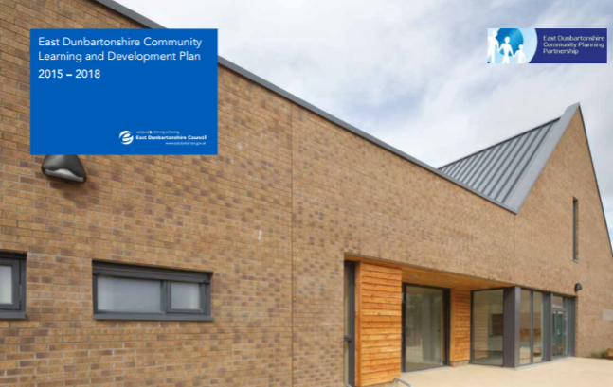
East Dunbartonshire CL&D Plan
Working together to achieve the best with the people of East Dunbartonshire.
East Dunbartonshire Local Outcomes
Improvement Plan

Slide 3
Defining CL&D
A common defining feature is that programmes and activities are developed in dialogue with communities and participants…[CLD's] main aim is to help individuals and communities tackle real issues in their lives through community action and community-based learning.
Working and Learning Together (SG, 2004)
Community Learning and Development includes programmes of learning and activities designed with individuals and groups to promote the educational and social development of those individuals and groups.
CLD (Scotland) Regulations 2013

Slide 4
Defining CL&D – Strategic Guidance for CPPs
Community development (building the capacity of communities to meet their own needs, engaging with and influencing decision makers)
Youth work, family learning and other early intervention work with children, young people and families
Community-based adult learning, including adult literacies and English for speakers of other languages (ESOL)
Volunteer development;
Learning for vulnerable and disadvantaged groups in the community, for example, people with disabilities, care leavers or offenders;
Learning support and guidance in the community.

Slide 5
Strategic Guidance for CPPs – Policy Goals
Ensure communities across Scotland – particularly those who are disadvantaged – have access to the CLD support they need.
Strengthen coordination between full range of CLD providers, ensuring CPPs, Local Authorities and other providers of public services respond appropriately to the expectations set by the CLD Strategic Guidance.
Make the role and contribution of CLD more visible.

Slide 6
CLD Values
The CLD Standards Council has set the following values for CLD that have been adopted in the plan:
Self-determination
Inclusion
Empowerment
Working collaboratively
Promotion of learning as a lifelong activity

Slide 7
The Competent CLD Practitioner

Slide 8
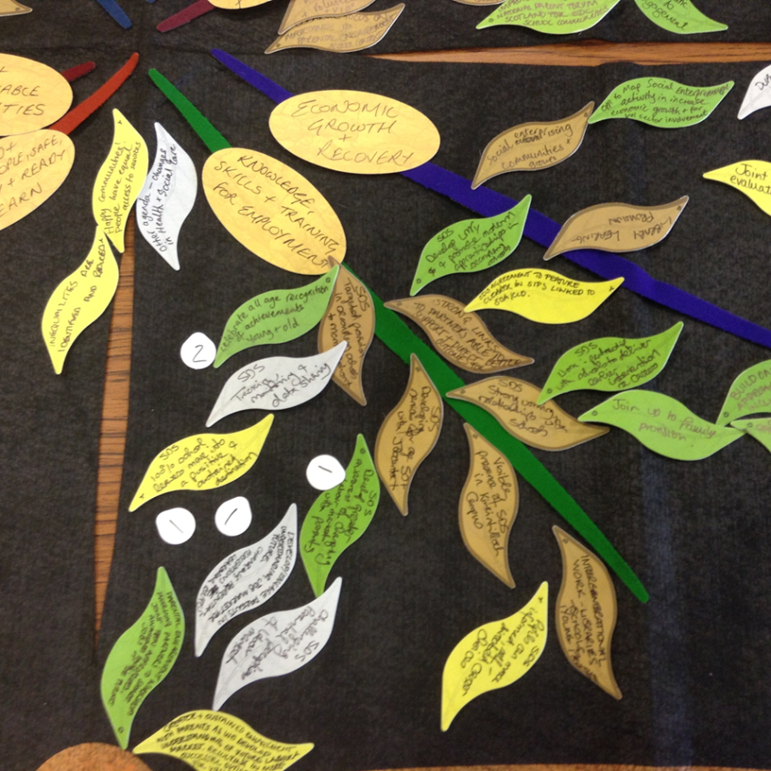
How the Plan was Developed
CLD Partnership formed in August 2014
Community Audit with CLD Partnership undertaken using Ketso
Community Audit with CLD practitioners via focus groups
CPD Sub Group and regular survey on learning needs / programme of integrated workforce development (CLD Learning Lunches)
Consultation on Action Plans

Slide 9
Action Plans
CLD Partnership working
Place Approach to Joint Resourcing
Community Capacity Building
Improving Employability
Skills for Learning, Life and Work
Financial Inclusion
Early Years and Supporting Families
8. Reducing Health Inequalities

Slide 10
Consultation
Engagement
Do you want pizza or pasta? (closed)
What would you like for dinner? (open)
Co-production
Sustainability
Let’s make a meal together
Let me show you how to cook.

Slide 11
National Standards for Community Engagement

Slide 12
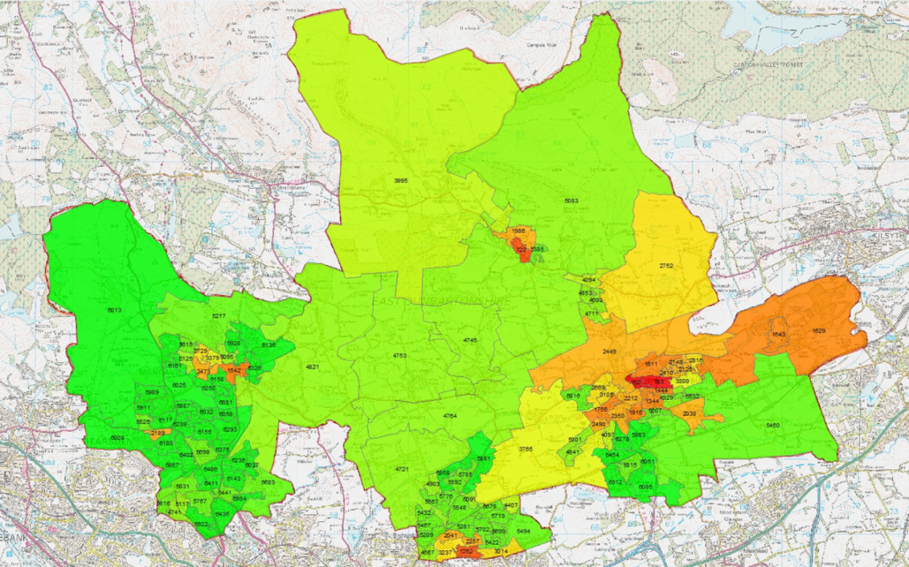
Place Approach to Joint Resourcing
LOIP and CLD plan commit to reducing inequality using targeted approaches to joint resourcing. Understanding
local need and building on local assets.

Slide 13
SIMD 2016
East Dunbartonshire remains relatively less deprived than other Local Authorities - majority of datazones in least deprived of the SIMD.
Hillhead remains the most deprived area in East Dunbartonshire, however SIMD ranks in the area have improved with two datazones moving out of the 5% most deprived in Scotland / majority of Datazones showing less deprivation than in SIMD 2012 e.g. Keystone and Dougalston moved out of 25% most deprived.
Still 7 Datazones in the most deprived 25% in Scotland, these are located in Hillhead, Auchinairn, Lennoxtown and now Kirkintilloch West.

Slide 14
Communities of Place and of Interest

Slide 15
Outcome Monitoring

Slide 16
How Good is the Learning and Development in our Community?
Questions:
What difference are you making?
How do you know?
Who do you ask?
Are you capturing all of the significant impacts you make?

Slide 17
Next Steps
CPP and locality plan engagement using Place Standard Tool (by October 2017)
Empowering our Communities / CLD Partnership
‘Growing the Learning Culture’ commitment for CLD employers to have professional development plans
CLD plan commits to SCSM Submission by 2018
CLD Learning Lunches – 18, 21, 23 Nov. 2, 8 Dec.
SCDC Programme & Community Impact
Improved Communications on CLD e.g. Newsletters
Community Empowerment (Scotland) Act 2015 – community participation in public decision making

Slide 18
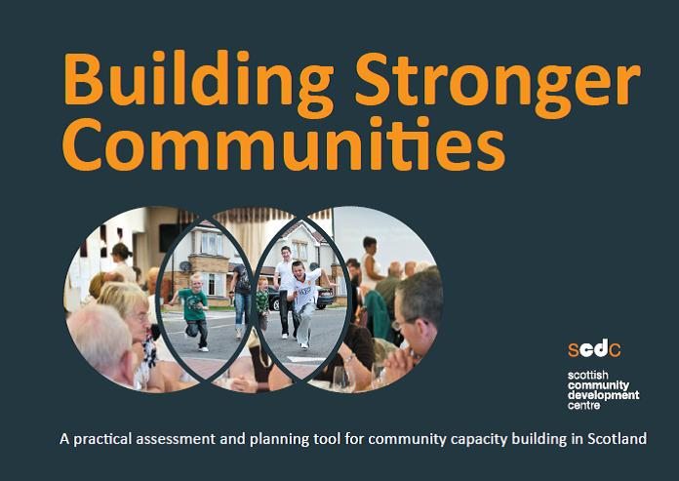
Community Development
Analysis of the range of community groups in East Dunbartonshire
Support to groups by East Dunbartonshire Council, East Dunbartonshire Voluntary Action and others
Building Stronger Communities Programme with key groups

Slide 19
Any Questions?
Kirsty.Anderson@eastdunbarton.gov.uk
KIRSTY ANDERSON
Policy Adviser (CLD)
Community Planning and Partnerships Team

Slide 20
Exercise 1
What are you currently doing to support:
a. Community or learner involvement in decision making?
b. Development of community skills?

Slide 21
Exercise 2
From your perspective what does a strong and empowered community look like?
How do you identify the needs of individual learners or communities? Have you identified any gaps or unmet needs?
How do you know that the work you do has a positive impact on learners or communities?

Slide 22
Exercise 3
“Imagine 2 years in the future, describe what a successful picture looks like”
Arrive at two positive/affirmative statements
e.g. “In two years’ time community organisations will be integral partners to CPP decision making” or “In two years’ time all vulnerable or disadvantaged learners will be identified and supported to develop the skills they need to participate”

