Slide 1

Notes:
This is a front cover page and can only be used at the beginning of a PowerPoint presentation once. Do not add anything else to this screen if it is being used.

Slide 2

How good is the learning and development in our community?
Summer 2016

Slide 3

HGILDOC?
A self-evaluation resource which supports organisations and partnerships delivering community learning and development to evaluate progress, strength and areas for development
Written in line with Education Scotland’s values;

Slide 4



Written in line with other self-evaluation frameworks. Designed to provide a common self-evaluation language with other sectors
Notes:
This is an internal page in blue and can be duplicated to create additional pages. Always keep the heading and footer as shown. Use the corresponding blue internal and back pages if you are using this page.

Slide 5
Supports practitioners to undertake the core process of self-evaluation and ask
How are we doing?
How do we know?
What are we going to do now?

Slide 6
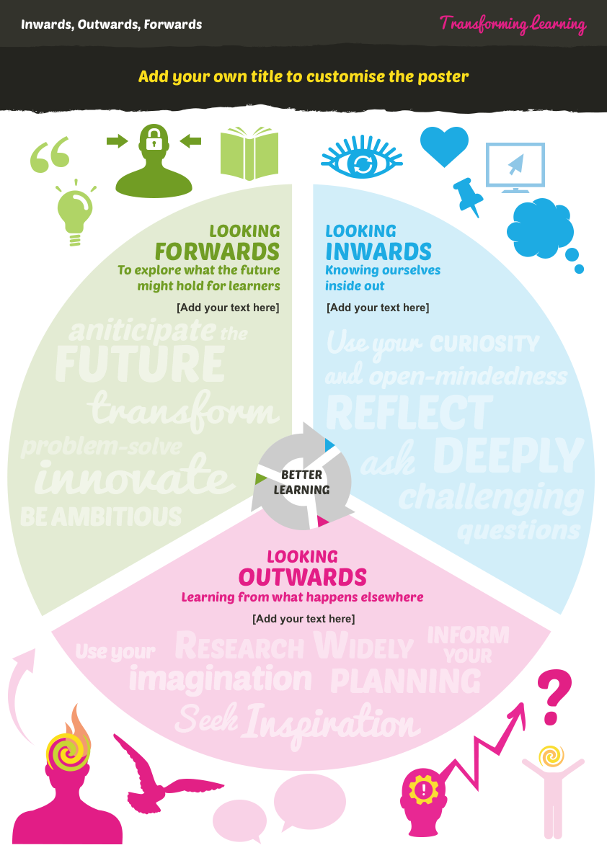





And engage in the
Virtuous cycle of improvement
Looking inwards: to evaluate performance at every level and use the information gathered to decide on what needs to be done to improve.
Looking outwards: to learn from research, others and best practice and use this to facilitate innovation and creativity and inform improvement actions.
Looking forwards: to explore what the future might bring and use this information to anticipate what change is required to ensure we are responsive to the future needs of all of the people we work with.

Slide 7
Still asks 6 key questions
What key outcomes have we achieved?
How well do we meet the needs of stakeholders?
How good is our delivery of key processes?
How good is our operational management?
How good is our strategic leadership?
What is our capacity for improvement?

Slide 8
But has a reduced the number of QIs:
Outcomes | Processes | Leadership
1.1 Improvements in performance | 5.1 Delivering the learning offer with learners | 9.1 Vision, values and aims
2.1 Impact on learners | 5.2 Inclusion, equality and fairness | 9.2 Leadership and direction
3.1 Impact on staff and volunteers | 6.1 Planning, policy review and development and participation by stakeholders in key processes | 9.3 Leading people and developing partnerships
4.1 Impact on the local community | 8.1 Partnership working | 9.4 Securing improvement of quality and impact of services
4.2 Improving impacts from sharing wider practice | 8.2 Financial, resource, knowledge and information management | 10. Capacity for improvement – global judgement based on evidence from the other QIs

Slide 9
What remains familiar?
Focus on results - impact
Learners and communities at the centre
Partnership threaded throughout
Themes and illustrations of very good practice
Colour-coding
Follows Overarching Framework and links to EFQM

Slide 10
What is new?
Greater focus on equality and equity
Introduction of challenge questions
No illustrations of weak practice
Expectation that CLD practitioners will become familiar with and use all of the QIs over time (rather than a focus of a few ‘inspection’ QIs)

Slide 11
Inspection and review
Will use HGILDOC? And where appropriate other frameworks including HGIOTSO?, HGIOC&S2?, Place Standards, HGIOS4?
Mix of new inspection and review models developed across all sectors including CLD

Slide 12
Autumn 2016;
Model 1
This model will be based in a local authority and will focus on the partnership that delivers CLD.
It will use four QIs and a theme from another QI. The four QIs will be graded.
Initial contact with the authority being inspected 4 weeks prior to phase 1.
Pre-inspection visit to be held around 2 weeks before phase 1.
One report covering both phases.
Notes:
QIs
1.1, 4.1, 5.1, 9.2 and a theme from 3.1

Slide 13
Autumn 2016;
Model 1
Phase 1 – Strategic Focussed Inspection
2 days
Asking How good is the strategic leadership of Community Learning and Development?
Focussed on the strategic aspects, with the CLD Plan as a starting point. One QI 9.2 and a theme from QI 3.1 (although all 4 QIs used will inform both phases).
Usual team two HMI
Notes:
This is an internal page in blue and can be duplicated to create additional pages. Always keep the heading and footer as shown. Use the corresponding blue internal and back pages if you are using this page.

Slide 14
Autumn 2016;
Model 1
Phase 2 - Place Based inspection
5 days
3/4 weeks after the SFI (occasionally longer)
Asking How good is the learning and development in a defined local community?
This phase will focus on ‘place’ to look at the operational aspects of the provision. Using three QIs. There will be a strong focus on key priorities for example prevention and raising attainment and achievement.
Usual team two HMI and 2 AAs
Notes:
This is an internal page in blue and can be duplicated to create additional pages. Always keep the heading and footer as shown. Use the corresponding blue internal and back pages if you are using this page.

Slide 15
Autumn 2016;
Model 2
Aspect or Thematic Reviews that may emerge from Ministerial request and capacity building.
Model 3
Validated Self Evaluation for CLD. This would be negotiated with the ALO and linked into the Partnership Agreement with the authority.
Development Trust reviews
We will carry out three further reviews of Development Trusts towards the end of 2016
Secondary and all through schools
Joining school inspections as a team member
Notes:
This is an internal page in blue and can be duplicated to create additional pages. Always keep the heading and footer as shown. Use the corresponding blue internal and back pages if you are using this page.

Slide 16
Questions and comments

