Slide 1
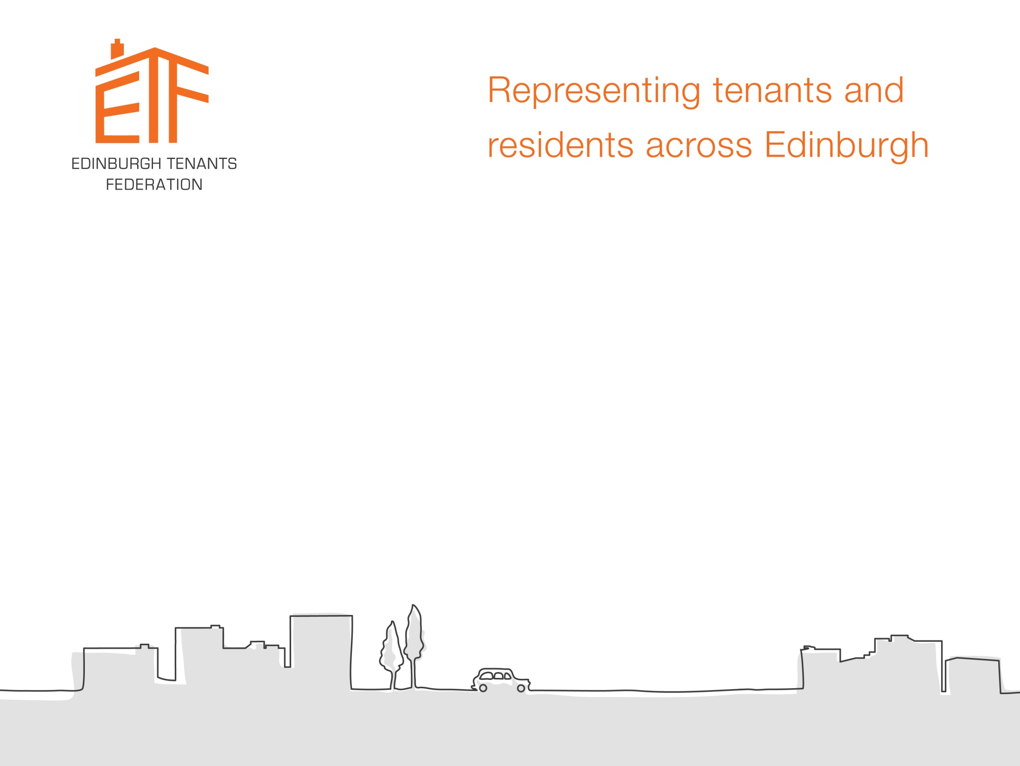
Facilitating and promoting community empowerment in practice
Betty Stevenson, Clare MacGillivray from ETF
John Galt from Education Scotland

Slide 2
Aims of Workshop
Reflect on the competence “Facilitate and promote community empowerment”
Context of social housing and tenant participation in Scotland
Edinburgh Tenants Federation collective community action
Reflections on your brilliance in this competence
Opportunities for action in your home communities / in your own practice.
Notes:
Clare

Slide 3
Facilitate and promote community empowerment
Purpose: so that people can take individual and collective action to bring about change.
Context: CLD practice is built on critical analysis of internal and external factors that influence individual and community priorities and has a distinctive role in working with people to take action to identify and influence decisions that impact on the quality of individual and community life.
Notes:
John

Slide 4
Facilitate and promote community empowerment
As a competent practitioner able to facilitate and promote community empowerment you will be able to demonstrate that you can support individuals, groups and communities to:
analyse and understand power dynamics and decision-making processes;
use community action as a means to achieve change;
be inclusive and involve the wider community;
interact within and across communities;
participate in decision-making structures and processes;
campaign for change;
identify and manage community assets.
These competences and indicators should be read in conjunction with the definition of a competent CLD worker.
Notes:
John

Slide 5
Context
John to say a few words

Slide 6

What we’ll do
S Say your own word
I Input
D Discuss
A Action!
Notes:
Clare
This is how we’ll run today’s session.
Using SIDA.
SIDA means – go straight ahead in Urdu – and we use it as a way of getting people involved from the start.
We’ll ask you to say your own word – saying a little bit about yourself to people in your group.
Then you’ll hear input from us.
You’ll have a chance to discuss what you’ve heard and bring your own experiences to the conversation.
Then you’ll get a chance to reflect on actions.

Slide 7

What’s your passion?
Notes:
Clare
In ‘Home’ teams of 4 people – make sure you’re sitting with people you don’t know.
The best part of this learning experience is in connecting with others.
These people will be your “neighbours” for the day.
The best part of being in a community is cherishing our neighbours as friends.
In your home team – choose the person next to you – each of you has 30 seconds to tell the other person what they are passionate about.
Now find another person in your group – do the same
And a last round of introductions to last person

Slide 8
The right to housing
“Everyone has the right to a standard of living adequate for the health and wellbeing of [them]self and of [their] family, including ... housing.”
Universal Declaration on Human Rights
(10th December 1948)
Notes:
Betty
We all have our passions – it’s what makes us work best in our communities. Now I have a question for you - is passion one the CLD competences? If it’s not, maybe it should be.
I will tell you about my passion - housing! And specifically – tenants influencing their own housing conditions.
I will tell you a bit about our work in ETF. So as you hear our story, think about where the competence you just heard about applies.
EVERYONE HAS THE RIGHT TO HOUSING.
This was recognised by the United Nations in 1948.
But housing is not just about homes.
It’s about people and communities.
Poor housing leads to poor health – and increases poverty.
Good quality housing makes people feel safe, secure, settled, healthy and able to be part of a community. It’s a fundamental human right – and that’s why I’m passionate about it.

Slide 9
Tenants’ Charter
“Right to healthy, safe, secure, affordable housing.
Right to form tenants’ organisations and participate in decision making, free from discrimination.”
International Union of Tenants
(6th June 1974)
Notes:
I am only one of thousands of tenants active globally.
Every one of us wants these goals from the Tenants Charter of the International Union of Tenants – to be a reality – for every citizen on the globe.
We know we are nowhere near that goal yet – because poverty and homelessness is found in every town and city on earth.
But that’s what makes it important for groups like ETF to campaign for tenants’ rights, connect with others and make this goal a reality.
I want to tell you how tenant participation developed in Scotland, because it’s important that we recognise how our past shapes our present.

Slide 10
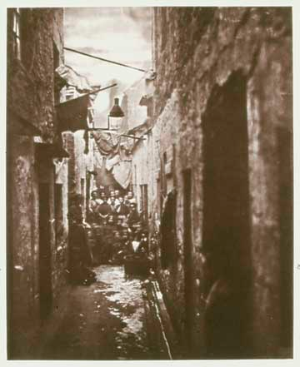
Scottish slums
Notes:
Betty
As you know, Scotland had a history of poor slum housing.
Landlords had all the power.

Slide 11
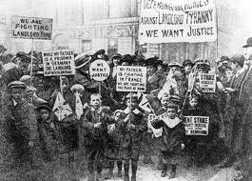
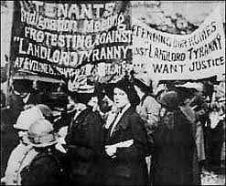
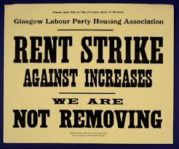
Tenant activism
Notes:
Betty
By the 19th Century, communities began to realise they had strength in numbers and began to take action against poor housing.
In 1885 Glasgow militants campaigned for decent housing in the city.
By 1914 the Glasgow Women’s Housing Association was formed to improve tenement homes.
100 years ago in 1915 came the famous Glasgow rent strikes. Women got organised, brought their communities together, came out on the streets in great numbers and opposed rent increases. And they won!
They understood the power dynamics and began to use community action and campaigning to achieve change. This was the real start of tenant activism in Scotland.

Slide 12
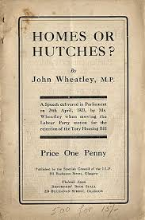
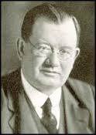
Social housing in Scotland
The Wheatley Act in 1924 brought 500,000 Council homes.
Notes:
Betty
But the rent campaign was not enough. They system had to change. The law had to change.
The Government had to deliver better housing.
The campaigners knew they had to influence the decision makers. So they elected one of their own who turned out to be key - John Wheatley.
He was part of a Government elected to act on better housing. He led on two Housing Acts that meant Councils could build large numbers of decent public sector homes for people.

Slide 13
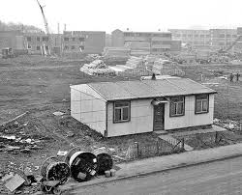
New homes
Notes:
Betty
By 1940 – 67% of housing in Scotland was in the public sector.
The homes were better quality than the slum conditions, affordable and built on a large scale in “Council housing schemes”.
But we all know the schemes had their problems.
In those days - local people living in the new homes had no choice – and no power in how our homes were run!

Slide 14
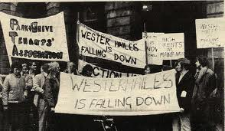
Tenant participation
Notes:
Betty
In the big cities, tenants began to change this.
From the 1940s in Edinburgh tenants formed natural community groups – friends and neighbours joining together in local community associations – bringing together new communities in new housing.
In the early days there were no community workers. Communities did community development for ourselves.
The Parkhead Residents group in Edinburgh in 1948 had a membership of 1400 out of 2000 households, with 200 people actively involved.
The first “community worker” in Edinburgh was employed in 1948, and he was charged with overseeing the recognition of community associations in the city. It was much less about enabling communities and more about overseeing us and making sure we did what the local authority wanted us to do.
As housing conditions began to decline in the 1960s and 70s more and more tenants groups formed. And community development became a buzz word apparently.

Slide 15
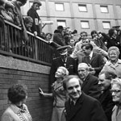
Notes:
Betty
In Edinburgh tenants groups really took off in the 1980s and 1990s as Scotland’s public housing faced an onslaught.
Thatcher had decided to sell off our Council housing through the Right To Buy.
Sure – people could buy now their homes - but there was no way to re-invest in affordable homes for rent. So the availability of social rented housing began to decline.

Slide 16
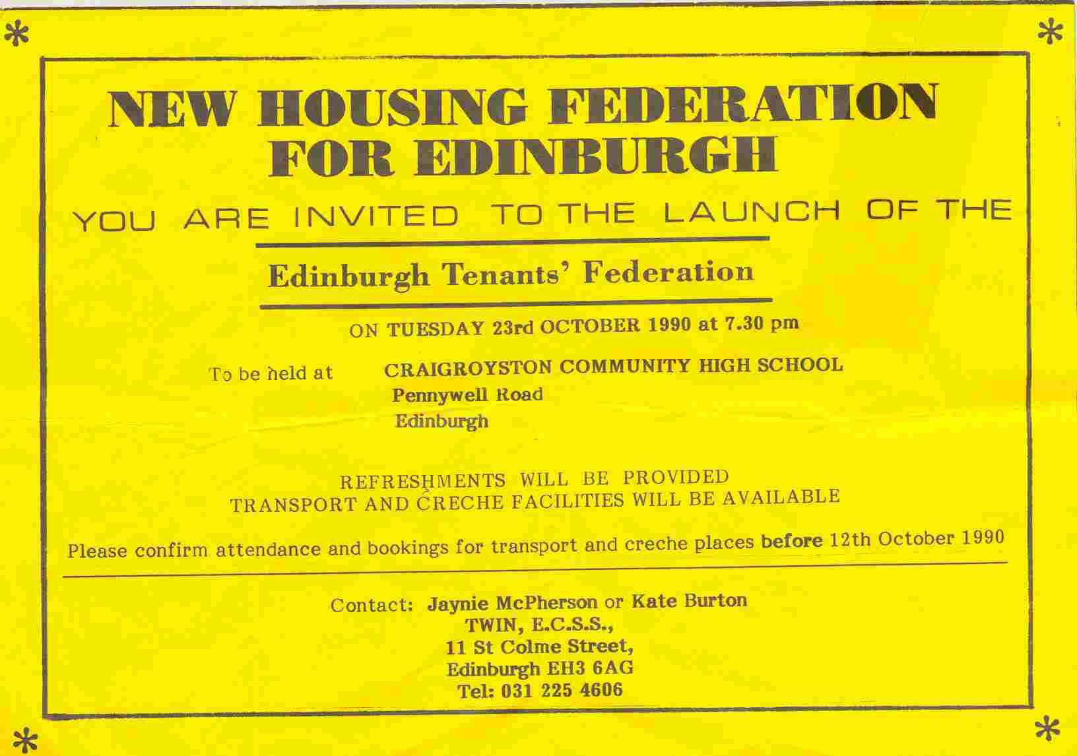
Edinburgh Tenants Federation
Notes:
Betty
In Edinburgh, we decided that many voices joined together would be stronger. We wanted to challenge inequality and claim our rights to decent, affordable rented housing.
We decided to form a collective – Edinburgh Tenants Federation – back in 1990.
I was around from the start of the Federation.
Our aims are to represent tenants, and to bring tenants together to improve housing conditions in our communities.
We started off with no staff. We had two years before we managed to convince the Council to fund us workers.

Slide 17
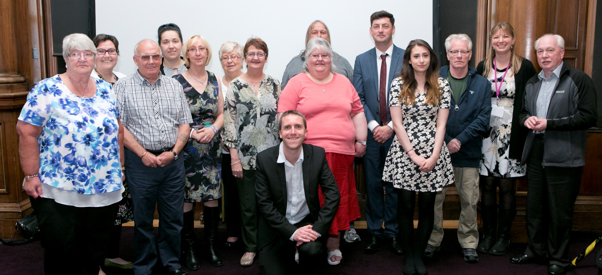
Staff and volunteers
Notes:
Betty
From those early days we’ve grown, and now there are over 50 tenants’ groups in the city – all run by local tenant volunteers. Our Federation is run by tenants for tenants and there are around 300-400 people active at any one time locally.
We now employ 5 staff.
They help to provide independent advice, information and training to tenants’ groups, so our network can continue to grow from strength to strength.
It’s important to us volunteers that our staff are trained in community development.
3 are registered with the CLD Standards Council. They know about the CLD competences. They lead on the work to support community groups. They provide support to enable groups to develop and to help individuals get the information and skills they need to be successful.
But we’re a team – staff and volunteers - and its important for communities to know there is a network of volunteers available too - someone who has been in their shoes when they’re facing a blank wall to connect with and help out.
So for me, Community development is not just a profession for workers to be proud of – it’s a way of life for all of us interested in seeing communities flourish. Its not just workers who do community development - Volunteers like me are doing community work every day.

Slide 18
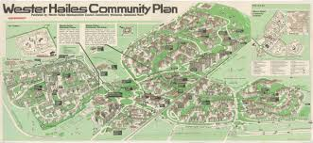
Local action
Notes:
Betty
Our approach in Edinburgh starts at the local level.
Tenants’ groups are involved in influencing locally – in each of the areas of the city – on issues important to local people.
This might be housing improvements, play parks for young kids – or recently – providing food through food banks, community shops and soup kitchens so our neighbours can eat!
Our staff provide practical support to tenants groups to get started, and help local groups to carry out community surveys to find out what the issues are locally. Then help put an action plan in place to achieve change.
We run training and capacity building programmes, do study visits and connect tenants from different parts of the city together so we can all learn from each other.

Slide 19
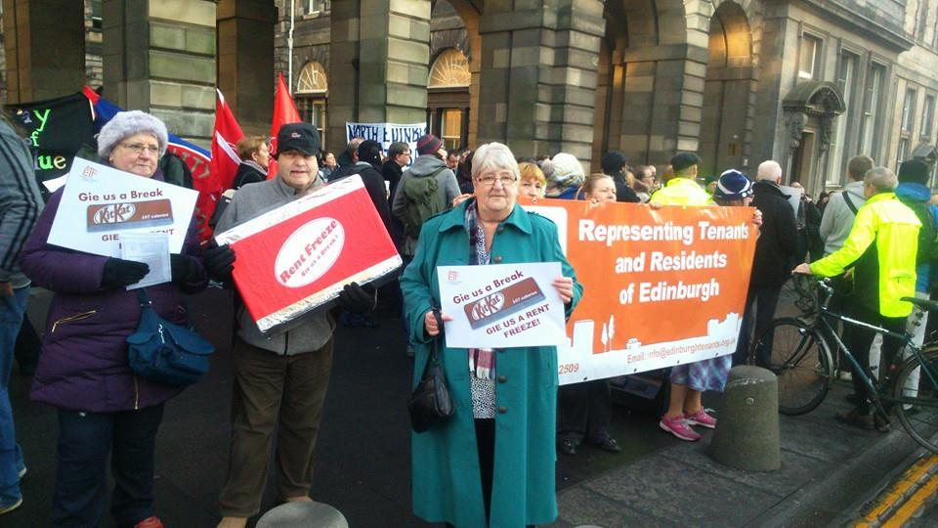
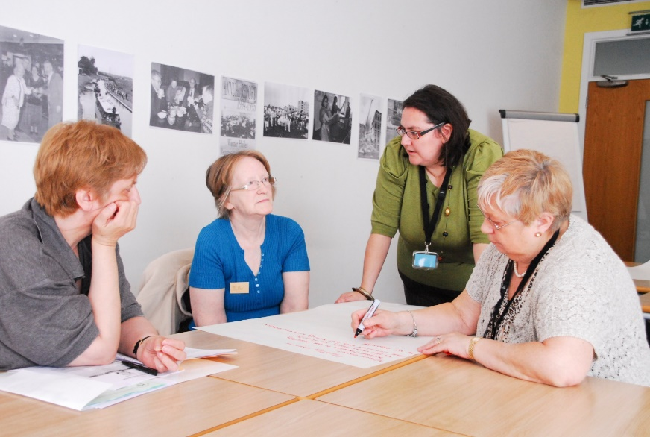
Connecting citywide
Notes:
Betty
We love to bring people together.
We work collectively to campaign for better services citywide.
We work on everything from rents, to repairs, regeneration and housing improvements.
We meet with the senior managers and elected representatives at a citywide level to ensure the tenants’ voice is heard in every decision being made.
And we have had huge success – as the city is transforming its housing areas through a huge regeneration programme that is building Council housing again after a 30 year gap.
We do campaigning on issues – like last years’ Gie’s a break gi’es a rent freeze campaign. We made a giant kit kat and gave 2 fingers to the Council in the form of kit kats for elected members as they voted to increase our rent levels against our will.

Slide 20
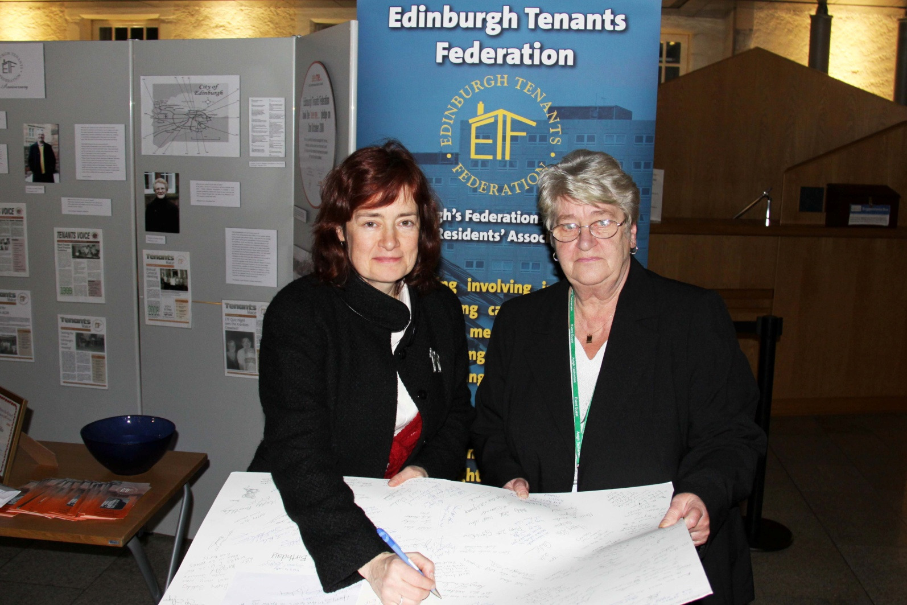
The right to participate
Notes:
Betty
ETF has always fought to influence national housing issues.
Together with tenants across Scotland we campaigned for the RIGHT TO TENANT PARTICIPATION.
In 2001, we finally won the right to be involved in decisions that affect us. That year, the Scottish Government passed the Housing (Scotland) Act – which gave tenants the first time in law – the right to participate with their landlord.
We always get involved in any new housing legislation from the Scottish Government.
We still regularly meet with Members of the Scottish Parliament – like Sarah Boyack MSP in the picture - bringing forward tenants’ issues.

Slide 21
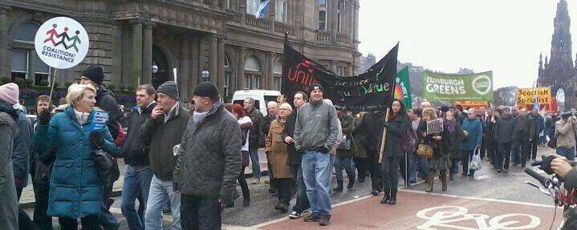
National action
Notes:
Where we see it will benefit tenants, we get involved.
We were part of a nation-wide campaign to abolish the Bedroom Tax.
We took to social media to highlight the issues, lobbied the UK and Scottish Government on this, marched on the streets, took deputations to the Council and even went to the European Parliament with a petition that this policy infringes Human Rights.
This was about us knowing the decision- making processes and campaigning for change at every level.

Slide 22
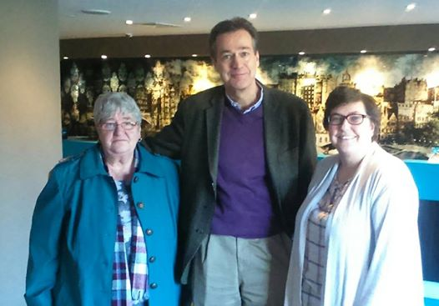
International connections
Notes:
Betty
It’s important to make the international connections in our work too.
This is us meeting with Magnus from the International Union of Tenants.
And we’ve had connections with tenants groups globally through being at international conferences. We need to think big to help us see that we're not alone.

Slide 23
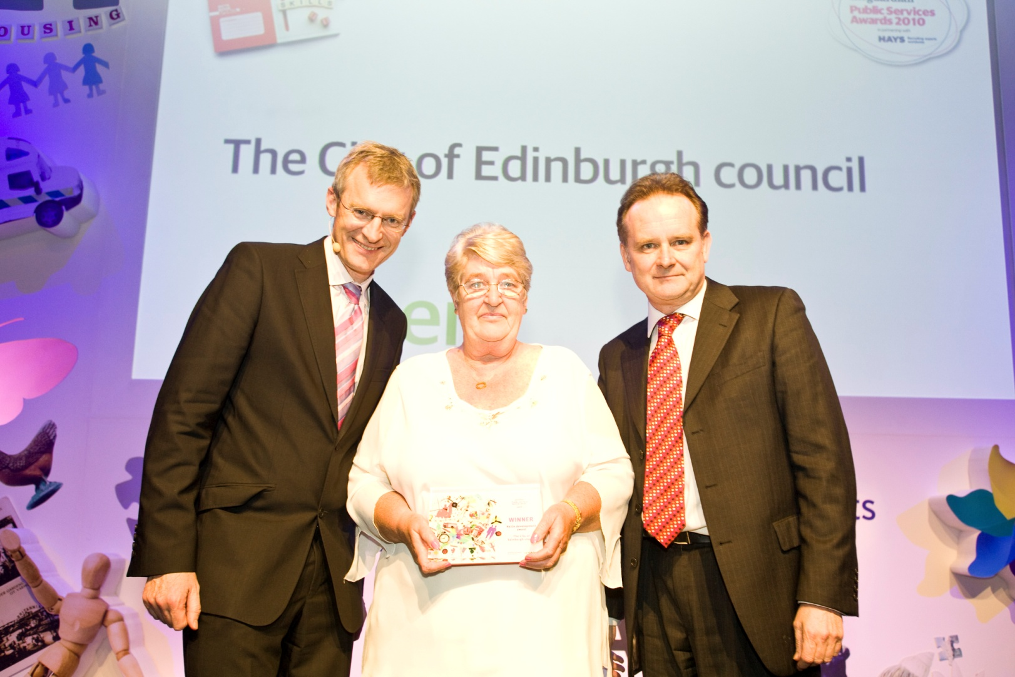
Award winners
Notes:
Betty
In recent years we’ve been award winning for our work on helping tenants with mental ill health.
I raised the issue of mental health support for tenants after witnessing suicides in my block. Council staff were not trained in dealing with this, nor given any support. I sat at every Council meeting I attended for 2 years raising the issue – until the Council finally got fed up of me and set up a working group to discuss this.
We campaigned to get better support for vulnerable tenants, and training in suicide awareness for City of Edinburgh Council staff. And we’ve been hugely successful in this. Hundreds of staff have now been trained in SafeTALK and how to support someone thinking about suicide.
Winning the awards are not that important – sure, they bring national recognition - but what matters most is that we raise the profile about tenants’ issues and work hard to make things better for tenants.

Slide 24
Work and competences
Examples of our work | Competence
Induction training for new members with Council staff, elected members and MSPs | Analyse and understand power dynamics and decision making processes
New rent consultation process after tenant complaints | Use community action as a means to achieve change
Assisting the Syrian community to set up a new tenants’ group | Be inclusive and involve the wider community
Bringing tenants together citywide | Interact within and across communities
Influencing Working Groups with the Council | Participate in decision-making structures and processes
“Gie’s a Break, Gie’s a Rent Freeze” campaign | Campaign for change
Support groups in community surveys | Identify and manage community assets
Notes:
Clare
So here are some examples of our work that we see fit with the Facilitate and promote community empowerment competence.
We’ll be asking about your brilliance in a minute.

Slide 25

Envisioning the Future
Notes:
Betty
In Edinburgh Tenants Federation we firmly believe that communities coming together can influence those with power by holding them accountable to the people.
We always start with the local connections – then build to citywide, then the national level and international.
But we all need to work together and tackle the issue big issues in society.
We are making change happen.
WE don’t need permission from those in power. Its our right and we must claim it.
Together we can change society for the better.
We are doing it – every day.
And so are you. By holding community development as a passion.

Slide 26

The Conversation
Notes:
What have you learned from the input?
Where did you see evidence of the facilitate and promote community empowerment competence in ETF work?
Each individual to reflect on what they have learned and write on yellow post its.
Each individual to tell the group one at a time why they have chosen this point and stick on flipchart
Group these in to any emerging themes
Choose one theme to discuss in more detail
Write your theme on a blue post it

Slide 27

A deeper understanding
Notes:
This is your chance to learn from each other.
Ask questions of each other to find out others’ views.

Slide 28
Questions to consider
Celebrating your brilliance. How do you:
analyse and understand power dynamics and decision-making processes;
use community action as a means to achieve change;
be inclusive and involve the wider community;
interact within and across communities;
participate in decision-making structures and processes;
campaign for change;
identify and manage community assets.
Notes:
You don’t need to choose all of these – just one.
Or use them for a reflection afterwards.
But tell a story and share ideas about how you do these brilliantly.

Slide 29
Notes:
Clare
Some parting thoughts: How do you identify Global influences when you’re looking at power dynamics in your communities?
What are the external and internal factors that influence the priorities of communities you are working with?
How often do you stop to think about the global picture?
Should passion be a CLD Competence? Because if its not why are we doing what we do? For what purpose?
What role do workers / volunteers play in using the competences? Are they different?
Should volunteers be trained in CLD competences? Or is it ok that volunteers ‘do’ community development without the professionalization angle?

Slide 30

Your reflections
Notes:
As individuals reflect on the learning from today. What have been your main learning points?
What actions can you take back to your ‘Home’ community?
Write yourself a note that you will look back on in one year – the actions you will have taken from today’s session. Write your address on an envelope.
Tell us one of these if you feel comfortable to do so.

Slide 31

Connect with us
We would love to connect with people interested in our work.
info@edinburghtenants.org.uk
www.edinburghtenants.org.uk
Facebook and Twitter
Edinburgh Tenants Federation
Notes:
Connect with us – we want to learn more from you...

Slide 32

Thanks

