Slide 1

Community Activists Training Programme

Slide 2
Did we make a difference? Evaluating Practice
Purpose of Community Learning and Development
“...empowering people individually and collectively, to make positive changes in their live and in their communities, through learning.”
CLD: Strategic Guidelines for Community Planning Partnerships
Notes:
In true evaluation style we will start the session with looking back/ reflecting. We will take this chance to refresh our memories of the purpose and focus of CLD and how this applies to being community activists,

Slide 3
Did we make a difference?
C.L.D.’s specific focus should be:
Improved life chances for people of all ages, through learning, personal development and active citizenship;
Stronger, more resilient, supportive, influential and inclusive communities.
CLD: Strategic Guidelines for Community Planning Partnerships
Notes:
When we become involved it should be with the intention of enabling and supporting change that involves communities in identifying needs and taking ownership of how these needs can be met, – Do we still all agree on this point?
This being the case we need to be clear about our plan of action what needs to change – what difference do we want to make – being outcome focussed, and following any action being able to measure if change has occurred, the impact of what we have done or taken part in – monitor and evaluate, review and reflect
All of which are indicators of competent CLD practitioners

Slide 4
Did we make a difference? Evaluation –WHY?
Efficiency : Are we working well? Are we making best use of our staff, skills and resources? Are we leading/ being led well?
Economy: Are we keeping to budget/being thrifty? Are we keeping to timescales? Are we being wasteful?
Effectiveness: What difference are we making? Have we achieved our desired result?
Notes:
Evaluation of a number of areas of the activity that has occurred or the opportunity that has been offered will help us to work out what if any change has occurred, This involves looking at the above three areas in the main and reflecting objectively on what we have experienced and contributed. Could we improve on what we have done? Could we do things differently or better? What did we actually contribute? Could we change our approach, methods?

Slide 5
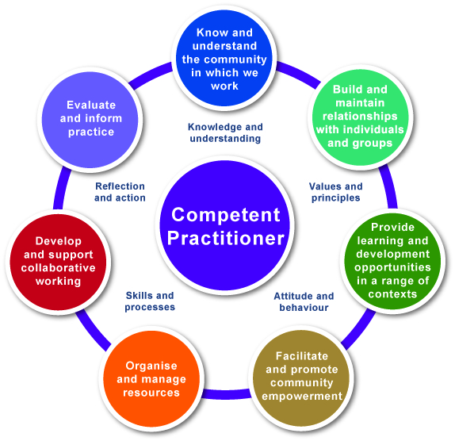
Competence: Evaluate and Inform Practice
Competence: Evaluate and Inform Practice
“interpret and use evidence related to outcomes and impact”
Competent (CLD) Worker
(CLD) practitioners are aware of their values and principles and critically reflect on their practice and experience so that they integrate their knowledge, skills, values and attitudes and use these effectively in their work. They use self-assessment, participative processes and evidence of the impact of their work to plan and manage their activities
Notes:
Read through and refer to comments on previous slide about monitoring, evaluating, reviewing, reflecting – leading to improvement or change

Slide 6
Did we make a difference? Evaluating practice
The 7 Habits of Highly Effective People
Habit 2 :
"Begin with the end in mind"
Author: Stephen Covey
Notes:
Prior to taking any community action you need to be clear about how it relates to the outcomes you want to achieve and how this will support (social) change.
Therefore this particular piece of advice from the author of this book can be particularly useful. At the beginning of the planning process it is helpful to identify what needs to change and how you will measure that change- building in time for evaluation and exploring methods you may use at this stage

Slide 7
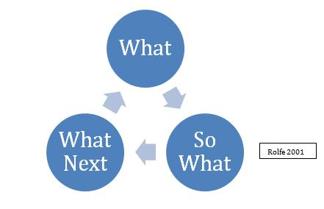
Did we make a difference? Evaluating practice
Steph Rolfe Model
Rolfe 2001
Notes:
There are a number of theories regarding evaluating activities and practice – This example looks fairly simple and asks the simply
What? – looking at what needs to change, what can we do, what can we use (need, outcome, outputs, process)
So What? – Right we did such and such what happened, what difference did we make? (evaluation, evidence)
What Next? – Now we know what happened where do we go from here? (review/reflect –full cycle to planning What needs to change now?)

Slide 8
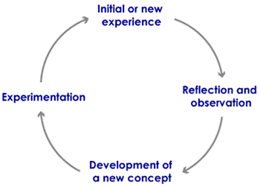
Did we make a difference? Evaluating practice
Kolb 1984
There is a clear link between action, reflection and change
Notes:
Kolb theory – follows that same cyclical process – trying something out, watching and reflection objectively about what happened, using that information to adapt or change what has happened and then trying out the new plan.

Slide 9
Did we make a difference? Evaluating practice
Being outcome focussed as a practitioner: starting with the end in mind
Identified need | > | This is what needs to change / why we are getting involved
Outcome | > | What changes can/should we expect to achieve? What will be different for the individual / group / community?
Output | > | What we are going to do / what we will deliver
Input / Process | > | This is what we will need and how we are going to do it
Evaluation | > | This is how we will measure the difference all of the above has made
Evidence | > | This is how we will know / show others that we have made a difference
Notes:
Taking each point talk through and discuss with participants ensuring that they understand the language that will be used in relation to working with CLD partners and other organisations as a community activist.
Identified need - In an ideal scenario who has identified this, you, a group you are involved in a community?
Outcome – Making sure we know what it will change for whom?
Outputs – exploring and ensuring that the methods/approaches activities we plan to use are appropriate for who we are working with/what we are trying to change – ask the group to call out good/bad examples for timing, venue, method? e.g. Holding a public meeting targeted at 25 – 60 age group in a rural community (or substitute an relevent example for the group you are working with to make it real)

Slide 10
Did we make a difference? Evaluating practice
  ‘Empowerment’ – encouraging people to take control of, or have a say in, decisions that affect them.
  ‘Participation’ – giving people every opportunity to get involved in learning and acting with others.
  ‘Inclusion, equality of opportunity and anti-discrimination’ – giving everyone a chance to be involved, whatever their background or abilities, and actively challenging discrimination.
  ‘Self-determination’ – allowing people to make their own choices about what they do.
  ‘Partnership’ – achieving more by encouraging everyone with an interest to work together.

Slide 11
Did we make a difference? Evaluating practice
Notes:
The project is not a huge undertaking but must include the planning, carrying out and evaluation of a community engagement activity , which must be supported by written evidence as well as an exploration of the participants role in this and the impact it has.

Slide 12
Did we make a difference? Evaluating practice

