Slide 1
Stereotypes and prejudice
It is wrong to judge people based on their identity and can have negative consequences.
Through this exercise we will be exploring stereotypes and prejudice.
Exercise outcomes :
  Understand that people have negative attitudes and what is meant by prejudice and stereotypes.
  Be able to recognise my own and others stereotypical and prejudicial attitudes.
  Be aware of the negative consequences of prejudice and stereotypes.

Slide 2
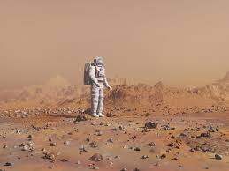
Choose your apprentice
You are an entrepreneur, like Alan Sugar on The Apprentice.
You need to ‘hire’ an engineer to set up life on the Mars!
It’s a big, challenging job that will make history.
It needs the right apprentice - someone with resilience, determination, engineering expertise and great people skills!

Slide 3
Choose your apprentice
Line up the cards in front of you - that is your apprentice line up.
Each time I reveal a layer of information about each apprentice, you need to ‘fire’ one person by removing them from your line up.
Who will you ‘fire’ and ‘hire’?

Slide 4
Choose your apprentice
The apprentices…
Fire one now so you have six remaining
Ali | Patrick | Jamie | David | Adriana | Hannah | Delroy

Slide 5
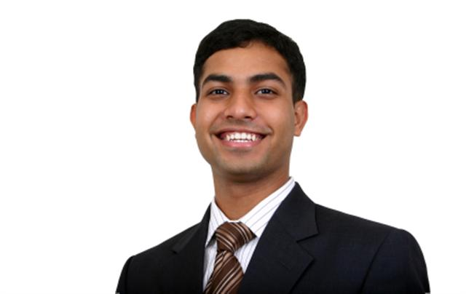
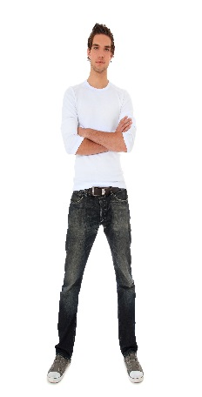

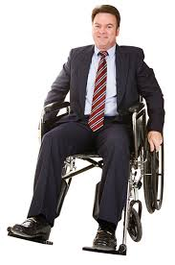
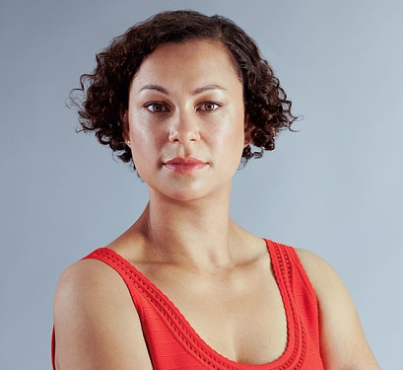
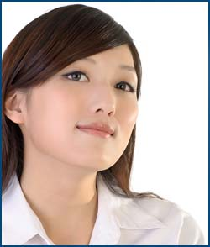
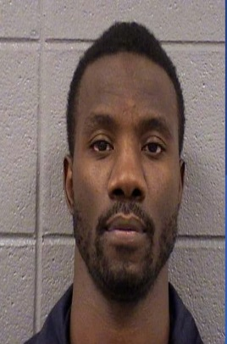
Choose your apprentice
Fire one now so you have five remaining
Ali Abdul
Patrick Murphy
Jamie Small
David Campbell
Adriana Carboni
Hannah Mann
Delroy
Bailey
Hetero-sexual
Gay
Lesbian
Hetero-sexual
Hetero-sexual
Hetero-sexual
Hetero-sexual

Slide 6
Choose your apprentice
Fire one now so you have four remaining
Ali Abdul
Patrick Murphy
Jamie Small
David Campbell
Adriana Carboni
Hannah Mann
Delroy
Bailey
Hetero-sexual
Gay
Lesbian
Hetero-sexual
Hetero-sexual
Hetero-sexual
Hetero-sexual

Slide 7
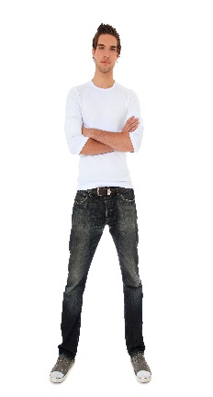
Choose your apprentice
Fire one now so you have three remaining
Ali Abdul
Patrick Murphy
Jamie Small
David Campbell
Adriana Carboni
Hannah Mann
Delroy
Bailey
Physically fit but wears glasses
Physically and mentally fit
Physically and mentally fit
Physically disabled, mentally fit
Physically and mentally fit
Pregnant, physically & mentally fit
Physically fit but suffers anxiety

Slide 8
Choose your apprentice
Fire two now so you have one remaining
Ali Abdul
Patrick Murphy
Jamie Small
David Campbell
Adriana Carboni
Hannah Mann
Delroy
Bailey
Ex-Army
Entrepreneur business man
Firewoman
Doctor of engineering
Engineer and project manager
Army engineering officer
Engineer graduate

Slide 9
Who was your choice?
What choice did you make?
Are you pleased with your hired apprentice?
Would you have made a different decision if you had the qualifications information first?
What is wrong with judging people with such little information?
What do you think influenced your decisions?
Do you think people often judge people like this in our everyday life?
What could be the consequences of pre-judging people?

Slide 10
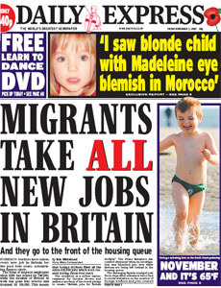
Challenging stereotypical statements
Statements:
  All gay men are weird
  The woman’s place is in the home
  All black people are good at sports
  You have to talk slowly to a disabled person
  All kids are lazy
  Blonde women are stupid
  Elderly people are frail and boring
  Boys in hoodies are violent
  Immigrants are scroungers
  All Gypsy/Travellers are thieves
  Boys that cry are gay
  Scottish people are stingy

