Slide 1
Investigating your Community
There are 3 key ways of identifying needs in a community:-
use what you already know (as part of the community)
use what is already known –demographics and the research of others
conduct research or consultation yourself

Slide 2
demographics
characteristics and statistics of human population: the characteristics of a human population or part of it
Including information on population
Size
Age
Sex
Health
Education
Employment

Slide 3
Demographics are most useful for looking at areas ‘communities of place’
Different ways areas are defined:-
Local Authority
Settlement – towns and some villages
Council Wards - Multi-member or pre-2007 wards
Intermediate zones –within a ward and contain between 2,500 and 6,000 household residents
Datazones – Scotland is divided into 6505 datazones (each averaging around 750 people)
Postcodes – although usually considered too small

Slide 4
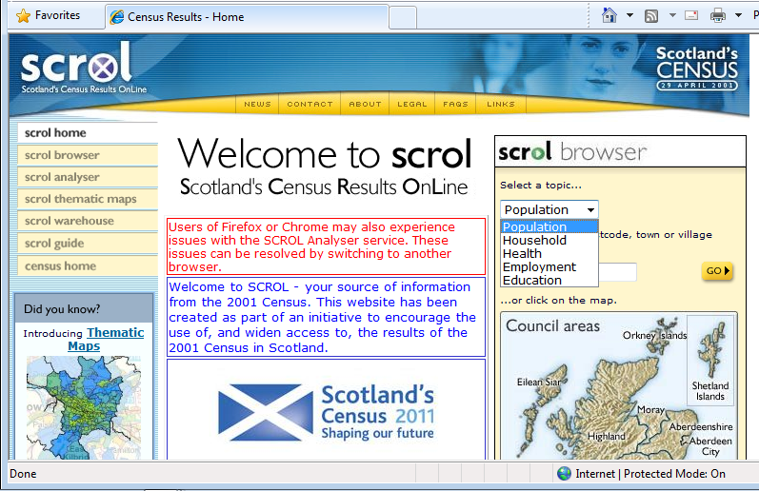
www.scrol.gov.uk

Slide 5
www.scrol.gov.uk
Choose a topic
Population
Education
Household
Health
Employment
Can search by different types of areas

Slide 6
Statistics are really only useful when you can compare them to something else

Slide 7
Scottish Neighbourhood Statistics the Scottish Governments website to improve the availability, consistency and accessibility of statistics in Scotland.

Slide 8
www.sns.gov.uk – quick profile
Topics covered in the quick profile include –
Economic activity, benefits and tax credits
Health
Education training and skills
Housing
Index of deprivation
Crime and justice
Physical environment
Population
Access to services

Slide 9
www.sns.gov.uk – advanced reporter

Slide 10
www.sns.gov.uk – advanced reporter

Slide 11
Comparative Health Profiles 2010 (and 2008)
http://www.scotpho.org.uk/home/Comparativehealth/Profiles/2010CHPProfiles.asp
The 2010 health profiles are now available, along with complementary profiles focussing on children and young people. These profiles highlight the considerable variation in health between areas and help identify priorities for health improvement.
The profiles give a snapshot overview of health for each area using spine charts (which show how the area compares to the Scottish average), and allow further understanding of the results via rank charts and trend charts.
Information is available for NHS boards, CHPs/local areas* and small areas (Intermediate Zones)

Slide 12
SIMD http://www.scotland.gov.uk/Topics/Statistics/SIMD
Overview
The Scottish Index of Multiple Deprivation identifies small area concentrations of multiple deprivation across all of Scotland in a consistent way.
The SIMD is presented at data zone level, enabling small pockets of deprivation to be identified.
The data zones, which have a average population size of 769, are ranked from most deprived (1) to least deprived (6,505) on the overall SIMD and on each of the individual domains.

Slide 13
Scottish Schools On-line http://www.ltscotland.org.uk/scottishschoolsonline/index.asp
For Primary Schools
HMIE school reports
Attendance and absence
Free school meals
For Secondary Schools
HMIE school reports
Fourth year exam results
Fifth year staying on rates and exam results
Sixth year staying on rates and exam results
Attendance and absence
Leaver destinations
Free school meals

Slide 14
gives access to the most detailed and up-to-date UK labour market statistics from official sources
https://www.nomisweb.co.uk/
Data presented by Local Authority, ward area and Scottish Parliamentary Constituencies
Includes data on population, employment, unemployment, qualifications, earnings, benefit claimants and businesses.

Slide 15
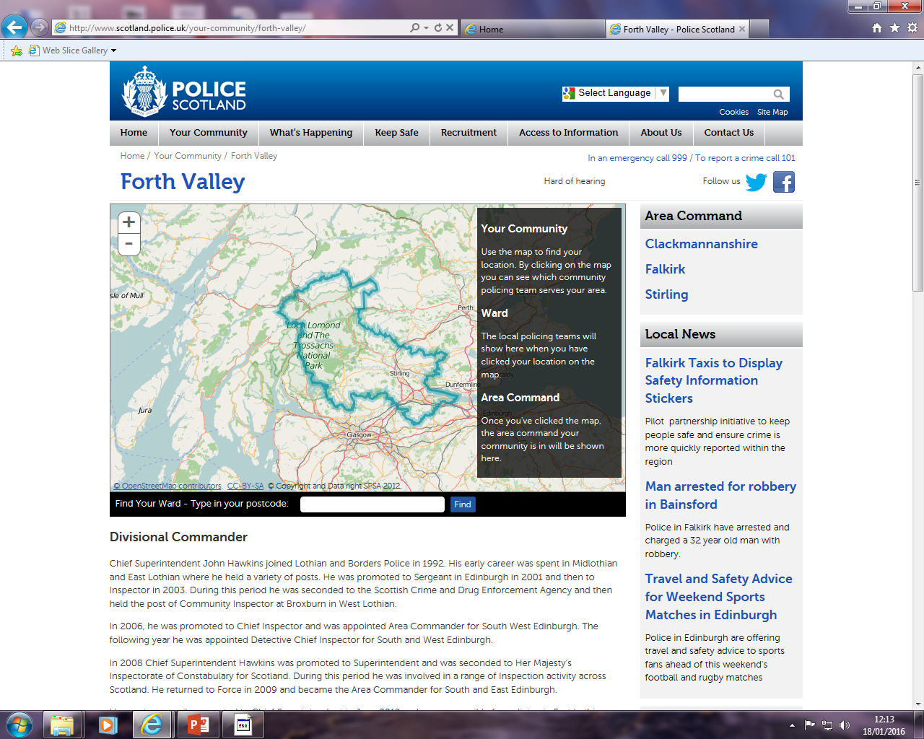

Slide 16
Scottish Government Statistics http://www.scotland.gov.uk/Topics/Statistics

Slide 17
researching demographics on-line
Some key things to remember:-
Statistical information about an area is most useful when compared to something else
eg. a larger area that it is part of, an area of similar size elsewhere or another time
The age of the data is important
Logic and local knowledge can help judge whether the data still has comparative value
Statistics can be misleading
make sure you can always understand them in terms of real people – watch out for tricks caused by percentages and numerical standardisation
If you don’t fully understand it, don’t use it
It is helpful to know what you are looking for, and what you will use the information for, before you start
Saves following trails of possibly interesting but not necessarily useful data

