Slide 1
The Mini Public approach… ADP Strategy Consultation Jan 2020

Slide 2
What is a mini –public
A process to involve individuals who reflect the diversity of the local community in a group discussion about an important local issue….
…with enough time built in to the process to make sure everyone understood the issue being discussed.
People got the chance to interview key stakeholders and to explore the issue -developing a shared understanding of how the issue could be addressed to meet the needs of the community.
The result – the group agreed on what they think should happen and made a recommendation of their findings...

Slide 3
Smaller Mini-Publics
“Smaller mini-publics are not intended to be statistically representative of the population, but are still demographically diverse……. A range of demographic characteristics from the broader population are adequately represented.”
“Underpins the argument about the mini-public’s legitimacy”
Final Report of the Commission on Fair Access to Political Influence: Annex Document,
Jimmy Reid Foundation, October 2013

Slide 4
Icebreakers, ground rules and group dynamics.
ADP Mini Public
Dialogue
Divergent phase
Key inputs on Human Rights approach, and Radical Kindness – small group discussions, large group Q&A
Introducing the strategy
Recap on day one and keynote input on the strategy.
Convergent phase
Deliberation
Two small group processes to deliberate on key questions.
Prioritisation - agree on final recommendations

Slide 5
Mini-publics: Key features (Escobar and Faulkner)
Selection: participants selected randomly or quasi-randomly
Lowering barriers to participation: e.g. stipend, childcare, transport
Facilitation: fostering dialogic + deliberative patterns
Learning phase: participants call in contributors/‘witnesses’ to present testimonies and evidence: activists, stakeholders, experts, politicians, civil society, business…
Deliberative phase: participants deliberate in light of evidence and testimonies > re-examining own preferences/views/positions
Decision-making phase: reasoned conclusions or recommendations made after considered judgement

Slide 6
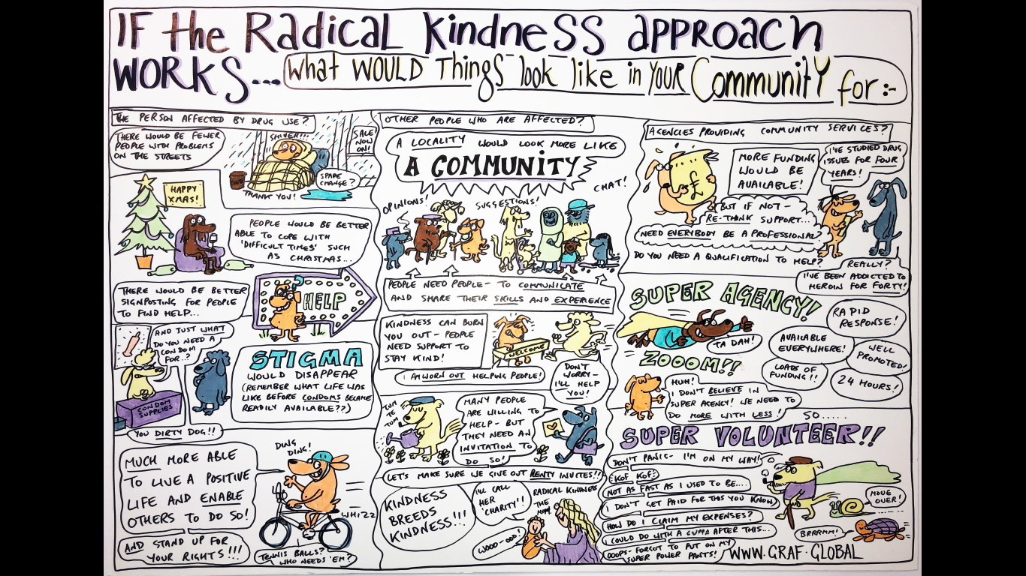

Slide 7
Evaluation
90% felt better informed after day 1 – 95% on day two
100% felt they and others had been able to contribute to the discussions.
95% endorsed the final findings – one person partly endorsed them.
Feedback to ADP – broad support for a strategy underpinned by radical kindness and the human rights approach.

