Slide 1
Curriculum for Excellence Upskilling Event
Andrena Waghorn
Craigie High School
andrena.waghorn@dundeecity.gov.uk

Slide 2
Aims of this session
Brief overview of
Broad General Education in the Junior Phase
Preparation for the Senior Phase
Impact CfE has had on Partnership Working
Challenges?

Slide 3
Junior Phase
Broad General Education
12/13 Subjects in S1/S2
Inter Disciplinary Learning – 3 IDL’s
Skills Based
Skills for Learning, Life and Work
Personal Learning Planning/Learning Logs

Slide 4
Personalisation and Choice
Select from each of the Curriculum Areas – total of 8 subjects

Slide 5
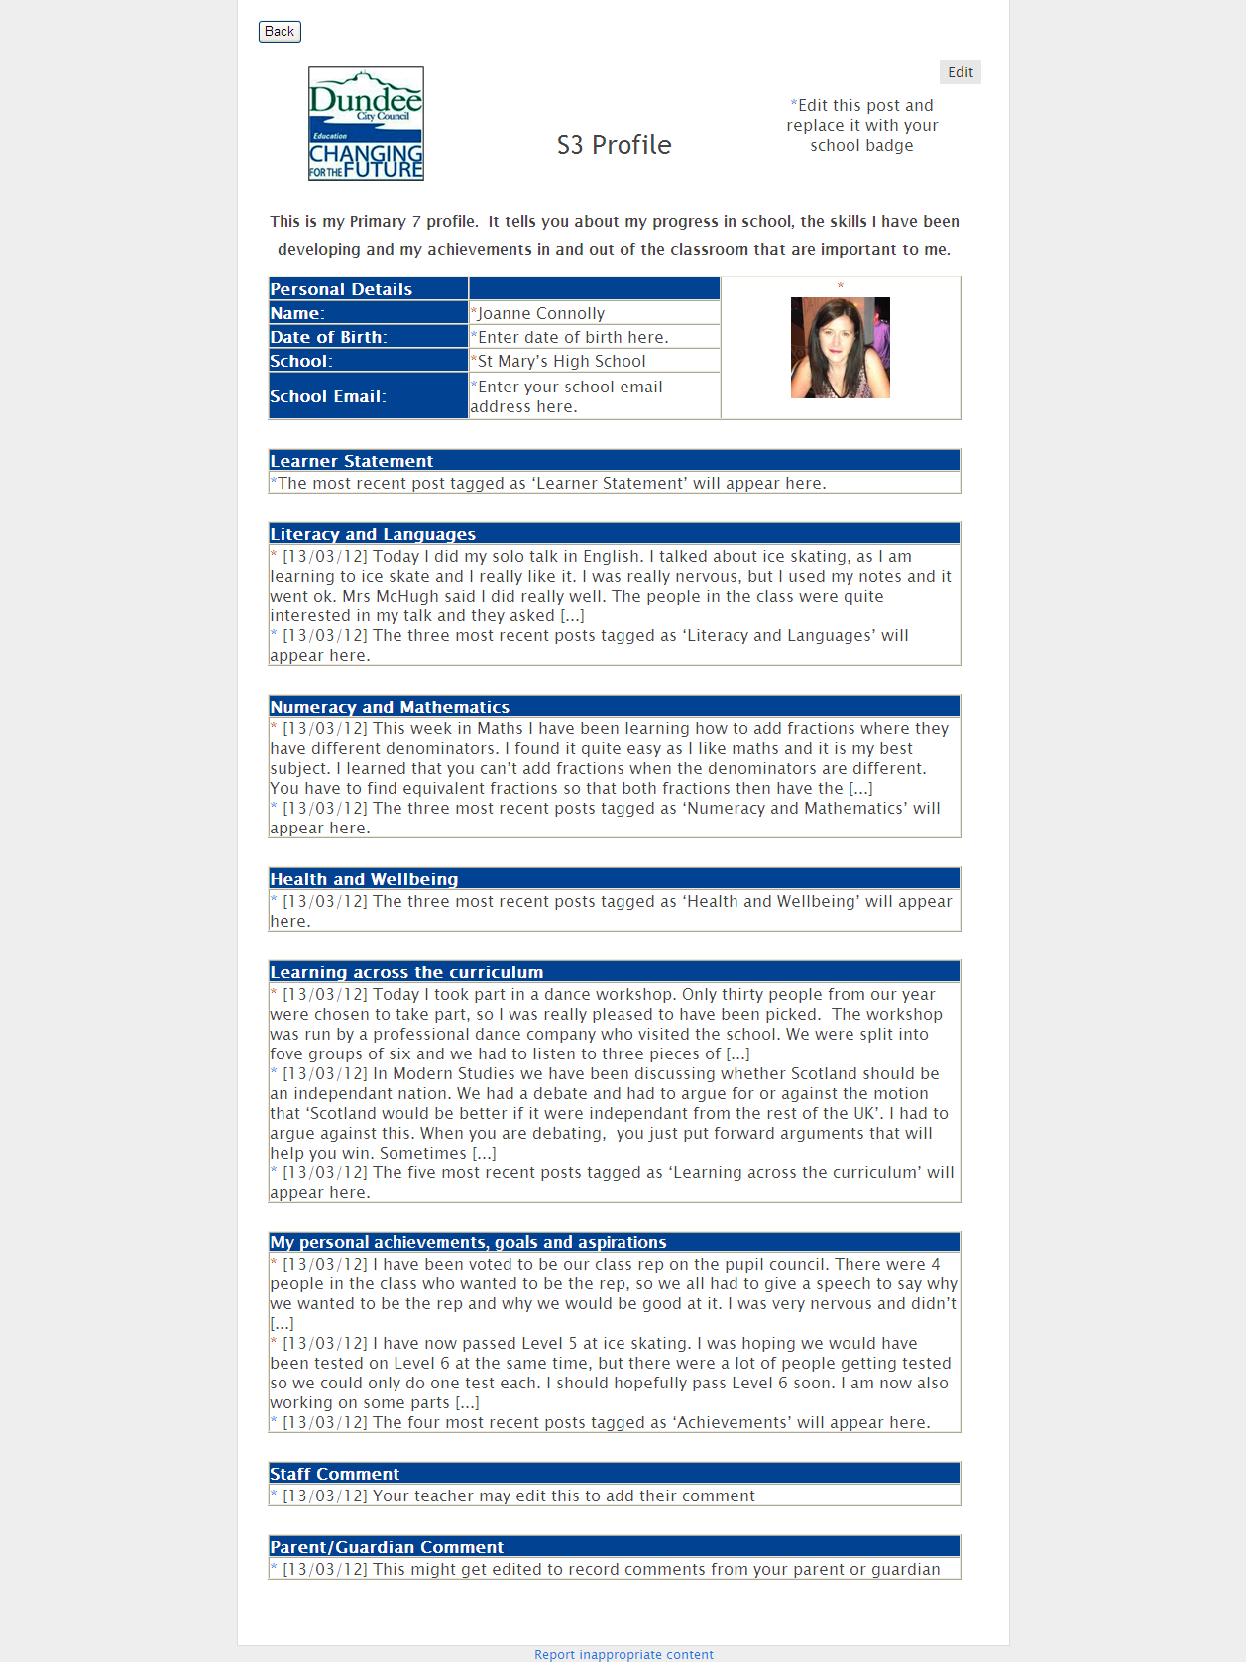
Culminating
in S3 profile

Slide 6
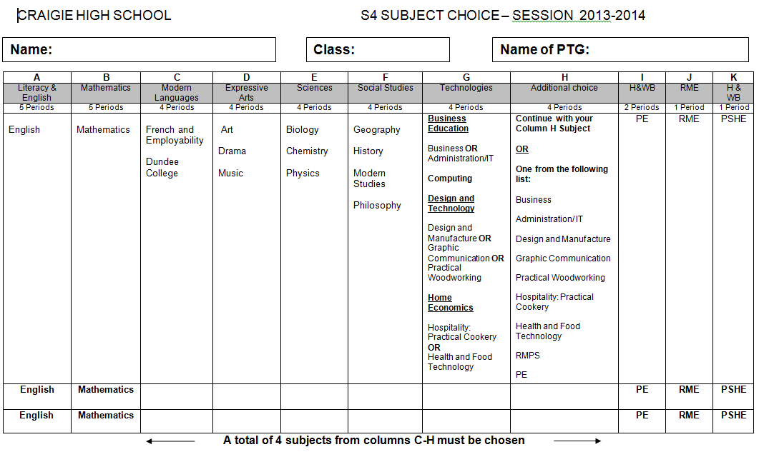
Senior Phase
Course Choice at end of S3
Select 6 subjects – DCC Guidelines

Slide 7
The New Qualifications
Current Qualification | Will be Replaced By | New Qualification
Access 1 |  | National 1 (2013)
Access 2 |  | National 2 (2013)
Access 3 OR Foundation Level Standard Grade |  | National 3 (2013)
General Level Standard Grade OR Intermediate 1 |  | National 4 (2013)
Credit Level Standard Grade OR Intermediate 2 |  | National 5 (2013)
Higher |  | Higher (new) (2014)
Advanced Higher |  | Advanced Higher (new) (2015)
Progression

Slide 8
General Points
Recognising Achievement
Personal Development Awards, Youth Achievement Awards, Wider Achievement Suite from SQA, etc
Meeting Learner’s Needs – targeted approach
Joint Working, Planning, Recording and Reporting

Slide 9
Work with Partners
Working
School is the common denominator
Sharing a common vision to support our young people and their parents/families
Mutual respect and understanding of roles
Joint 3 year CLD Improvement Plan
Open invite to all CPD/Staff Training Events
Wider Community

Slide 10
Work with Partners
Planning
Considered and deliberate
Matching HGIOS and HGIO CLD
Matching Outcomes and Experiences of Pupils against Partnership Measures
Agreeing Success Criteria/Outputs
Monitor and Evaluate the Impact of Partnership Working

Slide 11
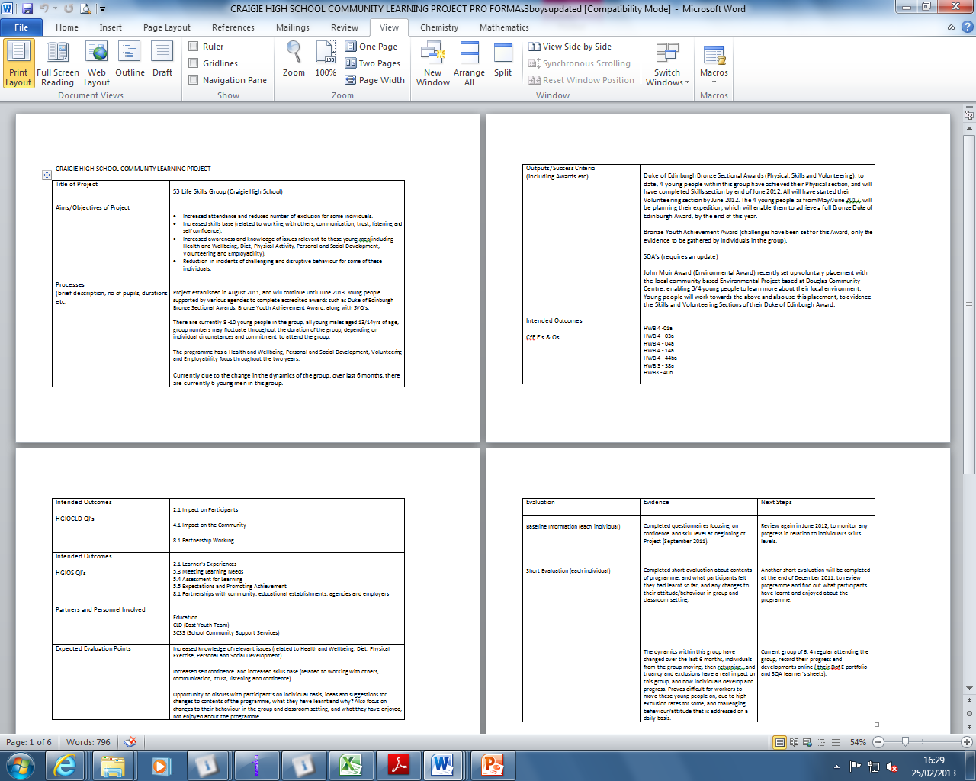

Slide 12
Work with Partners
Recording and Reporting
Documentation stored centrally
Access for Partners
On Track with Learning (OTWL) – mapping experiences and outcomes
Recording Wider Achievement – who is working with our young people? What are they doing? Can this be recognised?

Slide 13
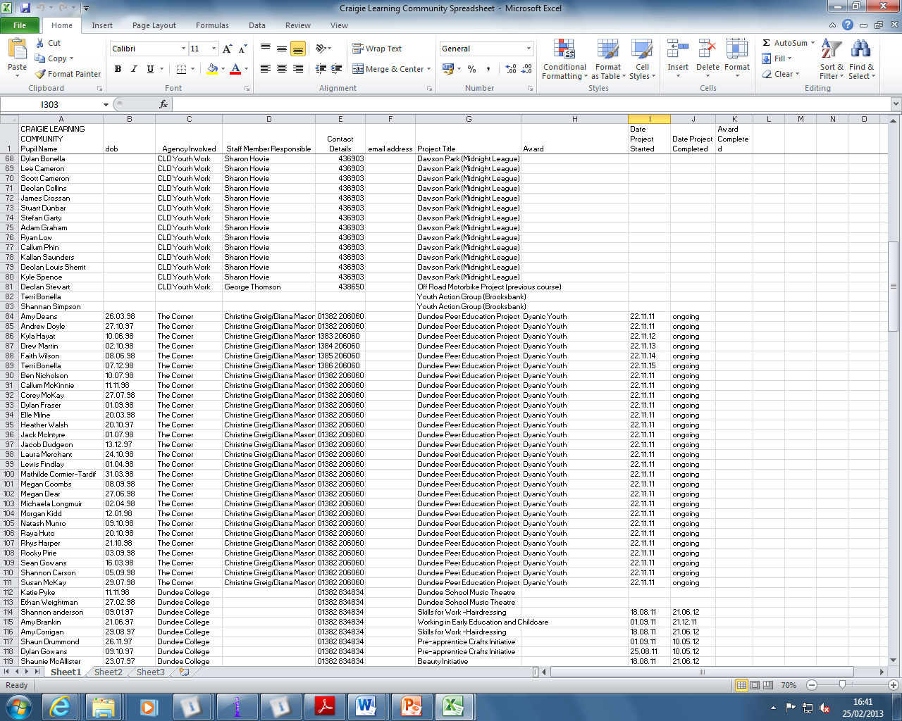

Slide 14
Joint Reporting to Parents

Slide 15
Challenges?
Earlier identification of needs and targeted support (individual and community)?
Involvement of young people in CLD planning?
Getting It Right for Every Family?
Common Vision and Values?
Wider Understanding of School Staff of CLD Roles and Impact on Young People?
The contribution of Partners to building in numeracy, literacy and health and wellbeing outcomes to learning experiences ............
........ in a context of diminishing resources and high levels of deprivation?

