Slide 1
Coaching Approaches Development Programme for
CLD:
Day 1
Notes:
1

Slide 2
How the day will go…
Clearing the Space
Setting the Intention/Parking
Connections round
Coaching in context - What coaching is and how it works
Core skills of coaching 1 … 3P’s; Listening & Clarifying...learning by doing / Peer Coaching
Feedback – a tool to support the training
Core skills of coaching 2 ..Powerful Questions with Peer Coaching
We are what we think - a brain based approach to coaching
Thinking about Thinking – FOCUS & Faces of insight/Peer practice
CREATE
Assigning of peer partners
Completion & Close
2
Notes:
2

Slide 3
Clear the Space
What’s on top?
What feeling does this generate?
How can I clear the space?
What else…

Slide 4
Getting Started…
Intention:
Notes:
4

Slide 5
Connections Round Succinct – Specific - Generous
Who am I?
My current role?
Me in a personal context
Any connections to coaching?
5
Notes:
5

Slide 6
Coaching in Context
From sport to business to life
Industry or profession
Participant work context
Coaching
conversations / approaches / programmes
6
Notes:
6

Slide 7
Sociology
Anthropology
Brain
functioning
Person
centred
approach
Positive
psychology
Cognitive
behavioural
therapy
Behavioural
science
Emotional
intelligence
Thinking &
creativity
Coaching…
an emerging
profession
Adult
learning
theory
Systems
theory
Solutions
focused
therapy
Sports
psychology
Change
models
NLP
Motivation
Mentoring
Counselling
© YCS November 2007
7
Philosophy
Notes:
7
.

Slide 8
What Coaching is & How it works
What Coaching is & How it works
In order to get the best out of people,
we need to believe the best is in there
Sir John Whitmore
Notes:
8

Slide 9
How Coaching Works
Person at the centre
You
Comfort Zone
Your Potential
Learning Zone
Outcomes
Notes:
9

Slide 10
P = p – i
Performance = potential – interference
Tim Gallwey
Notes:
10

Slide 11
Coaching is…
…A facilitated action learning process that empowers the learner to identify and release their potential.
Notes:
11

Slide 12
Core Coaching Skills
3P’s of effective coaching
Building Rapport
Listening/Clarifying
Using Intuition
Useful Feedback
Asking powerful questions
Conversational Skills
Notes:
12

Slide 13
3 P’s of Coaching Practice
Preparation
Placement
Permission

Slide 14
Active Listening
Ability to focus completely on what the client is saying and is not saying, to understand the meaning of what is said in the context of the client’s desires, and to support client self expression
ICF Professional Coaching Core Competencies
Notes:
14

Slide 15
Listening & Clarifying
How do we know that what we are hearing is what the other person is saying?
15
Notes:
15

Slide 16
Clarifying
Benefits to the client
Reassures - what they say is valid
Feels listened to & valued
Ensures both on same track
Enables client to move forward
Enables deeper exploration
What is it?
Summarising
Paraphrasing
Mirroring
Notes:
16

Slide 17
Pairs activity…Real Play...
Share your reflections with a partner on… what you do to enjoy yourself (4 mins)
When you’re not talking…listen and clarify…be fully present with your partner; notice what you notice.
Notes:
17

Slide 18
Debrief
What did you notice?
What did you find interesting?
What are you learning about coaching?
What was getting in the way for the coach?
What are your thoughts?
How are you feeling now?
Notes:
18

Slide 19
Powerful questions
Powerful
Questions
Socratic
questioning
WHY
vs.
Learning
Wisdom Access Questions
Notes:
19

Slide 20
Peer Coaching…
I would really like to….
But…
You have 7 mins coaching; 3 mins feedback
Notes:
20

Slide 21
Debrief
What did you notice?
What did you find interesting?
What are you learning about being a coach?
What was getting in the way for the coach?
What are your thoughts?
How are you feeling now?
Notes:
21

Slide 22
You are what you think……
Sit the riders on the horses
Brain Fact 1: We think in Maps
Notes:
22

Slide 23
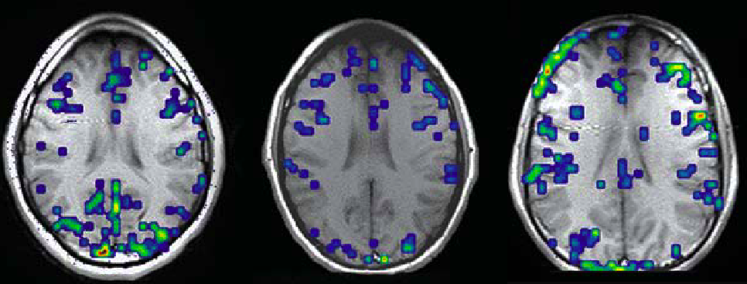
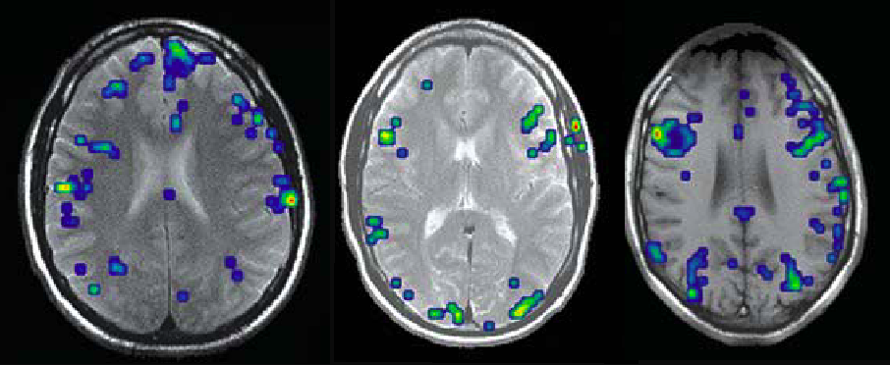
Brain Fact 2: our brains are all different
© YCS November 2007
23
Notes:
23

Slide 24
Fact 3: What we learn becomes hard wiring
Notes:
24

Slide 25
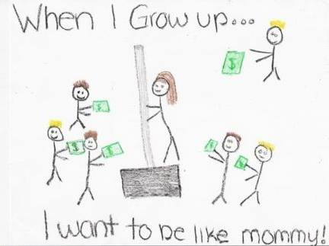
Fact 4: Perception is driven by our hard wiring
Notes:
25

Slide 26
Fact 5. Old hard wiring is hard to change
Dear Ms. Davis, I want to be very clear on my child's illustration. It is NOT of me on a dance pole on a stage in a strip joint. I work at Home Depot and had commented to my daughter how much money we made in the recent snowstorm. This picture is of me selling a shovel. Mrs. Harrington
Notes:
26

Slide 27
Recent Insights from Neuroscience
We think in maps
All brains are different and unique
What we learn becomes hard wiring
Our perception is driven by our hard wiring
Old hard wiring is hard to change
Creating new wiring is easy
Notes:
27

Slide 28
Thinking about Thinking
“Ideas are like children… there are none so wonderful as your own”
Chinese Fortune Cookie

Slide 29
Understand the thinking… not the problem on the table
Notes:
29

Slide 30
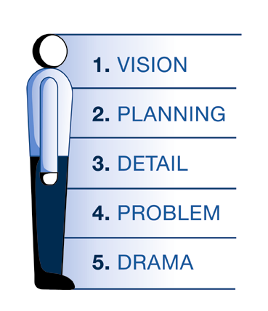
The 5 levels of focus

Slide 31
Giving Feedback
Noticing what you notice
Non-judgemental
Supporting awareness
Notes:
31

Slide 32
Peer Coaching
In pairs, take 10 minutes each to coach a partner on:
where you are now;
What are you learning;
What questions do you have;
What are the implications of this learning for us personally / professionally;
What do we need to address in order for you to feel confident about coaching?
Notes:
32

Slide 33
Debrief
What did you notice?
What did you find interesting?
What are you learning about coaching?
What was getting in the way?
What are your thoughts?
How are you feeling now?
Notes:
33

Slide 34
Start with the end in mind
Unconscious incompetence
Conscious incompetence
Conscious competence
Unconscious competence
Establishing the baseline

Slide 35
The CREATE Model
CR current reality
EA explore alternatives
TE target energy
Notes:
35

Slide 36
Peer Coaching on CREATE
In pairs, take 10 minutes each to coach around:
Current reality
Explore alternatives
Target energy
Notes:
36
36

Slide 37
Debrief
What are you learning about coaching?
What are your thoughts?
How are you feeling now?
Notes:
37

Slide 38
Sharing our Learning
What are we learning and how might this apply to practice?
Notes:
38

Slide 39
Between Day 1 & Day 2
Practice
Set up at least 2 practice sessions with a peer partner before Day 2 and use these sessions to practice the
Core skills - Asking questions, listening, clarifying, giving feedback – notice what you notice
Self Study
Reading: Anything you like to further your understanding – share key learning on GLOW if you want to.
Journaling / Self Reflection
Contribute to online forum
Mentoring arrangements
Notes:
3.55pm – 5 mins
Emphasise the key learning activity that takes place online as part of their shutterfly group. There will be the following facilities:
A discussion group to share your learning journey experiences;
Additional learning resources
Copies of handouts and workbook
Question area for logging issues with trainers
Teleclass details
Ensure that all participants have a peer partner assigned and that they agree a process of ensuring that both (preferably) but at least one can take part in the teleclass to share additional learning.
39

Slide 40
Parking…
What more do we need to say / do?
Notes:
40

Slide 41
End of day 1
Completion
Acknowledgement
Something I’ll take away
Reflection on the group / my own intention for the day.

