Slide 1


Improving Gender Balance and Equalities and CLD
Introduction to new toolkit
For Scotland's learners, with Scotland's educators

Slide 2
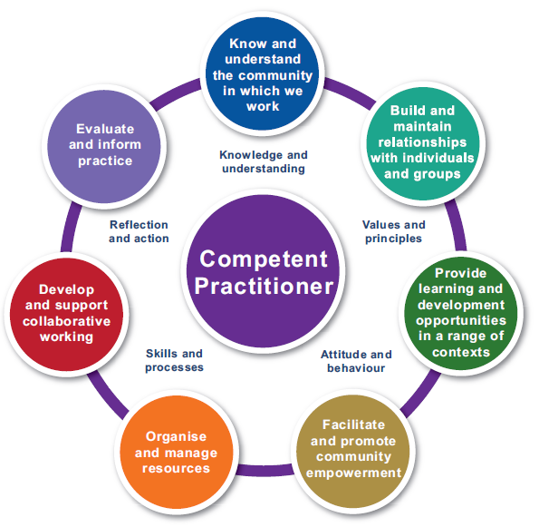

Improving Gender Balance and Equalities and CLD
Why gender equality is important in education in Scotland today
Introduction to the new resources
How the resources have been used in pilot sites
What support is available to use the resources

Slide 3
What does gender balance look like in your services?
Consider an area of your CLD practice. This may be one ESOL group, a programme of learning, a project, an ESOL service.
What data do you currently gather, if any, that tells you what gender equality looks like in this practice?
And what does this data tell you?
Notes:
Invite people to put answers in the chat. Could do this as a waterfall exercise.

Slide 4
Improving Gender Balance and Equalities and CLD
The resources have been developed by a wide stakeholder working group:
CLD services: South Ayrshire, City of Edinburgh, Dundee
Third Sector: Fathers Network Scotland, LGBT Youth Scotland, Community Development Association Scotland
Education Scotland representatives
Piloted by: Aberdeen City, S Ayrshire, City of Edinburgh, LGBT Youth Scotland, Learning Link Scotland
Notes:
Education Scotland is proud to launch this important toolkit for the CLD sector, which has been co-produced with CLD managers and practitioners
Education Scotland has been focusing on improving gender balance in education for some time ….
Gender equality is goal five of the United Nations Sustainable Development Goals
It underpins all Outcomes in the Scottish Government’s National Performance Framework.
National Improvement Framework:
Improving gender balance in ELC workforce
Gender Equality Taskforce in Education and Learning
Support for schools to address gender based violence and sexual harassment.
STEM Strategy
Gender equality is important now more than ever with the rise in misogyny on social media, uncovering of misogyny in a number of front facing public services etc.
CLD practitioners are already working to improve gender balance. Eg Considering gender issues in community needs assessments; encouraging community learners of all ages to question gender stereotypes; discussing gender-based violence with young men in youth work settings.
Are we doing enough?
The most recent study of the CLD workforce in 2018 revealed a workforce composed of 75% women, and a gender pay gap for practitioners which appears to be at least in part linked to the fact that males are more likely to be in management roles.
Our ambition is that these resources will support the CLD sector to use a gender-based lens to look carefully at current practice: to recognise and enhance what is working well and to identify and work on where practice could be improved.

Slide 5
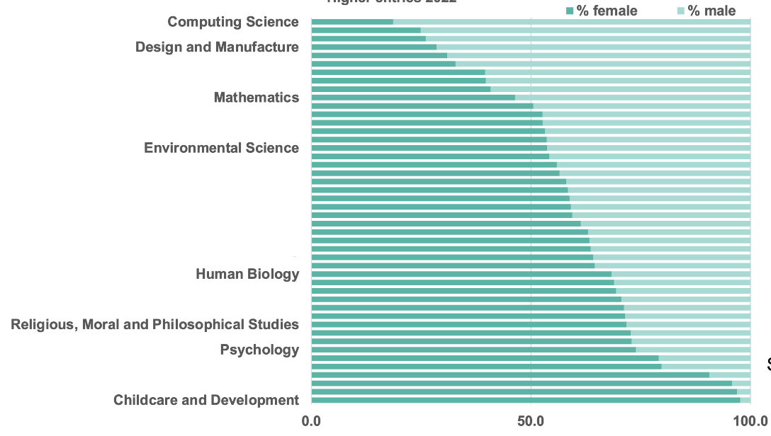
Why an IGBE and CLD Resource?
Higher Entries 2022
86% of Social Security Scotland clients self-identify as women (2021)
Just under three quarters of all suicides in Scotland are men and almost half (46%) were aged 35-54 (2021)
80% of domestic abuse incidents recorded by the police involve a female victim and a male accused (2021)
75% of victims of homicide are male (2017)
Notes:
Gender inequality exists in Scotland:
SQA data shows that entries for Highers in 2022 follow gender stereotypes – far more young men choosing computing and young women choosing childcare.
Statistics across many domains show that life outcomes can vary by gender. We’ve included some information about income, health and crime
Gender equality underpins all 11 of the outcomes in the Scottish Government’s National Performance Framework
Gender equality is goal 5 of the United Nations Sustainable Development Goals. The aim is to achieve gender equality and empower all women and girls. Currently “ the world is not on track to achieve gender equality by 2030”.

Slide 6
Why an IGBE and CLD Resource?
CLD Professional Standards
Values:
Inclusion – valuing equality of both opportunity and outcome, and challenging discriminatory practice
Code of ethics:
Equity - Our work promotes equality of opportunity and outcome. Our practice is equitable and inclusive
HGIOCLD
QI 1.2 Improvements in equality, diversity and inclusion
Ensuring access and inclusion by reducing barriers and inequalities and promoting an equitable culture
Notes:
As members of the CLD profession we agree to abide by a set of values and observe our code of ethics. Inclusion and equity are at the heart of CLD practice.
Our Quality Improvement Framework has a Quality Indicator devoted entirely to improving equality, diversity and inclusion

Slide 7
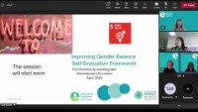
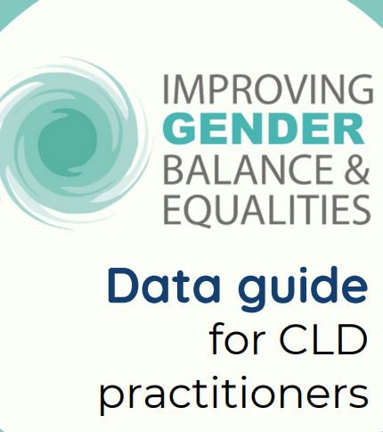
The Data Guide
For Scotland's learners, with Scotland's educators
Notes:
Julie’s introduction You tube clip: 22:15 – 24:37
Or use notes:
The Data Guide is designed to be used alongside the Self-evaluation Framework to support CLD providers to use data to better understand how gender balance looks in their provision. It contains general guidance on using data: why data is important, how to gather and analyse it and things to watch out for when using data.​
Split into 4 sections:​
Participation​
Personal learning and achievement​
Health and wellbeing​
Workforce and volunteer development​
For each section:​
Examples of data disaggregated by gender, relevant to CLD​
Pointers to data that CLD providers could gather and how they might use it​
Reflective questions​
​
Finishes with a reference section

Slide 8
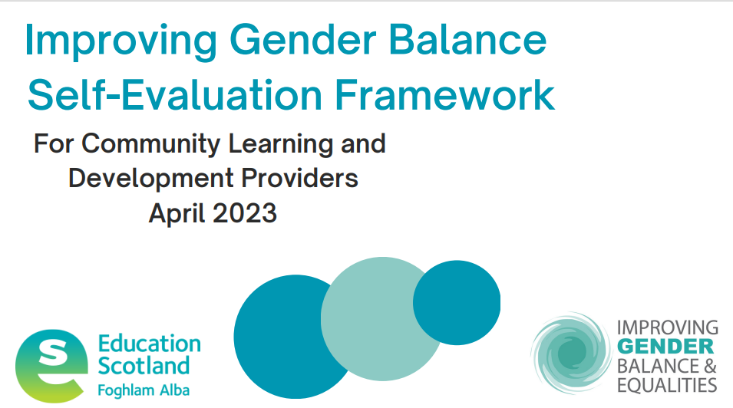
The Self-evaluation Framework
For Scotland's learners, with Scotland's educators
Notes:
Introduction: we acknowledge that the framework is a long document. We believe that the underlying causes of gender imbalance are deeply rooted and worthy of careful consideration.
We have gathered together some research and statistics to give background to the framework. We encourage CLD providers to take the time to consider how unconscious bias, gender stereotypes, patriarchy impact on how we see the world and our local communities. We ask you to consider the impact of online pornography and role models available through social media. Take time to understand the complex and cumulative way in which multiple forms of discrimination (such as racism, sexism and classism) combine, overlap or intersect, especially in the experiences of marginalised individuals or groups.
The introduction also goes on to explain how to use the Framework. We strongly advise taking one small step at a time, rather than trying to use the whole document from start to finish
The Framework:
P10 Leadership and direction: QI 5.1 Vision, culture and direction
QI description is straight from HGIO
Relevant illustrations of highly effective practice selected from HGIO
Through consultation with practitioners and managers we quickly discovered that we needed to take a gender-based lens to these illustrations to promote challenge and deeper thinking
P15 Challenge questions
The illustrations are followed by a set of challenge questions, designed to help CLD providers make judgements about how their service is addressing gender balance.
Caution: there are a lot of illustrations, and a lot of challenge questions. We advise you to start small, choose a QI that seems relevant, current and important and focus only on two or three challenge questions to help you gather evidence
You are invited to make a judgement about whether your service is at the exploring, adopting or embedding phase. We've developed an evidence tracker where you can list or store the evidence you've gathered to help you make that judgement.
HGIOCLD:
The Framework uses the elements shown and QIs directly from HGIOCLD?4: Leadership and direction, Performance and outcomes and management and delivery.
There is a bibliography for further reading and links to other resources

Slide 9


Piloting the resources: Youth Work in South Ayrshire
For Scotland's learners, with Scotland's educators
Notes:
Written case study is also available
Youtube ( 4 sections, just over 6 mins in total)
Covers: participation (including gender and SIMD); referrals from schools; embedding UNCRC; QA systems across the team and roll out to other teams; Equality Impact Assessments roll out; workforce

Slide 10

Piloting the resources: LGBT Youth Scotland
For Scotland's learners, with Scotland's educators
Notes:
Written case study is also available
Youtube ( 4 sections, just over 5 mins in total)
Covers: participation, familiarising workers with QI Frameworks, embedding QA processes across the whole organisation

Slide 11
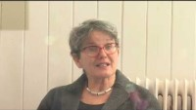
Piloting the resources: City of Edinburgh Council
For Scotland's learners, with Scotland's educators
Notes:
Written case study is also available
Youtube ( 4 sections, just over 9 mins in total)
Covers: adult literacies provision; gathering evidence from stats and policies; using challenge questions for surveys and conversation starters; interviews with learners and tutors; learners identifying multiple barriers and suggesting improvements

Slide 12

Further information and support
Improving Gender Balance and Equalities in Community Learning and Development | Resources | Education Scotland
Improving Gender Balance and Equalities in CLD – Wakelet
Professional learning (Winter Learning Festival)
Support from Education Scotland – contact oonagh.mcgarry@educationscotland.gov.scot
For Scotland's learners, with Scotland's educators
Notes:
Resources available on CLD Wakelet
Website: new ES site in development. We're making sure the resources meet all the standards required for the new site. We'll promote the new pages as soon as they are ready to go.
Offer of ES support to sites wishing to use the resources in the next 6 months
Questions for CLD Leads: What would help you to use these resources? Is there any particular Professional Learning or support that you would find helpful?

Slide 13
Education Scotland
Denholm House
Almondvale Business Park
Almondvale Way
Livingston EH54 6GA
T +44 (0)131 244 5000
E enquiries@educationscotland.gsi.gov.uk
For Scotland's learners, with Scotland's educators

