Slide 1


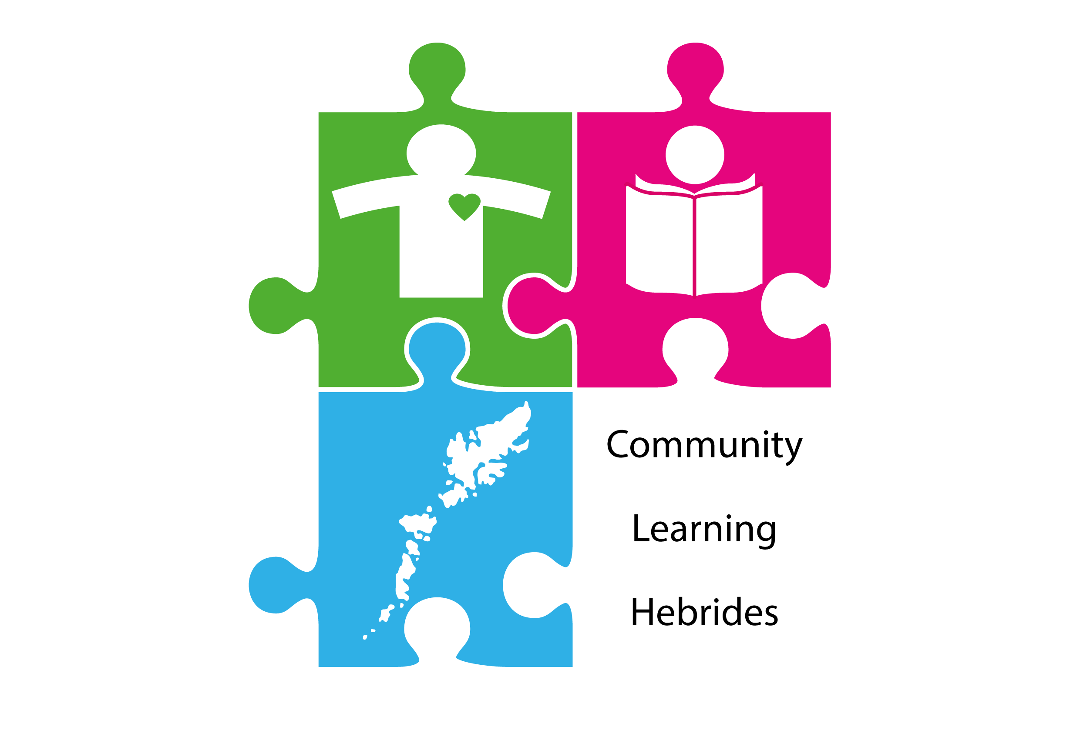

A Brief Introduction to Gàidhlig
Mira Byrne
Gaelic Development Officer
Comhairle nan Eilean Siar | e-Sgoil

Slide 2

A Linguistic Context

Slide 3
Gàidhlig in context
Indo-European Languages
Germanic
Celtic
Romance
Slavic
Scots
Brythonic (p-Celtic)
Goidelic (q-Celtic)
Breton
Cornish
Welsh
Irish
Manx
Gaelic

Slide 4
A Historical Context

Slide 5
The rise of Gaelic
possibly as early as 200AD: A Goidelic language is spoken in the Argyll area of Scotland (”Dalriada”). Close links exist with northern Ireland.
This is the first group to adopt Christianity in post-Roman Britain and theirs is the longest, living literary language in Europe after those of classical Rome and Greece.
c. 842 AD: Kenneth MacAlpin (Coinneach Mac Ailpein) becomes the first joint king of Scots (i.e. Gaels) and Picts → the Kingdom of Alba.
Over the coming centuries, the Kingdom of Strathclyde and other southern areas are subsumed.
early 11th century: Gaelic becomes the language of dominance in what is now Scotland and beyond. “Gaelic was the language of the Scottish state, its royal house, the language of learning and the church” (MacKinnon, 1991).

Slide 6

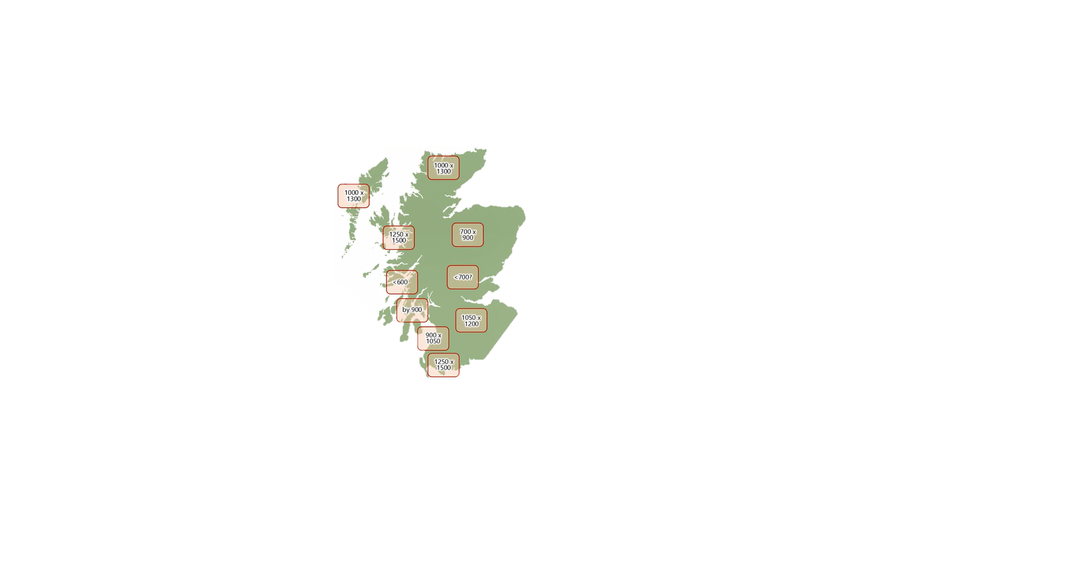
Kingdom of Alba c. 1100
arrival of Gaelic

Slide 7
Hanging in the balance
1058-93: Reign of Malcolm III “Canmore” (Maol Chaluim Ceann Mòr)
  English introduced at court
  Norman French elite takes over England
1285/6: death of Alexander III brings to an end the Canmore dynasty which had maintained some Gaelic traditions, e.g. accession ceremonies
by 1400: Gaelic has fallen out of use in Central Scotland but remains accepted as one of the languages of Scotland
James IV (1488-1530) is the last Scottish monarch to speak Gaelic (learner)

Slide 8
The Lordship of the Isles
1266: Norway cedes the Western Isles to Scotland → The Lordship of the Isles
  a virtually independent, confident Gaelic society
  patronage of Gaelic arts leading to an evolving culture
  independent institutions, political and legal system
  a common (written) language and culture are maintained with Ireland
the Stuart monarchs exercise increasing power, see the Lords of the Isles as rivals
1493: forfeiture of the Lordship of the Isles

Slide 9
Alienation & Decline
“From about 1520 onwards the common Lowland speech came to be called “Scots” and Gaelic identified as “Irish”.” (MacKinnon, 1991, pp.38-9)
James VI (1567-1625):
  Gaelic becomes associated with barbarity and “popery”
  1609: Statutes of Iona
1701: The Society in Scotland for Propagating Christian Knowledge (SSPCK) is founded
  The eradication of Gaelic is seen as integral to eradicating Catholicism. Attitudes towards Gaelic softened somewhat once Protestantism became widely adopted.
1745/6: Jacobite risings & Culloden
  August 1746: Act of Proscription
18th & 19th century: Clearances & Emigration

Slide 10
A tentative resurgence
from early 19th century: Establishment of Gaelic Societies, e.g. the Edinburgh Society for the Support of Gaelic Schools (1811), An Comunn Gàidhealach (1891)
1843: “the Disruption” leads to the establishment of the Free Church which embraces the use of Gaelic
1872: Education Act (Scotland) discourages and punishes the use of Gaelic in schools
from late 19th century: Gaelic regularly appears in publishing, e.g. MacTalla, An Gaidheal
1918: Education Act (Scotland) includes a vague Gaelic clause but with little effect
1958: Gaelic Medium Education schemes are introduced at Primary level, initially in Inverness-shire
1959: Gaelic appears in broadcasting (Radio 4 initially)
1960s onwards: volunteer movements, e.g. Comunn na Gàidhlig, Sradagan, Fèisean nan Gàidheal

Slide 11
Gàidhlig san Latha an-Diugh
1997: creation of the Scottish Government
2005: Achd na Gàidhlig / Gaelic Language (Scotland) Act agreed with cross-party
support, leading to the establishment of Bòrd na Gàidhlig
2007: first Plana Cànain Nàiseanta (National Gaelic Plan) published
2008: BBCALBA is launched
2016: Education (Scotland) Act gives parents the right to request GME for their child
2020: publication of “The Gaelic Crisis in the Vernacular Community”
2021: substantive commitments to Gaelic (and Scots) in the SNP’s election manifesto
  https://www.gov.scot/publications/consultation-scottish-government-commitments-gaelic-scots-scottish-languages-bill/

Slide 12
Gàidhlig san Latha an-Diugh
Number of speakers (according to the 2011 census)
  57,000 people can speak Gaelic (59,000 in 2001); 1.1% of population (over 3 years of age)
  52.3% can speak Gaelic in the Outer Hebrides, 5.4% in the Highlands, 4.0% in Argyll & Bute
Attitudes towards Gaelic (Scottish Social Attitudes survey 2021)
  79% believe Gaelic is important to Scotland’s heritage
  65% would like to speak Gaelic better than they do now
  30% said they can speak an odd word of Gaelic (15% in 2012)
  55% in favour of children in Scotland being taught Gaelic in school (38% in 2012)
  31% believe Gaelic is important to their own cultural heritage (26% in 2012)

Slide 13
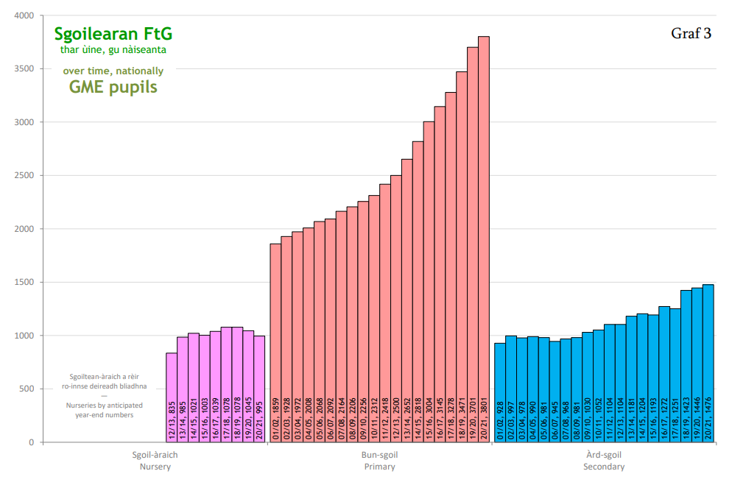
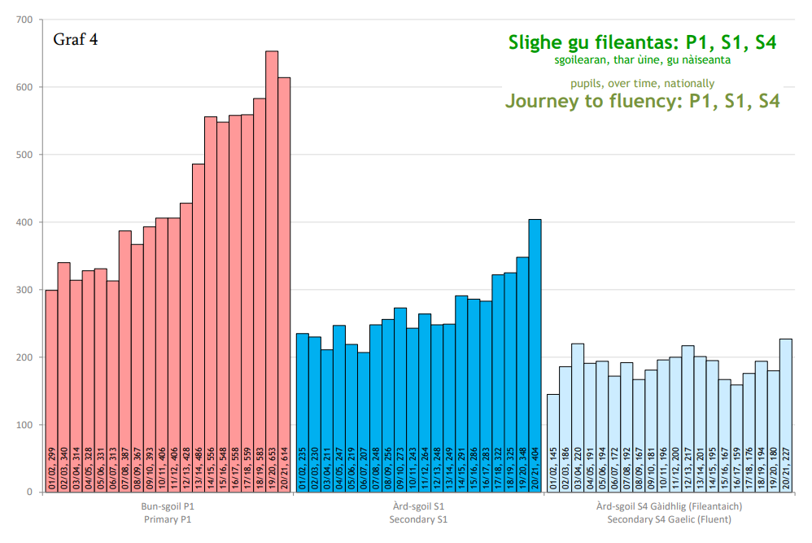
Gàidhlig san Latha an-Diugh
Gaelic in Education (2020-21 Gaelic School Data)
  52 nurseries, 61 Primaries & 32 Secondaries offering Gaelic Medium catering for >6,000 pupils
  figures for GLE are more difficult to define but make up about 1.2% of all Secondary pupils
  CnES: 55% P1 GME intake in 2022/23

Slide 14
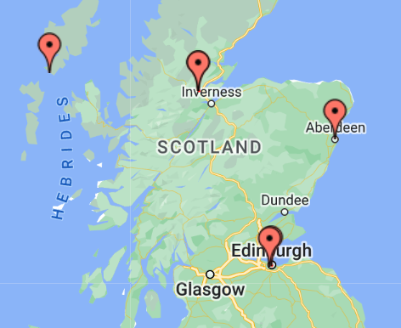
Gàidhlig san Latha an-Diugh
Adult learners
  Duolingo: 1.12 million reached and 431,000 active learners (April ‘22)
  e-Sgoil: 105 Adult Learners registered for Nat 5 and 43 for Higher Gaelic in 2022/23
  SpeakGaelic, launched in 2020, offers a free, standardised course available to all
Opportunities
  Demand for Gaelic-speakers in an increasing range of roles
  Technology provides new opportunities, e.g. e-Sgoil, Cothrom Cabadaich
Obraichean Gàidhlig, 01/11/22

Slide 15
Ceistean?

Slide 16
An Introductory Lesson

Slide 17
Madainn mhath.
Feasgar math.
Latha math.
Oidhche mhath.

Slide 18
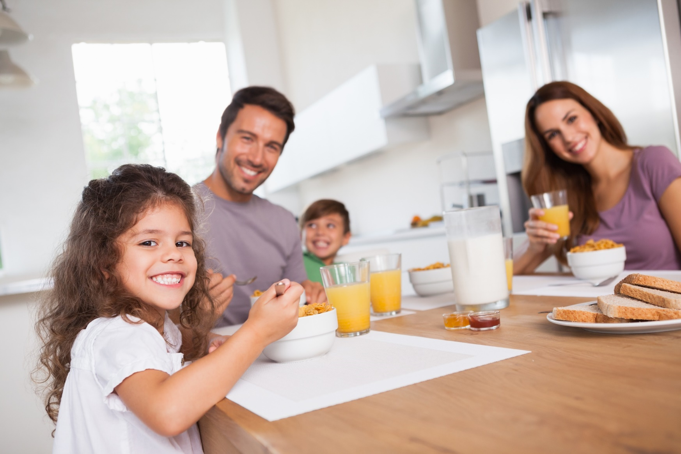
Madainn mhath.

Slide 19

Feasgar math. | Latha math.

Slide 20

Feasgar math. | Latha math.

Slide 21
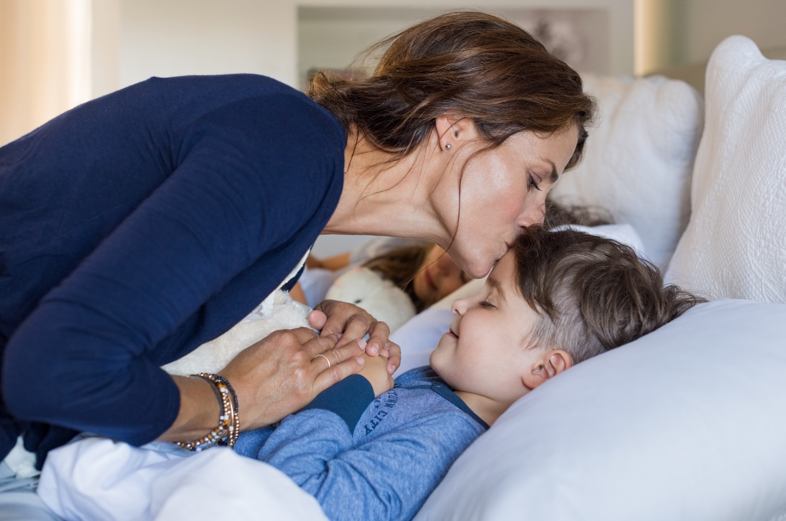
Oidhche mhath.

Slide 22
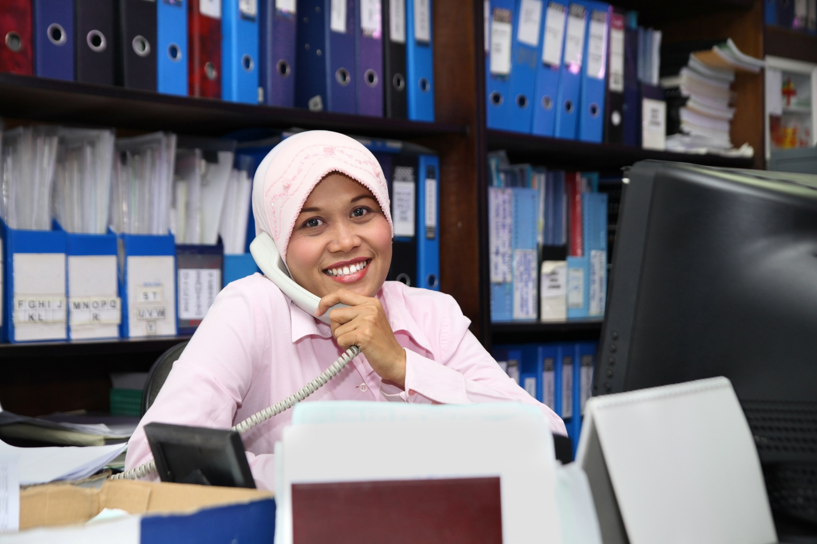
Feasgar math. | Latha math.

Slide 23

Madainn mhath.

Slide 24

Feasgar math. | Latha math.

Slide 25
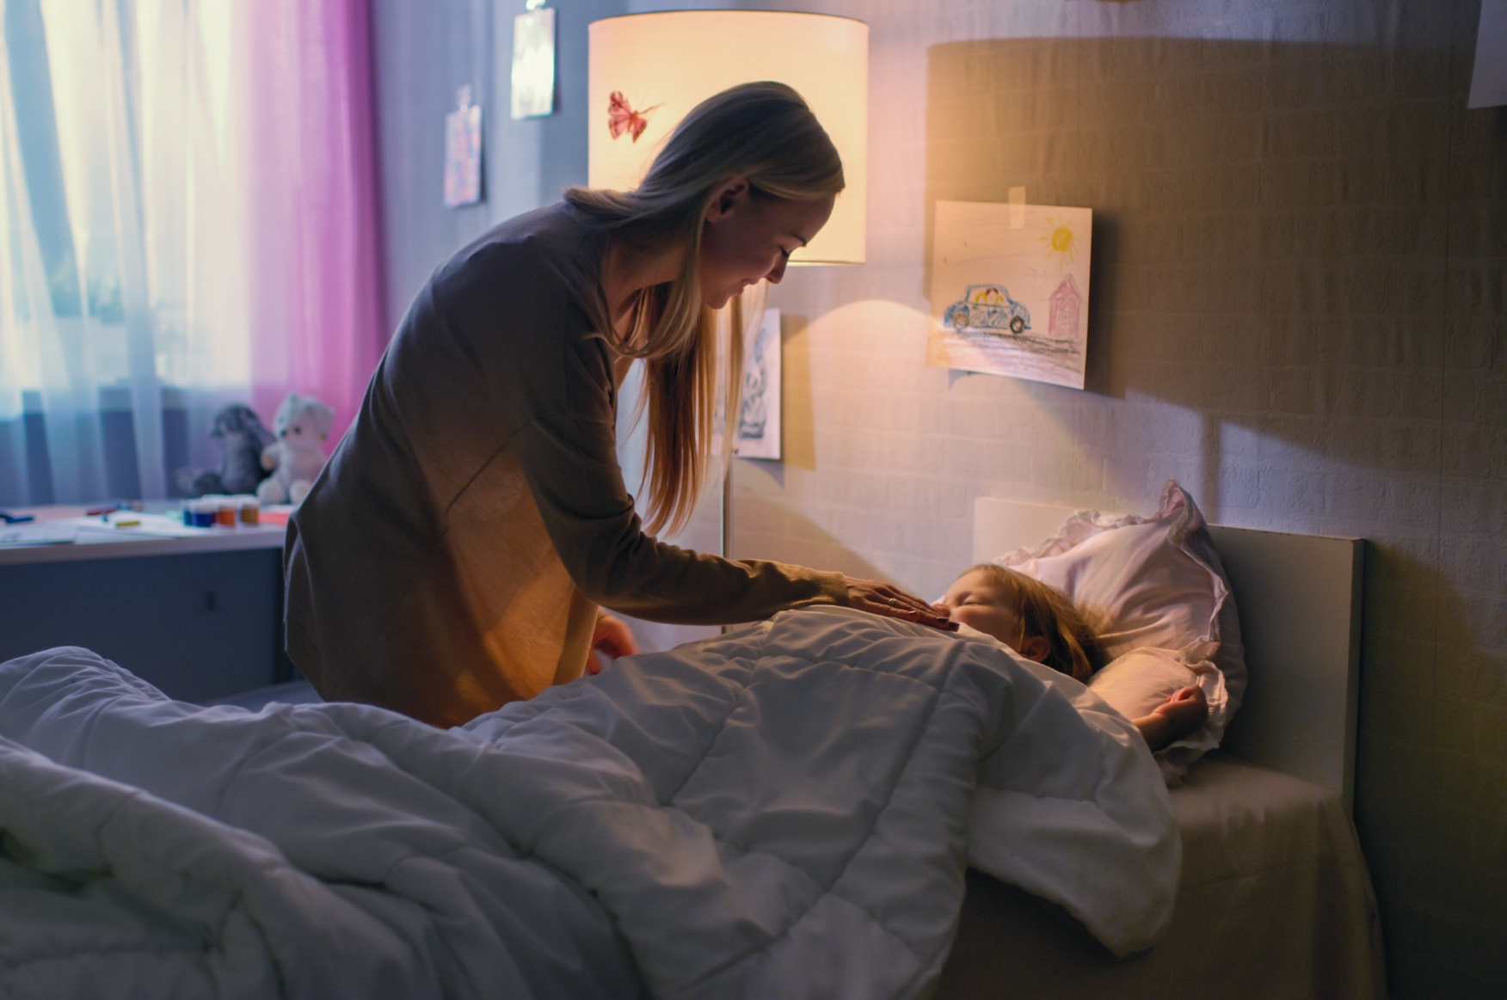
Oidhche mhath.

Slide 26
Dè an t-ainm a th’ ort?
Is mise Calum.
Dè an t-ainm a th’ ort fhèin?
Is mise Màiri.

Slide 27
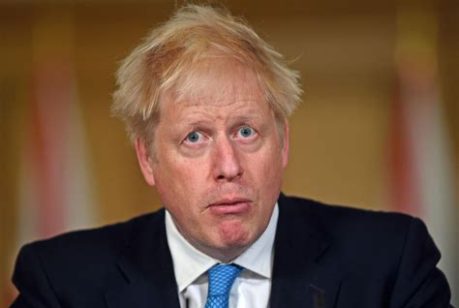
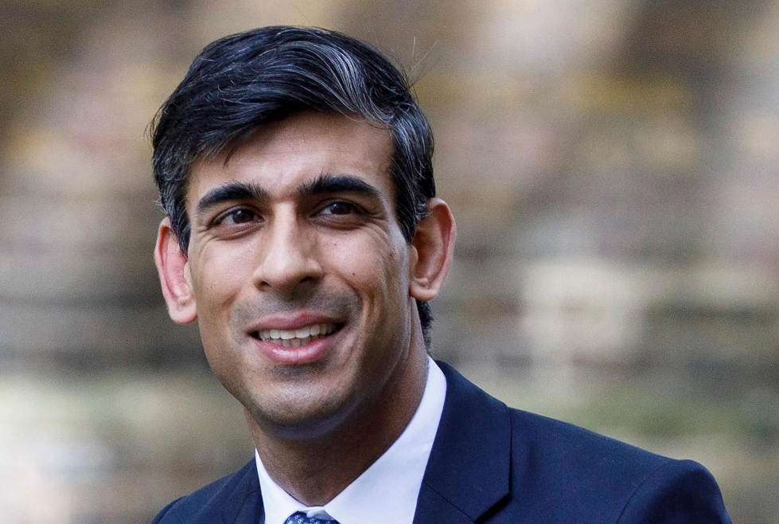

Slide 28
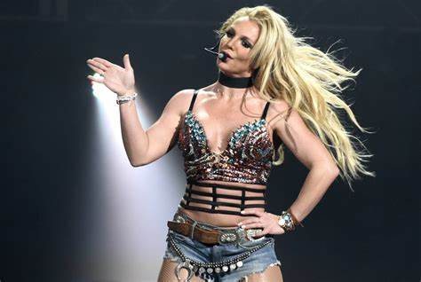
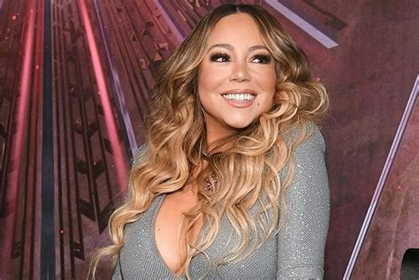

Slide 29
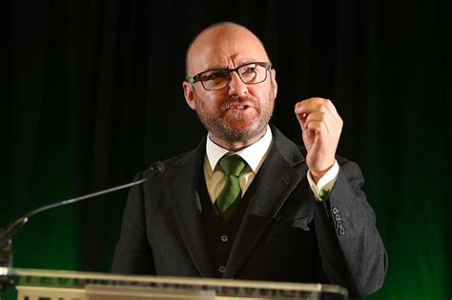
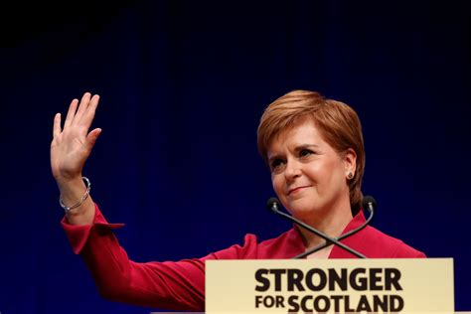

Slide 30
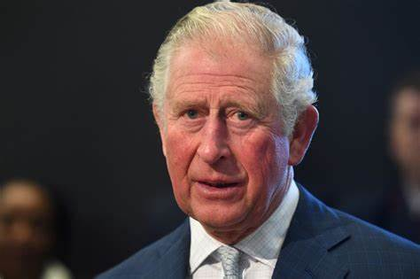
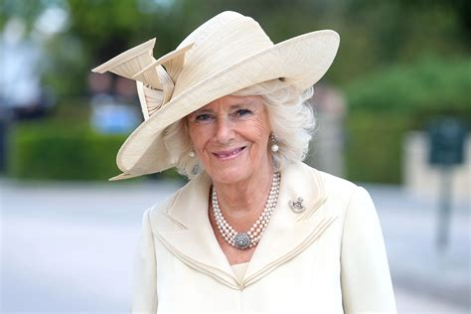

Slide 31
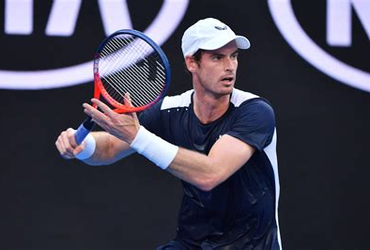
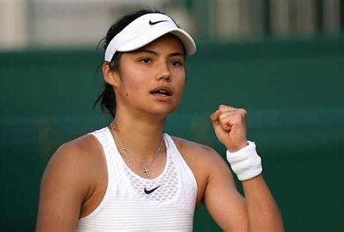

Slide 32
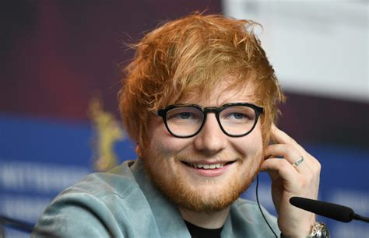
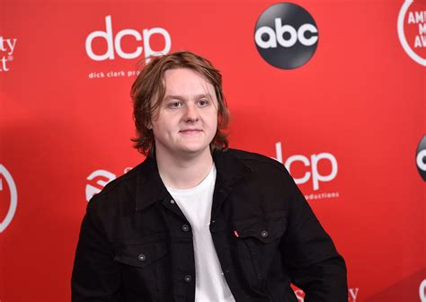

Slide 33
Dè seòrsa latha a th’ ann?
Tha i math.
Tha i fliuch.
Tha i fuar.

Slide 34

Tha i math.

Slide 35
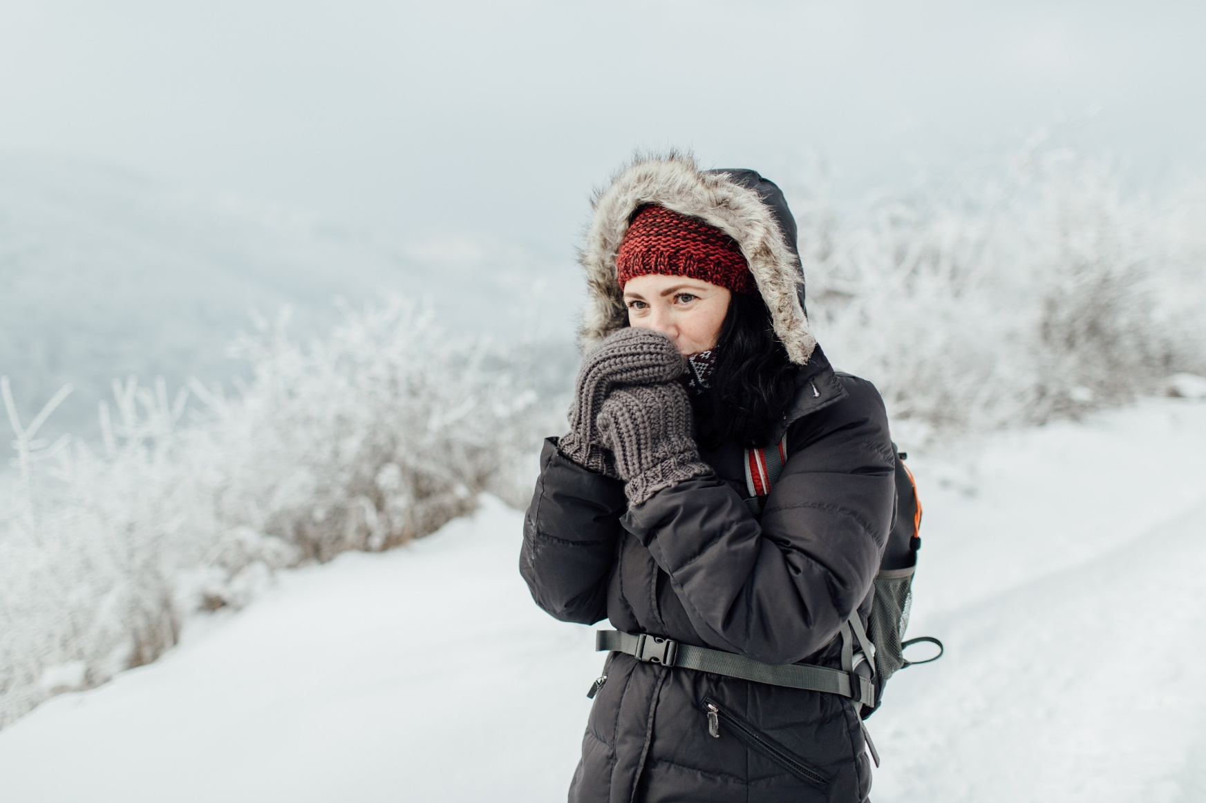
Tha i fuar.

Slide 36
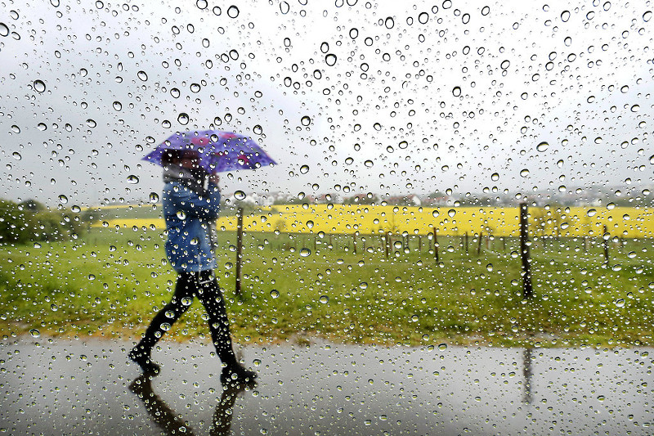
Tha i fliuch.

Slide 37
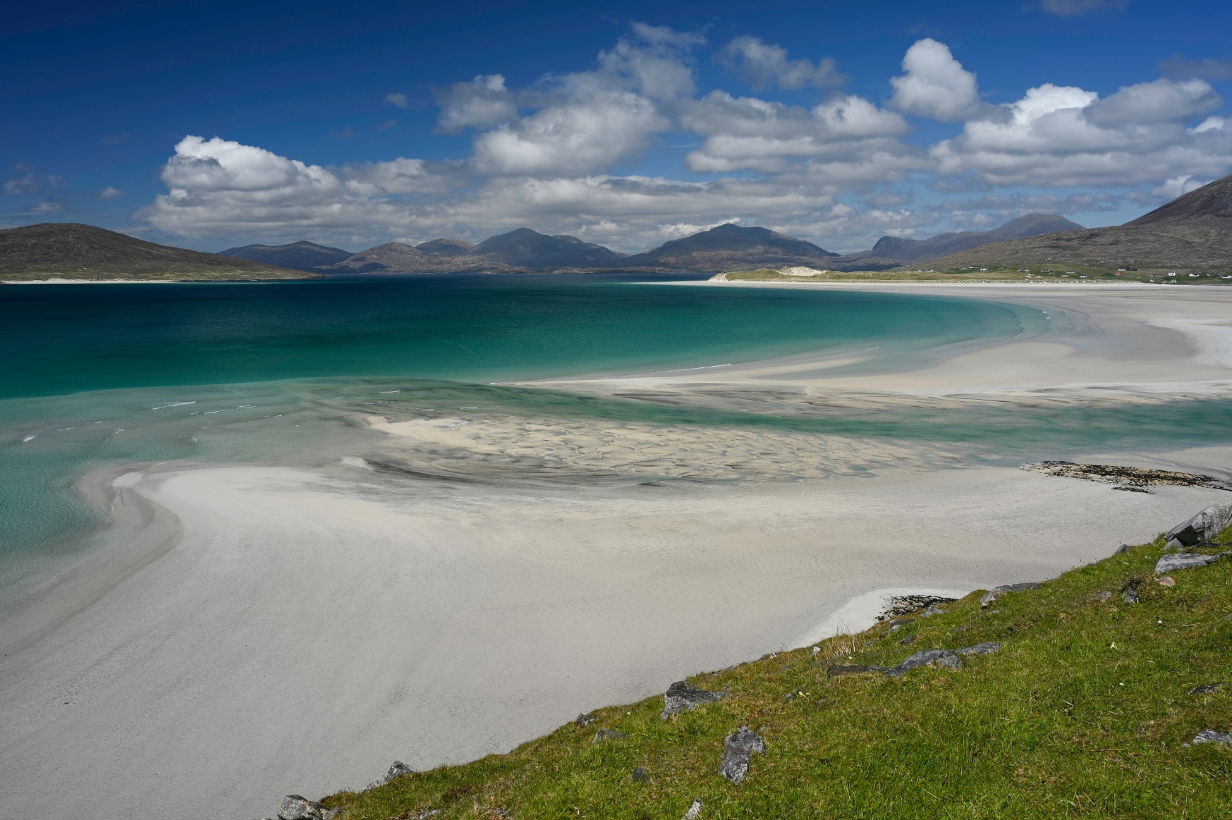
Tha i math.

Slide 38
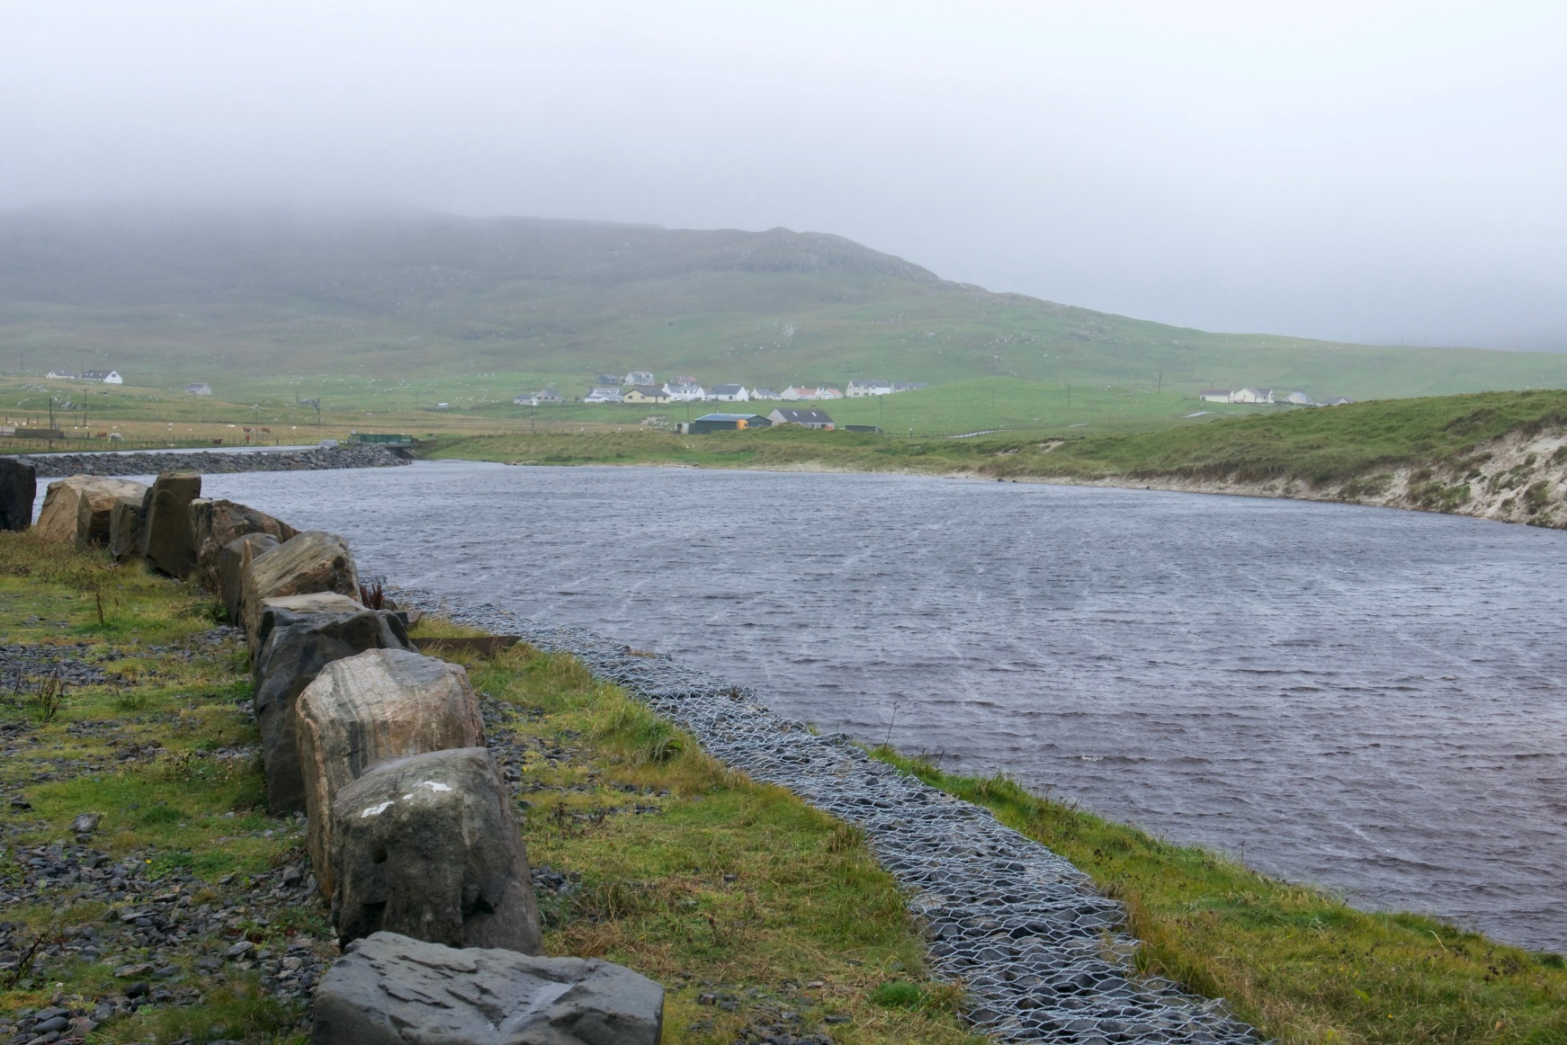
Tha i fliuch.

Slide 39
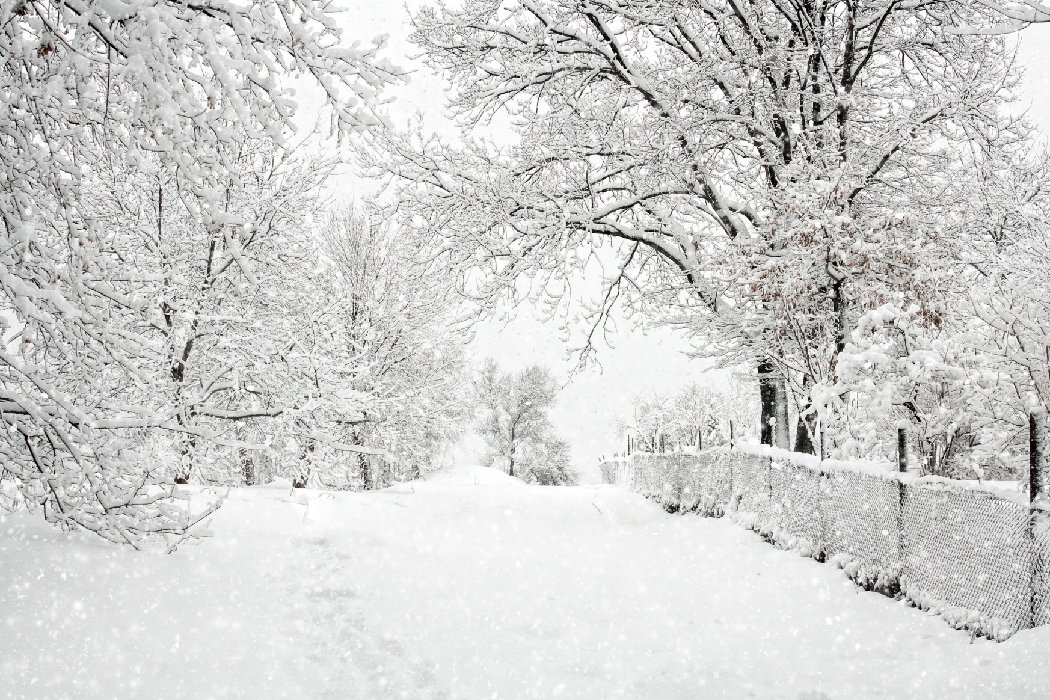
Tha i fuar.

Slide 40
Ciamar a tha thu?
Tha gu math, tapadh leat.
Ciamar a tha thu fhèin?
Chan eil adhbhar ri gearan.

Slide 42
Tapadh leibh!
Mira Byrne
Gaelic Development Officer
Comhairle nan Eilean Siar | e-Sgoil

