Slide 1
Review of Community Development National Occupational Standards
Focus Group
October 2022

Slide 2
Agenda
Welcome and Introductions
Background to NOS, approach to NOS reviews
Review of Functional Map and Standards
Next steps and approach to governance
Dates to Note

Slide 3
Project Outputs
A suite of up to date
National Occupational Standards for Community Development

Slide 4
Remit of the Focus Group
Review any materials and give us your professional opinions
Participate in a wider online consultation on the draft revised NOS
Promote the NOS review to your networks and encourage participation in the wider consultation of the draft revised NOS
Help us keep to agreed timescales set within the agenda for today and tell us if you need further opportunity to comment

Slide 5
What are NOS
A National Occupational Standard describes what an individual needs to do, know, and understand in order to competently carry out a particular job or function

Slide 6
Potential Uses of NOS
Competency frameworks
Job descriptions / requirements
Qualifications
Key outcomes
Underpinning knowledge
Career planning & progression
Individual performance
& appraisal
Focused training & development

Slide 7
Functional Analysis
Functional analysis is the main tool used to develop NOS
Functions are the main activities a person is expected to do as part of their job
3 Stages:
Begin with a key purpose of the sector, occupation or role
Identify main functions by asking ‘What needs to happen to achieve the Key Purpose?’
Identify possible NOS by asking ‘What needs to happen to achieve each main function?’

Slide 8
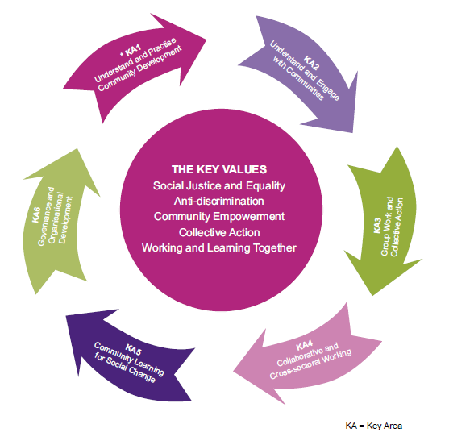
Existing Community Development Functional Map
Notes:
Is the FM fit for purpose?
Look at each key function in turn
Are there any gaps? Any new NOS needed? Digital?
Is anything out of date eg content or terminology? Democratic Renewal focus?
Consider the format of the CD functional maps
Consider any changes that may be required to the structure
Consider any changes that may be required to the content to reflect current best practice
Consider whether any additions may be required to the content.

Slide 9
Community Development
Functional Map
Key purpose
What needs to happen to achieve the Key Purpose?
Functional Areas
Notes:
Is the FM fit for purpose?
Look at each key function in turn
Are there any gaps? Any new NOS needed? Digital?
Is anything out of date eg content or terminology?
Consider the format of the Career Guidance functional maps
Consider any changes that may be required to the structure
Consider any changes that may be required to the content to reflect current best practice
Consider whether any additions may be required to the content.

Slide 10
Learning and Development Functional Map
Functional Areas
What needs to happen to achieve this functional area?
Sub-functions
Notes:
Is the FM fit for purpose?
Look at each key function in turn
Are there any gaps? Any new NOS needed? Digital?
Is anything out of date eg content or terminology?
Consider the format of the Career Guidance functional maps
Consider any changes that may be required to the structure
Consider any changes that may be required to the content to reflect current best practice
Consider whether any additions may be required to the content.

Slide 11
Learning and Development Functional Map
Sub-functions
What needs to happen to achieve this sub-function?
National Occupational Standards
Notes:
Is the FM fit for purpose?
Look at each key function in turn
Are there any gaps? Any new NOS needed? Digital?
Is anything out of date eg content or terminology?
Consider the format of the Career Guidance functional maps
Consider any changes that may be required to the structure
Consider any changes that may be required to the content to reflect current best practice
Consider whether any additions may be required to the content.

Slide 12
Existing Community Development Functional Map
Notes:
Is the FM fit for purpose?
Look at each key function in turn
Are there any gaps? Any new NOS needed? Digital?
Is anything out of date eg content or terminology? Democratic Renewal focus?
Consider the format of the CD functional maps
Consider any changes that may be required to the structure
Consider any changes that may be required to the content to reflect current best practice
Consider whether any additions may be required to the content.

Slide 13
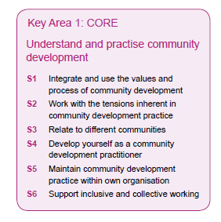
Review of Standards
Performance criteria
You must be able to:
1 apply the values and process of community development to own role
2 promote the values of community development to individuals, organisations and communities
3 support communities to use the values and process of community development
4 support communities to challenge local and national policies and decisions that have a negative impact on local communities
5 promote inclusive and empowering collective action in deciding and working on the changes identified by communities
6 support communities to make links between structural factors and their impact on well-being
7 promote the learning and developmental aspects of working with communities
8 enable the evaluation of community development practice's impact on communities
9 support communities and others to understand how policies at different levels impact on communities
Notes:
Initial thoughts
Gaps/amendments/additions
Review Methods discussion

Slide 14
Review of Standards
Padlet
Notes:
Initial thoughts
Gaps/amendments/additions
https://padlet.com/kirstygemmellcldsc/ap5x3c34f6x4nkut

Slide 15
Next Steps
Focus groups with employers in 4 nations
October 2022
Draft NOS submitted to regulators for review
Dec 2022
On-line consultation with industry of draft NOS
Jan 2023
Final NOS submitted
March 2023

Slide 16
Governance
Governance – Steering Group
Anna Clarke – Ireland
Mick Doyle – Scotland
Sue Gill – England
?? - Wales

Slide 17
Dates to Note
Focus Groups – Round 2 week beginning 5 December 2022
Online Consultation – Jan 2023
All nations feedback session – 22 February 2022 10am-12pm

Slide 18
Contact Details
Kirsty Gemmell
Education Officer
Kirsty.Gemmell@cldstandardscouncil.org.uk

