Slide 1



Leading CLD
Day 2:
March 8th 2022
For Scotland's learners, with Scotland's educators
Notes:
This is a front cover page and can only be used once. Use the corresponding blue internal and back pages if you are using this page. You may add a title and a subtitle if needed only. Do not add anything else or move elements around.

Slide 2



Welcome & Housekeeping
  Feel free to keep your camera on
  Mute unless speaking
  Use the chat pane or pop hand up for questions, comments etc.
  Take a break if you need it and try to minimise any distractions
Notes:
Susan

Slide 3

Leading CLD
Today's programme
  Warming up, session aims, reflection on bridging activity and CLD practice
  15-minute break (roughly 10.30am)
  CLD practice and the history of CLD, CLD Standards Council
  Leadership inventory and reflection
  45-minute lunch (roughly 12.45pm)
  Introduction to CLD policy, Scottish Government
  15-minute break (roughly 2.45pm)
  Rounding up and looking forward
Notes:
Susan

Slide 4

Notes:
10 minute random breakout rooms of three – what item would you bring to a desert island and why? Book, music & luxury item. Bit of fun – put in chat on return

Slide 5
Leading CLD
Facilitators
  Susan Epsworth, CLD, Education Scotland
  Mandy Toogood, PLL, Education Scotland
  Alison Weatherston, PLL, Education Scotland
  Kirsty Gemmell, CLD Standards Council
  Nicola Sykes, CLD, Education Scotland
Notes:
Susan

Slide 6
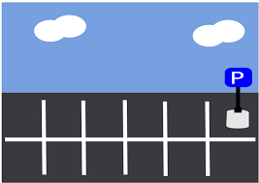

Notes:
https://jamboard.google.com/d/1A1rj-Yntlc8tSfRMeyeyFkj162qgEaLxedJyctn7K90/edit?usp=sharing page 1
Susan

Slide 7
Reflective Journal
  What am I learning about leadership in CLD?
  What am I learning about myself as a leader in CLD?
  What am I still curious about?
  What questions are arising for me now?
  What actions will I take to explore these further?
Notes:
Reminder re. Reflective journal – any questions or reflections Susan

Slide 8
Leading CLD
Session 2 aims
  Participants will have an opportunity to reflect on different areas of CLD practice
  Participants will have a clear knowledge and understanding of the Policy context of CLD
  Participants will have the opportunity to reflect on what this means for them as leaders
  Participants will explore social and emotional intelligence and the impact this has on them as leaders
Notes:
Susan

Slide 9
Leading CLD
Follow up on bridging activity
  What did you already know?
  What did you learn?
  What do you still need to know?
Notes:
Mandy
Breakout rooms – random – overview of CLD practice visited – 5 groups of 4?
Capture on Jamboard - https://jamboard.google.com/d/1A1rj-Yntlc8tSfRMeyeyFkj162qgEaLxedJyctn7K90/edit?usp=sharing (page that correlates with room number)

Slide 10

Notes:
Susan introduce

Slide 11
Notes:
Hand over to Kirsty & Marion

Slide 12

LISTENING
TO CREATE THE SPACE TO THINK
  “Our quality of listening determines the quality of the conversation we inspire”
  SuperCoaching
For Scotland's learners, with Scotland's educators
Notes:
Introduce coaching conversations as an approach we will be using to help them reflect and learn. Today focus on listening to keep it simple and connected to one of the main characteristics of Emotional and Social Intelligence

Slide 13
Coaching Spectrum
NON-DIRECTIVE
Enabling potential
Listening to understand
Asking questions
Offering advice
Problem solving
Telling what to do
DIRECTIVE
Notes:
Hand over to Kirsty & Marion

Slide 14
What is ESCI?
Emotional & Social Competence Inventory
“Emotional and social intelligence … … describes the behaviours that sustain people in challenging roles, or as their careers become more demanding …”
Emotional and Social Competence Inventory Ferry Feedback Report
© Boyatzis, Goleman & Korn Ferry 2019
Notes:
What is emotional and social intelligence?
Emotional and social intelligence is the capacity for recognising our own feelings and those of others, for motivating ourselves, and for managing emotions effectively in ourselves and in others. It describes the behaviours that sustain people in challenging roles, or as their careers become more demanding, and it captures the qualities that help people deal effectively with change.
The emotional and social competency inventory
Based on decades of research, across hundreds of roles and organisations, the emotional and social competency inventory (ESCI) model describes twelve competencies that differentiate outstanding from average performers. Although all of the ESCI competencies are important, you may not need to master all of them in order to be successful. You may draw ondifferent competencies, depending on your strengths, preferences, and the needs of the people and situations you work with.
The four clusters
The ESCI clusters highlight four distinct areas of ability:
self-awareness: recognising and understanding our own emotions
self-management: effectively managing our own emotions
social awareness: recognising and understanding the emotions of others
relationship management: applying emotional understanding in our dealings with others.
Relationship management is where emotional and social intelligence (or the lack thereof) becomes most visible to others.
The competencies in this cluster impact on the motivation and performance of others, but they depend on strengths in the social awareness and self-management competencies. These clusters provide direction, energy, restraint, and skill to the way we use relationship management competencies.
Self-awareness is at the heart of the model. It describes the ability to understand our emotions, our drives, our strengths and our weaknesses. It enables us to sustain our emotionally and socially intelligent behaviour over time, despite setbacks.
Self- awareness: All your other emotional and social intelligence competencies are built upon emotional self-awareness.
Self management: Keeps you open minded and focused. helps you channel your energies and contain your frustrations.
Social awareness: Helps you tune in and stay alert to others feelings and perspectives, and enables you to observe –accurately – influencers, decision makers, relationships and networks.
Relational management: Enables you to bring out the best in others. Helps you deliver much more than you possibly can on your own.

Slide 15
Emotional Intelligence and Social Intelligence
Social Intelligence and Leadership - Bing video
Notes:
https://www.youtube.com/watch?v=Y7m9eNoB3NU

Slide 16
Emotional Intelligence Self-Assessment
https://globalleadershipfoundation.com/geit/eitest.html
Notes:
https://globalleadershipfoundation.com/geit/eitest.html

Slide 17


Slide 18
Notes:
https://jamboard.google.com/d/1A1rj-Yntlc8tSfRMeyeyFkj162qgEaLxedJyctn7K90/edit?usp=sharing

Slide 19
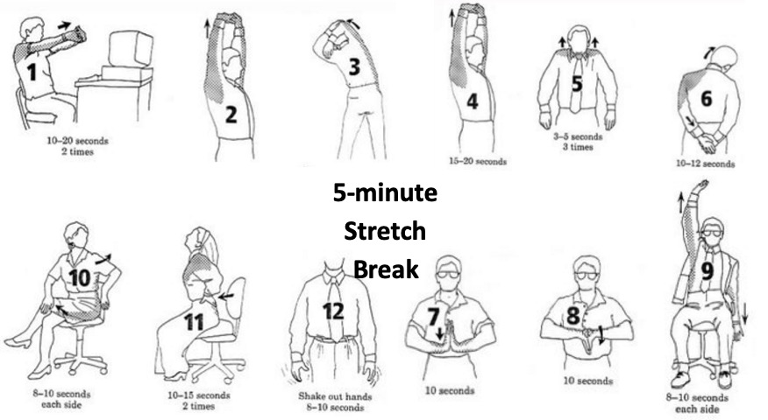
Notes:
Susan

Slide 20
Leading CLD
Reflection activity
In pairs....
  What are you still learning about yourself as a leader?
  What are you still curious about, what questions do you have?
  What actions will you take to explore these further?
Notes:
Breakout rooms - pairs, same as earlier activity
Mandy/Alison to add suggested questions

Slide 21
Time to think coaching conversation
Time to think and reflect
In pairs take it in turns to talk through what you are thinking about your own social and emotional intelligence
Prompt questions for coach:
What are you thinking now about your emotional and social intelligence?
On a scale of 1 – 10 where would you score yourself?
If you were to arrive at a higher number, what would this look like, feel like, what would you be doing differently?
Notes:
Self-awareness
Self-management
Social awareness
Relational management
What is emotional and social intelligence?
Emotional and social intelligence is the capacity for recognising our own feelings and those of others, for motivating ourselves, and for managing emotions effectively in ourselves and in others. It describes the behaviours that sustain people in challenging roles, or as their careers become more demanding, and it captures the qualities that help people deal effectively with change.
The emotional and social competency inventory
Based on decades of research, across hundreds of roles and organisations, the emotional and social competency inventory (ESCI) model describes twelve competencies that differentiate outstanding from average performers. Although all of the ESCI competencies are important, you may not need to master all of them in order to be successful. You may draw ondifferent competencies, depending on your strengths, preferences, and the needs of the people and situations you work with.
The four clusters
The ESCI clusters highlight four distinct areas of ability:
self-awareness: recognising and understanding our own emotions
self-management: effectively managing our own emotions
social awareness: recognising and understanding the emotions of others
relationship management: applying emotional understanding in our dealings with others.
Relationship management is where emotional and social intelligence (or the lack thereof) becomes most visible to others.
The competencies in this cluster impact on the motivation and performance of others, but they depend on strengths in the social awareness and self-management competencies. These clusters provide direction, energy, restraint, and skill to the way we use relationship management competencies.
Self-awareness is at the heart of the model. It describes the ability to understand our emotions, our drives, our strengths and our weaknesses. It enables us to sustain our emotionally and socially intelligent behaviour over time, despite setbacks.
Self- awareness: All your other emotional and social intelligence competencies are built upon emotional self-awareness.
Self management: Keeps you open minded and focused. helps you channel your energies and contain your frustrations.
Social awareness: Helps you tune in and stay alert to others feelings and perspectives, and enables you to observe –accurately – influencers, decision makers, relationships and networks.
Relational management: Enables you to bring out the best in others. Helps you deliver much more than you possibly can on your own.

Slide 22
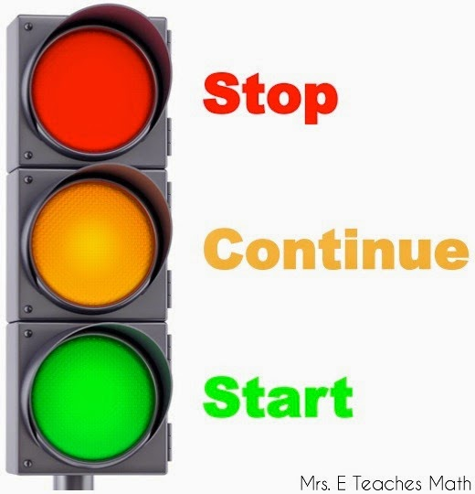
Stop, Start, Continue
Notes:
Susan E – chat pane

Slide 23
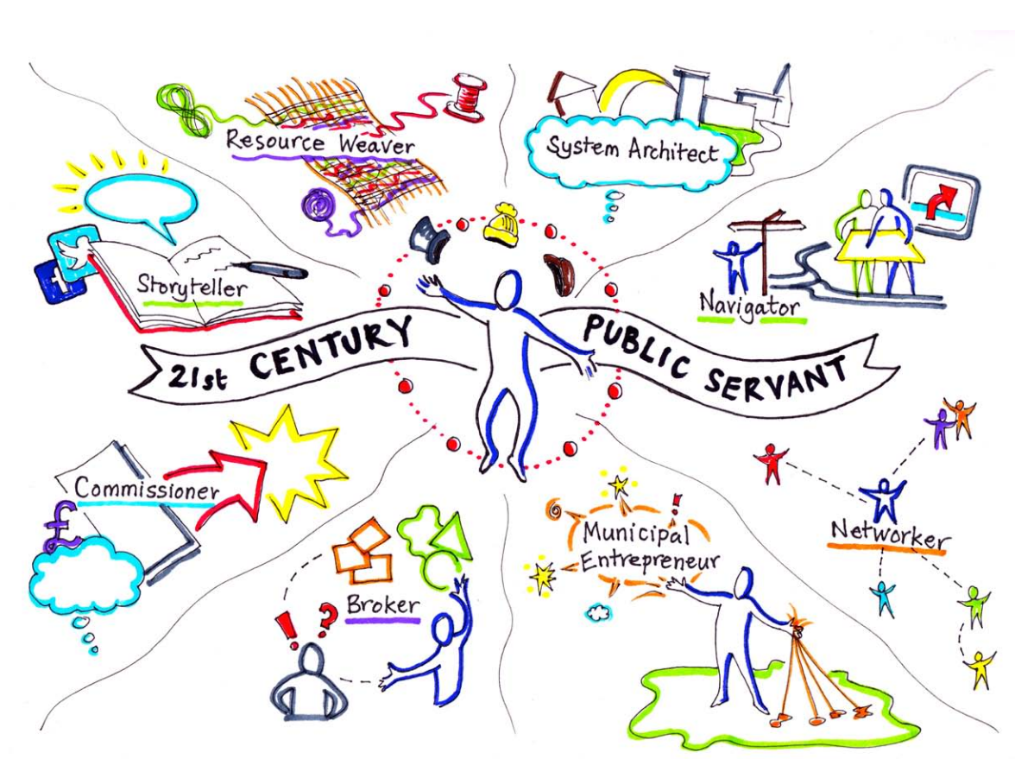
Bridging activity
Notes:
Nicola
https://www.birmingham.ac.uk/Documents/college-social-sciences/public-service-academy/news-events/2014/21-century-report-28-10-14.pdf

Slide 24


Leading CLD
Looking forward to sessions three and four – sense check
  Self-evaluation framework
  Change management
  Policy deep dive – Scottish Attainment Challenge/Community Empowerment
  Managing and leading in inter-agency settings
  Input from experienced CLD leaders
  Our approach – inputs alongside continual reflection and activities
Notes:
Susan

Slide 25


I-develop and Slack
Notes:
Does anyone still need access??

Slide 26
See you soon!
Thursday 28th April
Notes:
Susan/Mandy - round up, thanks and looking forward to day two – further inputs re. Policy, poss HMI

Slide 27
Education Scotland
Denholm House
Almondvale Business Park
Almondvale Way
Livingston EH54 6GA
T +44 (0)131 244 5000
E enquiries@educationscotland.gsi.gov.uk
For Scotland's learners, with Scotland's educators
Notes:
This is a back cover page in blue. You may edit the address if needed only. It can only be once and at the end of the PowerPoint presentation. Use the corresponding blue internal and back pages if you are using this page.

