Slide 1

PDA Supporting Adult Literacies Learning (SALL)
Adult Learning Coordinator

Slide 2

Who is High Life Highland
High Life Highland is a charity registered in Scotland, formed on the 1st October 2011 by The Highland Council. HLH develops and promotes opportunities in culture, learning, sport, leisure, health and wellbeing across nine services throughout the whole of the Highlands, for both residents and visitors.

Slide 3
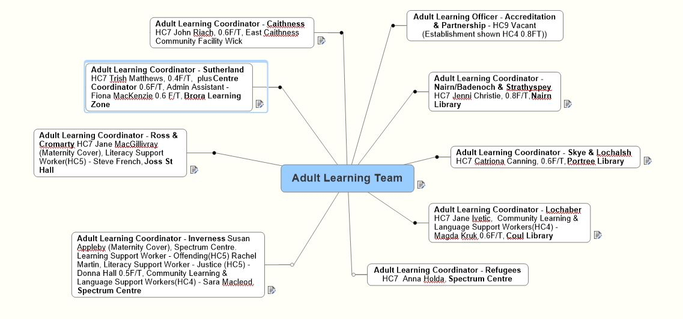
Highland Adult Learning Team 2021

Slide 4
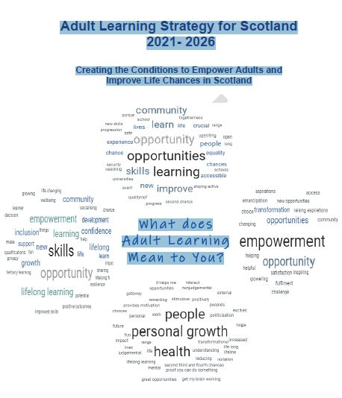

Slide 5
What is the Adult Learning Offer
Learning Streams | Core Plans | Example Activities Indoor/Outdoor; 1to1/group using risk assessments
PLANNING (ADULT 2020-23) | 9 Needs Analysis (1 for each CPP/Hub) 9 Partnership Development (1 for each CPP/Hub) 7 Workforce Development plans (1 each ALC) | Consultation/Focus groups/Partner feedback Attending local planning meetings Training sessions/Team meetings
GET INVOLVED (ADULT 2020-23) | Get Ready to go digital (face to face) ESOL and family Supporting Adults to help the Children | Basic ICT skills Cooking Group Using Google Classroom Activity packs
GET ON (ADULT 2020-23) | Go Digital for Learning (Online) ESOL and Work Recognising achievement | Core skills Hobbies & Interests Learning for work Celebration of learning including Local events & Highland wide event SQA
GET HEARD (ADULT 2020-23) | Go Digital for Life ESOL and Community Developing Reading, Writing and Numeracy | Saving money online Connecting with family and friends online Language Café Reading Group

Slide 6

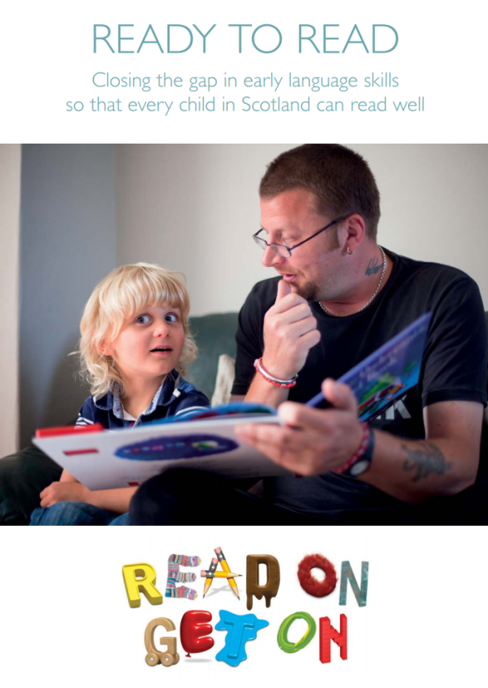
https://www.youtube.com/watch?v=Orb6xXPPBKo
Being able to read well is vital for a child’s prospects at school and in life. Yet one in five children growing up in poverty in Scotland leaves primary school unable to read well.
This helps explain the persistent educational divide in Scotland that, each year, prevents thousands of our poorest children from fulfilling their potential.
Notes:
I’m starting with something that is slightly off-topic…
This video was made by Save the Children for a campaign called ‘Read on Get On’ in 2014 which aimed to get all children in Scotland reading well by the time they left primary school.
The video was not created with an adult literacies focus but I think it demonstrates what the experience of someone who doesn’t read and write well might be like – the written word is all around us, all the time. The campaign also highlights the link between educational attainment, or low levels of literacy, and poverty. Deprivation is an indicator of need, and this helps us to identify how we begin to target our provision.

Slide 7
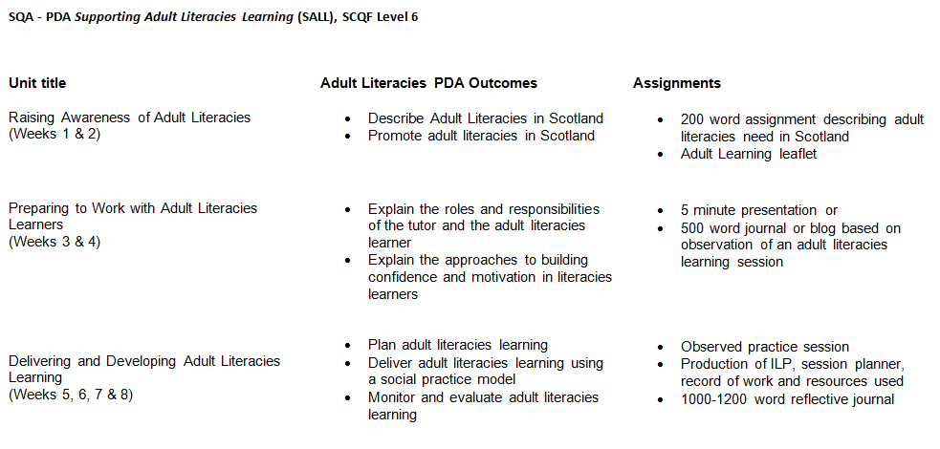
Notes:
Welcome and introductions – what brings you here? Why have you chosen to take part in this training?
SALL outcomes and assignments
Highlight the following forms (sent by email), complete and return by email:
Permissions
SQA Registration

Slide 8
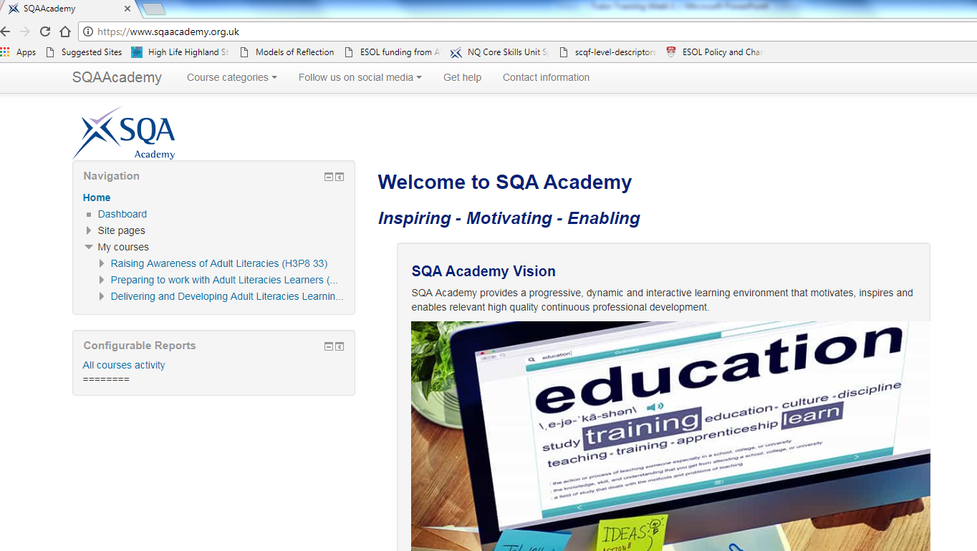
Notes:
SQA Academy
Google Classroom – enrolment keys and instructions on how to make an account

Slide 9
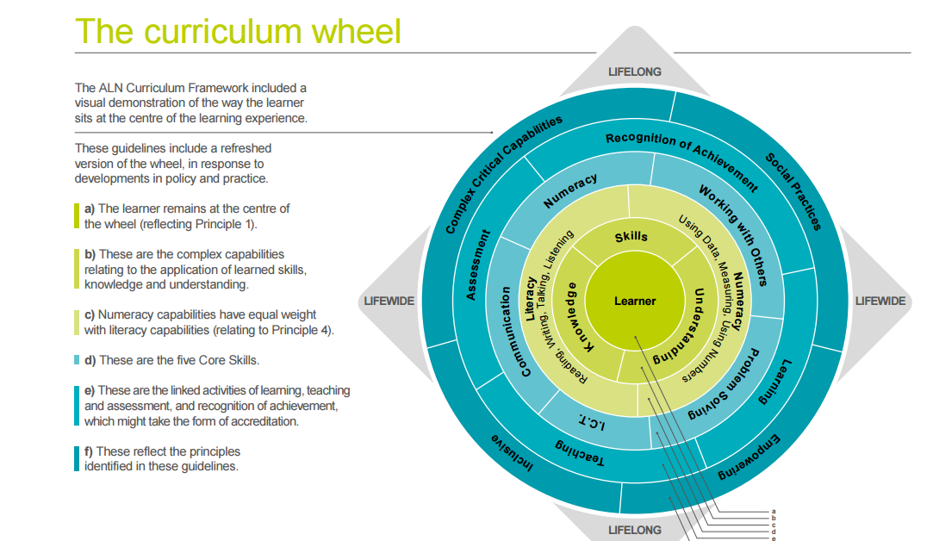
Activity 1 – The Literacies Wheel
Notes:
Google Classroom resource – wheel worksheet
From the time you got up this morning, to now, what activities have you carried out that require skills in any of these areas. An example to get you started: using PowerPoint (ICT), and presentation skills (communication).
Feed back to the group – group discussion.
SQA Academy videos 2, then 1.
What areas of the wheel were described in the videos? Add to the flipchart.

Slide 10
Activity 2 – The level of need among the working age population in Scotland
The Scottish Survey of Adult Literacies in Scotland
(2009)
73.3% | a literacies level recognised internationally as appropriate for a contemporary society
26.7% | may face occasional challenges and constrained opportunities due to their literacies practices
3.6% 1 in 28 | face serious challenges in their literacies practices
! Consider the term ‘occasional challenges and constrained opportunities’
What might this mean for adults in Scotland?
Notes:
Reveal title only, then discuss:
In groups, guess the percentage of the population who a) have an appropriate level of literacies for contemporary society; b) face occasional challenges and constrained opportunities; c) face serious challenges in their literacies practices.
Reveal answers.
Google Classroom – discuss the terms used in the report.

Slide 11
Defining Adult Literacies
The current definition of Adult Literacies Learning in Scotland:
“[…] adults are able to read, write and use numbers effectively in order to handle information, communicate with others, express ideas and opinions, make decisions and solve problems, as family members, workers, citizens and lifelong learners.”
Adult Literacies in Scotland 2020 (ALiS 2020), 2010
“Teaching should be focused on the application of skills and knowledge, not simply their acquisition.
“The focus in the guidelines is on learners applying their knowledge – whether in the workplace, family or community.”
- Adult Literacy and Numeracy Curriculum Framework, 2010
Notes:
SQA ‘s handouts 1 and 2 – on Google Classroom
Group discussion

Slide 12

A deficit Model for Teaching and Learning
Notes:
What do you think a ‘deficit model’ might be?

Slide 13
Defining Adult Literacies
The current definition of Adult Literacies Learning in Scotland:
“[…] adults are able to read, write and use numbers effectively in order to handle information, communicate with others, express ideas and opinions, make decisions and solve problems, as family members, workers, citizens and lifelong learners.”
Adult Literacies in Scotland 2020 (ALiS 2020), 2010
“Teaching should be focused on the application of skills and knowledge, not simply their acquisition.
“The focus in the guidelines is on learners applying their knowledge – whether in the workplace, family or community.”
- Adult Literacy and Numeracy Curriculum Framework, 2010
Notes:
Going back to our definitions of adult literacies learning –
In what ways does this definition inform the way we deliver adult literacies learning in Scotland?
How does this differ from a deficit model for teaching and learning?

Slide 14
Adult Literacies in Scotland 2020 (ALiS 2020)
A ‘Social Practice’ Approach to Literacies Learning
“Literacies development extends beyond the acquisition of the skills of reading, writing and using numbers. It is most successfully taught using a "social practice" approach.
This model of delivery emphasises the importance of a learner-centred approach and personal curriculum.
The focus is on how the learner will use the skills, knowledge and understanding of reading, writing and numbers in their everyday lives: with their families, at work, gaining qualifications to progress towards a job, or a better job, and in their communities.
However, the social practice approach is about more than contextualising learning to make it more relevant; it is about learners developing capabilities in making decisions, solving problems and expressing ideas and critical opinions about the world.” (Page 3)
Notes:
Social practice – the opposite of a deficit model

Slide 15
Adult Literacies in Scotland 2020 (ALiS 2020)
A ‘Social Practice’ Approach to Literacies Learning
“Literacies development extends beyond the acquisition of the skills of reading, writing and using numbers. It is most successfully taught using a "social practice" approach.
This model of delivery emphasises the importance of a learner-centred approach and personal curriculum.
The focus is on how the learner will use the skills, knowledge and understanding of reading, writing and numbers in their everyday lives: with their families, at work, gaining qualifications to progress towards a job, or a better job, and in their communities.
However, the social practice approach is about more than contextualising learning to make it more relevant; it is about learners developing capabilities in making decisions, solving problems and expressing ideas and critical opinions about the world.” (Page 3)
Notes:
Refer back to The Wheel – the learner is at the centre; the learning is relevant and can be applied to their day-to-day lives; reading, knowledge, skills and understanding of writing and using numbers are at the core and these, when applied, develop a learner’s capabilities around decision making, problem solving, critical thinking. This is social practice.

Slide 16
Activity 2 – Social Practice
Watch video clip 2 – SQA Academy
What literacy and numeracy skills have the learners been working on?
How have they contextualised this learning?
What broader capabilities do they refer to in the video?
Can you think of another example?
Notes:
Group discussion

Slide 17
Elinet – Literacies and Stigma
https://www.youtube.com/watch?v=ExSxOm-ZHG4
Notes:
Watch Elinet video
Question: what barriers might prevent learners from accessing learning? – Group discussion

Slide 18
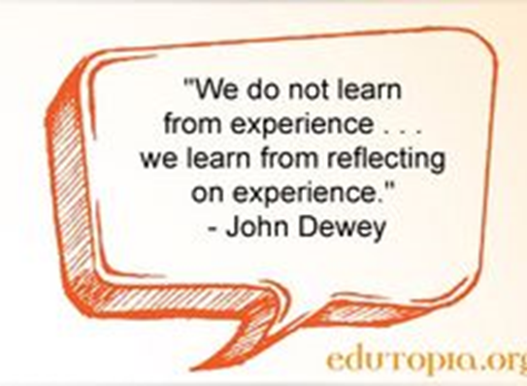
Reflective Practice
Reflective practice, as a concept for learning, is seen as one of the ways that professionals learn from experience in order to understand and develop their practice.
Reflective practice means that we learn by thinking about things that have happened to us and looking at them in a different way, which enables us to take some kind of action.

Slide 19
What is reflective Practice and why is it so important?
What is it? | Why is it important?
- The ability to use past experience to inform future action. - The active allocation of time to this review of past experience. - During this time, the analysis of that past experience to identify its features, components, causes and effects. - The identification of where help, improvement, knowledge or support can be found. - The commitment to an idea that nothing is perfect – everything can be built upon. | You don’t rely on others to learn, grow and improve. You take forward positives and develop strategies to deal with negatives. It adds to your critical thinking toolkit. It improves the experience of those you serve, help or work with through your self-development.

Slide 20
Activity 4
Choose a recent learning activity you have been a part of and complete the steps on the worksheet provided.
Reflective writing makes use of the first person
Reflective writing makes use of the self as an object of inquiry
Incorporates experience as a form of evidence
Notes:
Google Classroom - handout– Reflective Practice
Complete activity individually and feed back to the group
Discuss Unit 1 Assignment and keeping a reflective journal

Slide 21

Questions?
Notes:
Any questions?
Next week’s arrangements

