Slide 1

Our HMIe Inspection Journey
December 2016 – January 2017

Slide 2
How CLD is delivered in our area Our CLD Plan: www.cldplanning.com
Locally the delivery of the Strategic Guidance and Regulations is progressed on behalf of Community Planning West Dunbartonshire (CPWD) through three key partnership models:
Adult Learning Partnership
Youth Alliance
Your Community
The partnerships sit within CPWD arrangements, reporting through the Delivery & Improvement Groups which underpin the partnership and the Single Outcome Agreement.
Notes:
Key Partners from these partnerships/models of delivery were involved at every stage of the process including the initial meeting with the lead inspector.
The challenge of the initial meeting was ensuring it was the appropriate people round the table with a limit on the numbers at the inspectors request.

Slide 3

How prepared were we?
Notes:
HAZELS INPUT: Self evaluation is embedded in our practice. Strong focus on improving service following last inspection (2010). Priority to improve on 1.1 and5.10. Developed systems and processes to improve service.
Staff training has been focused on the new QI’s, embedding Policy in practice, planning in partnership (outcome focussed). Staff systematically gather evidence and save to a project evidence folder. Partners supported to develop 3 yr plans including the performance and quality assurance of plan. Conducted mock inspection work annually as part of self evaluation to check our readiness and to monitor and improve our services.
Created PROJECT FOLDERS TO Gather evidence:
Evidence folders for Key pieces of work should provide robust evidence illustrating the quality of the work and should include these documents (which are identified within workers IWP).
Plan: Explaining the Difference Logic Model or Weavers Triangle
Implementation plan with roles/responsibilities & timescales (if appropriate)
Reports
Case studies/personal statements
Stats (for project)
Evaluation results (for project, including What’s Changed for You reports)
These folders should only have most recent copies and not previous drafts of any paperwork!

Slide 4
The journey
Notification
Initial meeting with inspector
Inspection Paperwork
Strategic Inspection
Place Based Inspection
Challenges
Surprises
Notes:
Notification: Initial notification to Senior staff to develop a plan of action, this was then cascaded to operational staff and partners. Felt this approach could minimise any stress/panic reactions. Better organised.
Initial meeting with inspector - Limit and choose the key staff for the initial meeting with the inspector.
Inspection paperwork – planning meetings with structured action log with clear work allocation – who, where, when etc …..
Strategic Inspection - Restructure resulting joining up with other services and departure of key CLD staff. Senior Management team is a mix of CLD, Employability and financial Inclusion backgrounds but with a wealth of experience in strategy and audit processes.
Place based inspection - the choice of preferred place was discussed from the outset following notification, ensuring we had rationale for this and the evidence to back it up. Having a good base and working relationships with the partners in the area , and people who know the area and its demographics extremely well helped. Keep asking if they have all the evidence they need!
Challenges: Notice period for place based included 4 public holidays over the Christmas period and most activity groups off for holiday period – additional few days given to provide place based inspection documents but no extension to notice period. This had slight impact on timetabling.
Surprises: Guidance advises that MI will chair initial meetings of both inspections but this wasn’t quite what happened in our place based inspection when it was passed over to our manager. Discussion also covered some areas previously discussed.

Slide 5
The evidence
Action Log
Focus Groups
Briefing Notes
Gather the evidence
Indexing
Notes:
Action log: created a structure of identifying what was needed , when and person responsible. Weekly meetings involving key staff to review.
Focus Groups: One person responsible for emailing invites and collating responses.
Briefing Notes: briefing note required for Inspector but for Strategic inspection focus groups we created a simple to understand participant brief to prepare them.
Gathering the evidence: For the strategic based inspection it was important that we had up to date evidence to substantiate any claims made. For focus groups in both parts of the inspection, the lead person collated the evidence and updated the briefing note. All evidence was then saved to a central folder.
Indexing: An evidence log was created for both parts of the inspection process. Once all the evidence was collated in the appropriate folders, it was indexed and added to the log.
For the strategic inspection, each statement made in the self evaluation was copied onto the evidence log under the corresponding heading , linked to QI and indexed, ie file ref 1 with the evidence sub-indexed, ie 1.1, 1.2. The focus groups on the timetable and corresponding evidence was indexed, ie focus group number 1 with the evidence sub-indexed, ie 1.1, 1.2. Inspection evidence required by inspectors on initial day of visit was also added to this evidence log.
When complete, all the evidence was then copied into a central folder and saved onto a pen drive along with a copy of the evidence log for each of the inspection team.

Slide 6
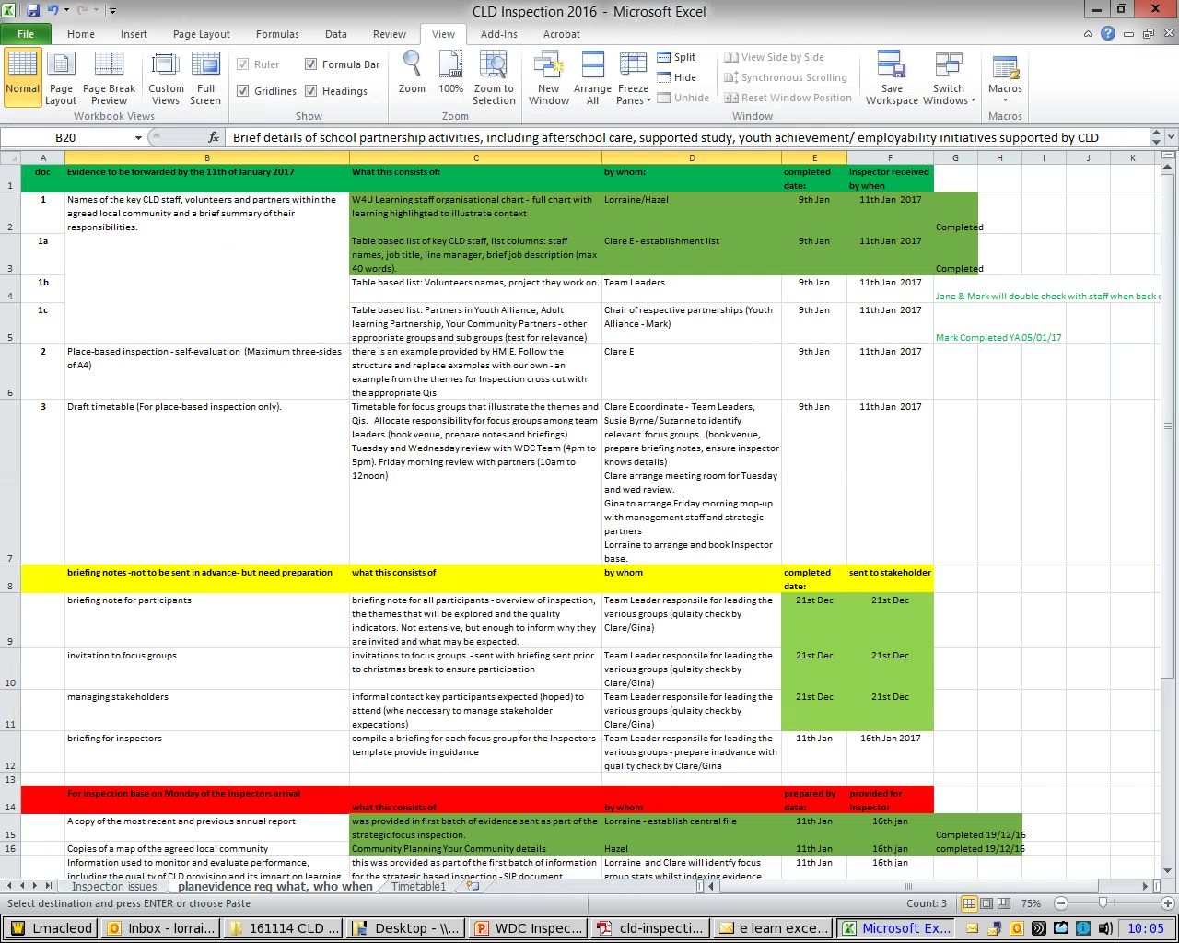
Action Log

Slide 7
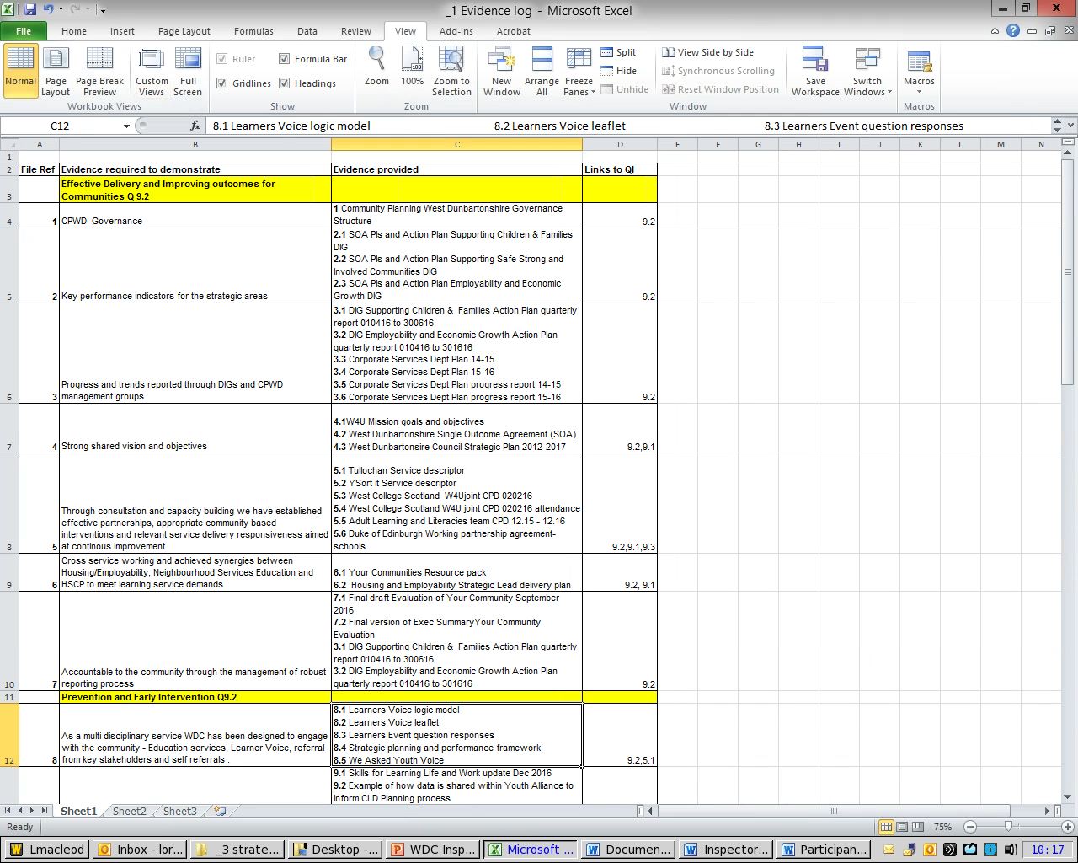
Strategic Inspection Evidence Log – Self Evaluation Statements

Slide 8
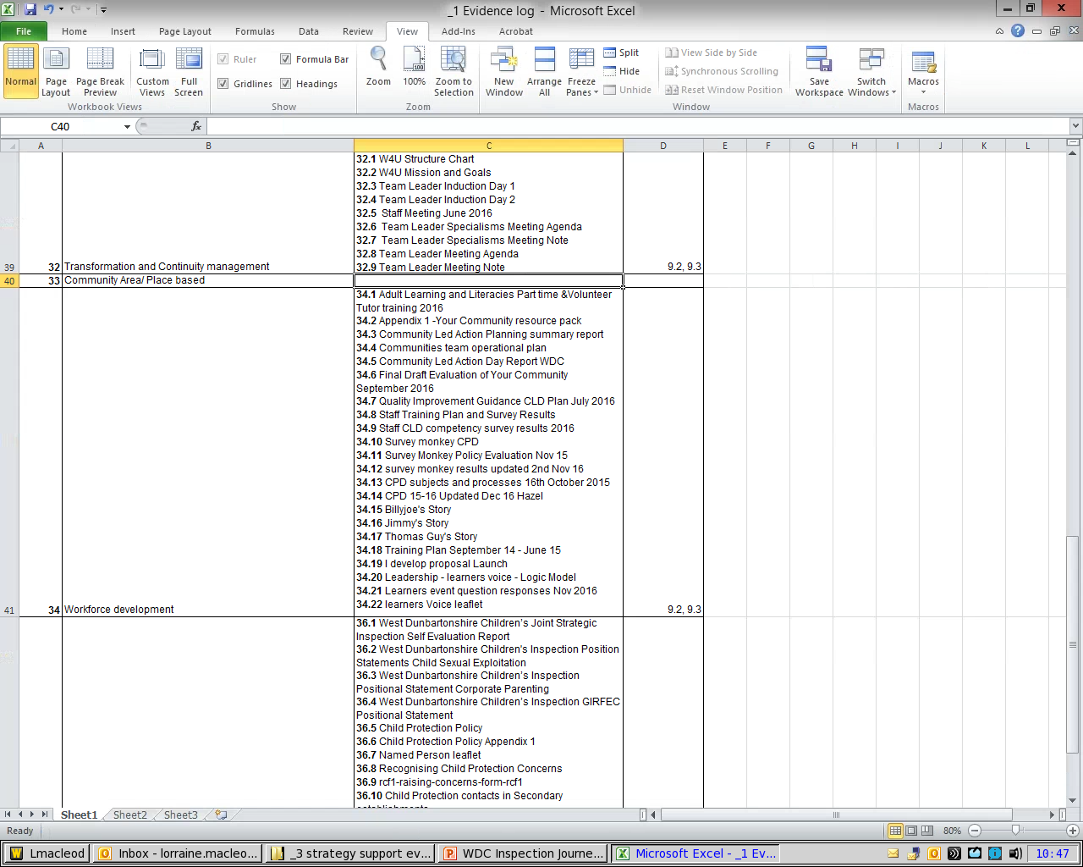
Strategic Inspection Evidence Log – Focus Groups

Slide 9
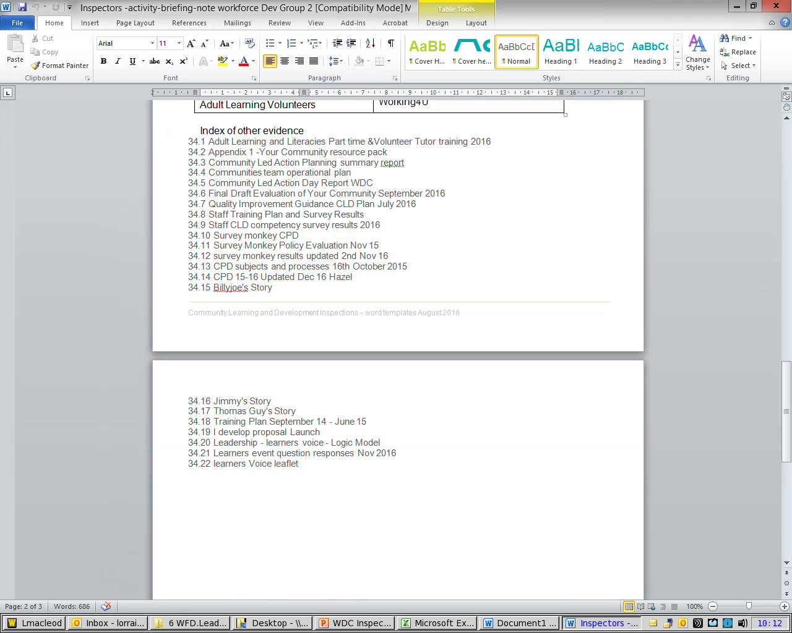
Strategic Inspection – Briefing Note evidence list

Slide 10
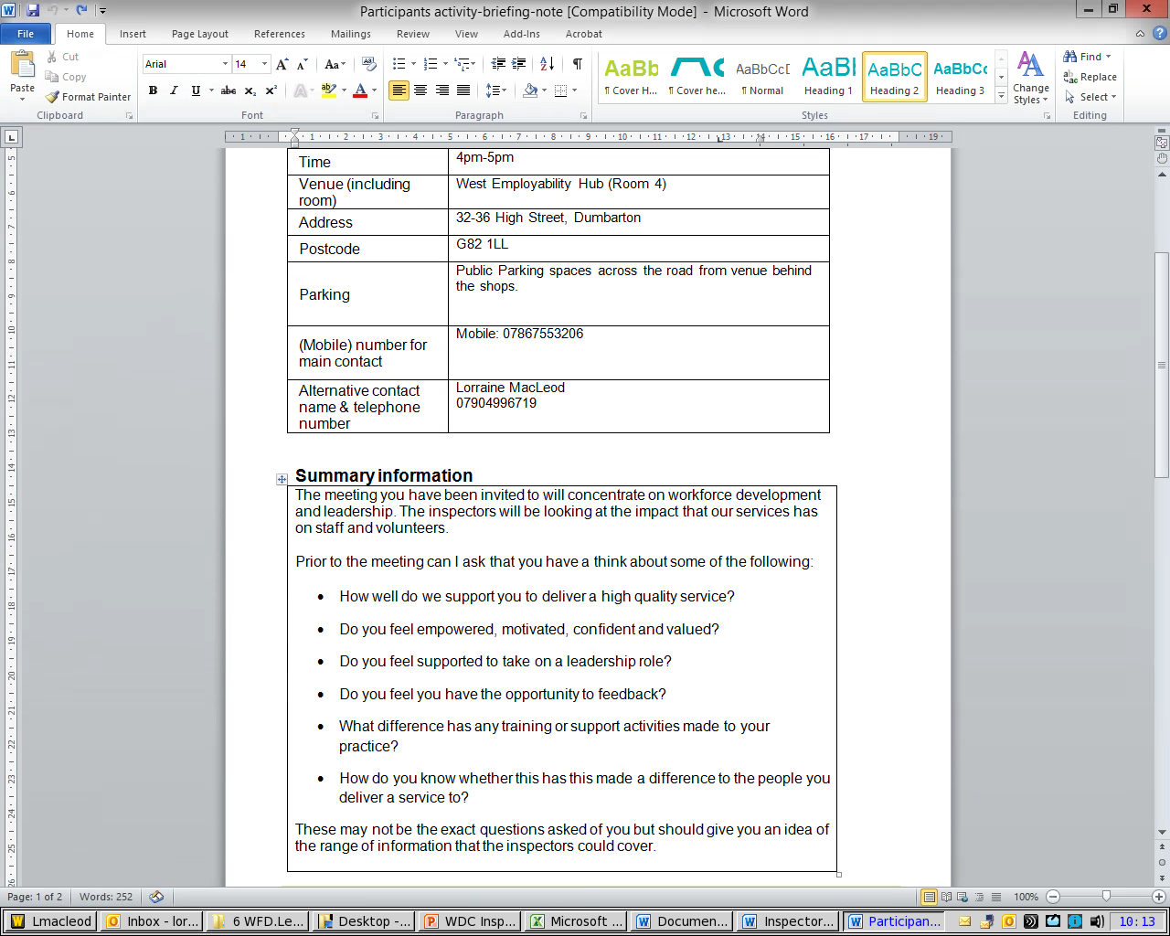
Strategic Inspection - Focus Group Participant Brief

Slide 11
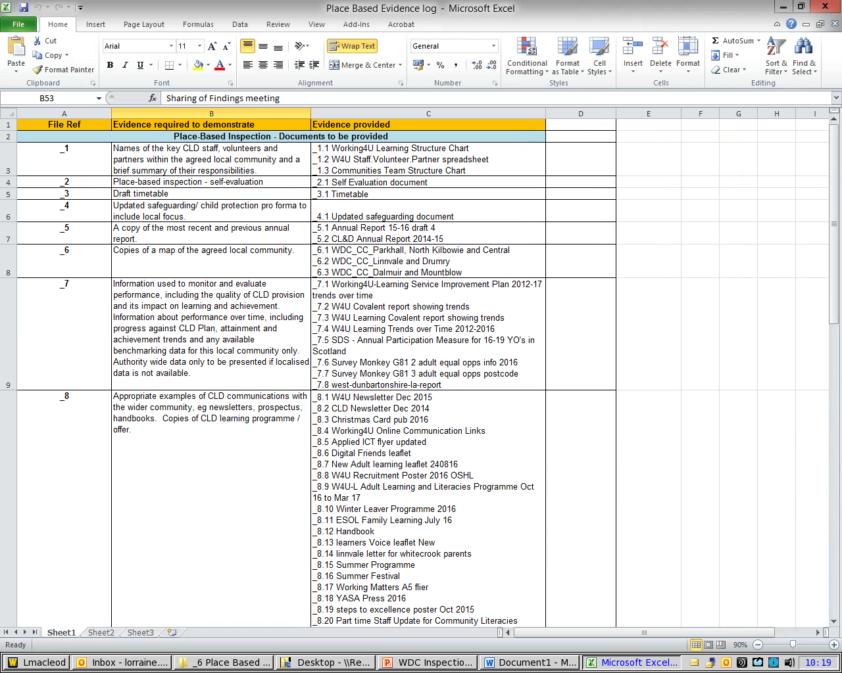
Place Based Inspection Evidence Log – documents

Slide 12
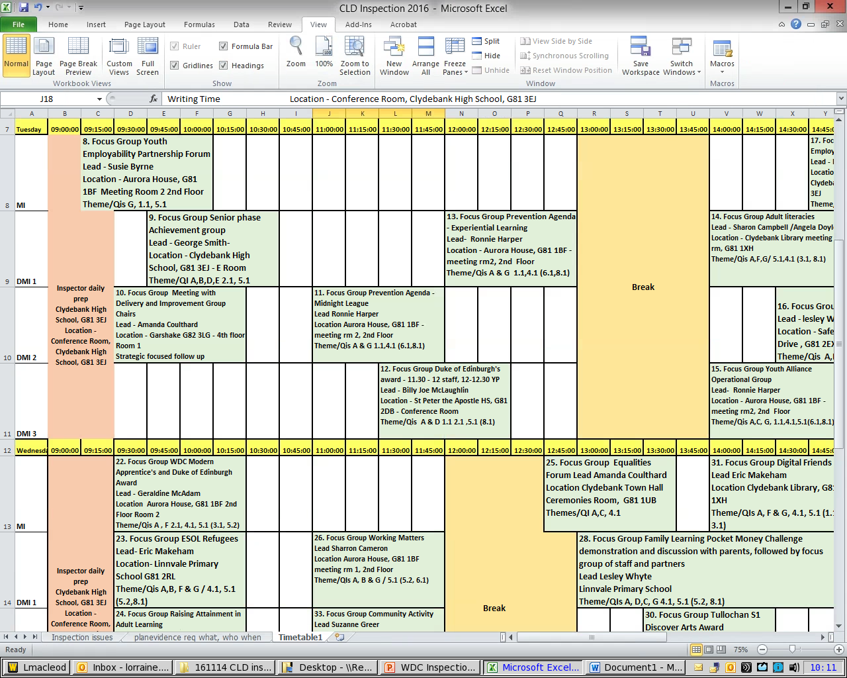
Place Based Inspection Timetable – numbered for evidence index

Slide 13
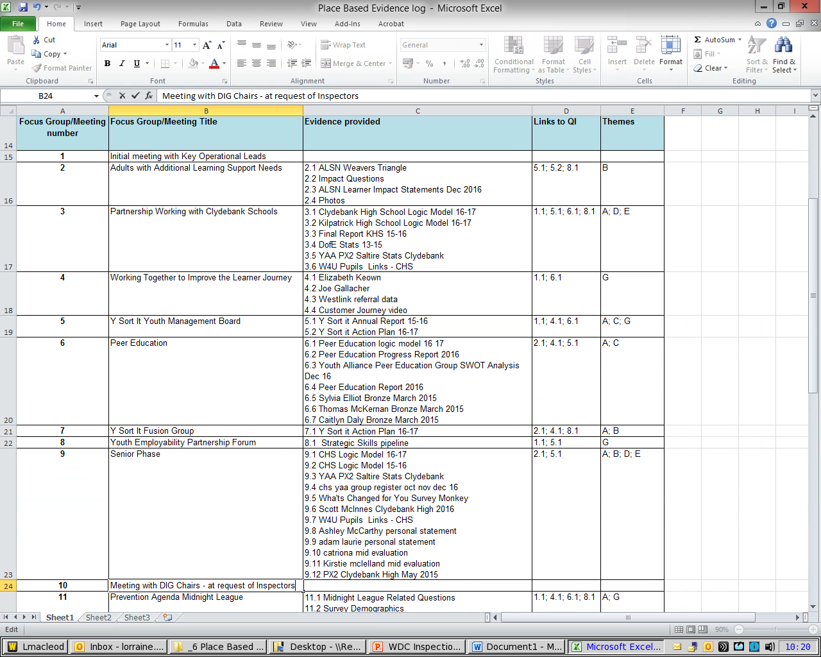
Place Based Inspection Evidence log – Focus Groups

Slide 14
The Results!
Improvements in performance | good
Impact on the local community | good
Delivering the learning offer with learners | very good
Leadership and direction | very good
Report published 14th March 2017
https://education.gov.scot/other-sectors/community-learning-and-development/688100
Lessons Learned?
Notes:
Now that we have received the published report, we can review the process and look at lessons learned and any required improvements. But given the learning achieved already by going through the process, I think we can look forward to future Inspections with significantly increased confidence

Slide 15

Notes:
Ultimately if you ensure that your practice follows the CLD competencies guidance and you self evaluate using HGIOL&DIC then you are ¾ of the way there. The rest is just pulling it all together in the format laid out in the most recent inspection guidance briefing.

Slide 16

Any questions?

