Slide 1
place standard tool for community engagement Planning for community engagement in East Dunbartonshire

Slide 2
community Empowerment (Scotland) Act 2015: Community Planning
Local Outcomes Improvement Plan
Locality Plans
Community engagement to underpin this
Community Planning
The Act outlines how public bodies must work together and with the local community to plan for, resource and provide or secure the provision of services which improve local outcomes in a local authority area, with a view to reducing inequalities.

Slide 3
Council
Health Board
Police Scotland
Scottish Fire and Rescue Service
Scottish Enterprise
Above Community Planning Partners (CPP) must:
Facilitate community planning
Take all reasonable steps to ensure the CPP conducts its functions effectively and efficiently
Cooperate with each other, share information, contribute funds, staff and other resources
Take account of the Local Outcomes Improvement Plan in carrying out their functions

Slide 4
By October 2017, we must publish:
Local Outcomes Improvement Plan (East Dun)
Place plan Hillhead/Harestanes
Place plan Auchinairn
Place plan Twechar
Place plan Lennoxtown
Notes:
CPP must identify each locality in which persons residing there experience significantly poorer outcomes which result from socio-economic disadvantage than—
(a) those experienced by persons residing in other localities within the area of the local authority, or
(b) those experienced generally by persons residing in Scotland.
Must provide a description of the proposed improvement outcome and a timescale. Must take account of resident ‘needs and circumstance’ – must take account of ‘any representations’.
Progress reports due each August (4 months after end of reporting year in April).

Slide 5
Inequality in east dunbartonshire
East Dunbartonshire remains relatively less deprived in contrast to other Scottish local authorities with the majority of East Dunbartonshire datazones falling into the least deprived of the SIMD.
East Dunbartonshire has the second highest proportion of areas in Scotland that are not deprived according to SIMD
Although East Dunbartonshire as a whole is relatively less SIMD deprived than other local authorities in Scotland, there are specific areas within East Dunbartonshire that fall below the Scottish average.

Slide 6
Inequality in east dunbartonshire
Hillhead remains the most deprived area in East Dunbartonshire, however SIMD ranks in the area have improved with two datazones moving out of the 5% most deprived in Scotland and the majority of Datazones showing less deprivation than in SIMD 2012.
East Dunbartonshire has 7 Datazones in the most deprived 25% in Scotland, these are located in Hillhead, Auchinairn, Lennoxtown and Kirkintilloch West
SIMD identifies areas with deprivation
Notes:
it does not mean that everyone living in the area is deprived, likewise there may be deprived people living in areas that are not deprived according to SIMD

Slide 7
why place Plans?
Working within a locality or neighbourhood enables the CPPs and their partners to tackle inequalities for communities facing disadvantage
Focussed
Can uncover hidden disadvantage
Often easiest for community bodies to participate in community planning at locality or neighbourhood level.

Slide 8
place Plans should
Be based on those areas which achieve poorer outcomes locally and/or nationally
Outline the outcomes and the improvements to be achieved in the locality
Be based on significant engagement
Notes:
A locality plan is a plan setting out for the purposes of the locality to which the plan
relates—
(a) local outcomes to which priority is to be given by the community planning
partnership with a view to improving the achievement of the outcomes in the
locality,
(b) a description of the proposed improvement in the achievement of the outcomes,
and
(c) the period within which the proposed improvement is to be achieved.
(4) In preparing a locality plan, a community planning partnership must consult—
(a) such community bodies as it considers appropriate, and
(b) such other persons as it considers appropriate.

Slide 9
Engagement for Locality Plans
Using a variety of methods and techniques of engagement based on individual need
Place Standard Tool
http://www.placestandard.scot/#/home
Training opportunities

Slide 10
Outcomes of the process
Consistent good quality information which can be shared
Communities identifying solutions as well as raising issues
An opportunity to involve people in community development work

Slide 11
PLACE STANDARD TOOL

Slide 12
What are we asking for?
Support to speak to people
Support to communities to identify potential projects
Support to reach vulnerable groups
Data to be collected online or on paper, evidence photographed
Use your judgement on how best to engage and report back
Once the findings are in and the plans are written, support to carry them out

Slide 13
Place Standard Tool
The Place Standard is a way of assessing places. Whether the place is well-established, undergoing change, or is still being planned, the tool can help you.
The Place Standard tool provides a simple framework to structure conversations about place. It allows you to think about the physical elements of a place (e.g. its buildings, spaces, and transport links) as well as the social aspects (e.g. whether people feel they have a say in decision making).
The tool provides prompts for discussions, allowing you to consider all the elements of place in a methodical way. The tool pinpoints the assets of a place as well as areas where a place could improve.

Slide 14
Place Standard Tool Hillhead
East Dunbartonshire Community Planning Partnership asked residents of Hillhead to take part in the
shape services in their area by sharing their views and experiences.
The ‘How Good is Our Place Survey?’ workshops were held in various locations in Hillhead to giving local people the opportunity to have their say on a variety of issues affecting their neighbourhood and offering them the chance to become involved in future service delivery.
The aim is to find out in detail what people like about living in Hillhead/places area and what they would like to see improve. Residents will be asked about a range of local facilities and amenities including cycle paths, public transport, the attractiveness of buildings, play and recreational spaces, housing and much, much more. The Community Planning Partnership Workshops are taking place on:

Slide 15
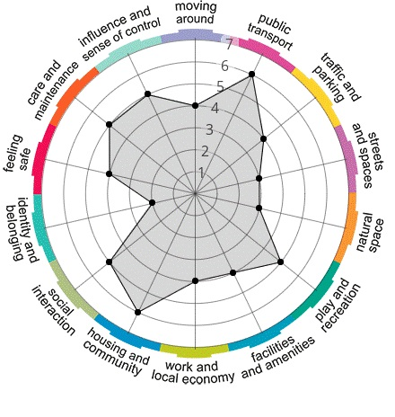

Slide 16
Any Questions???

