Slide 1
East Dunbartonshire CLD Plan
22 March 2017
Kirsty Anderson
Policy Adviser
Community Planning and Partnerships Team

Slide 2
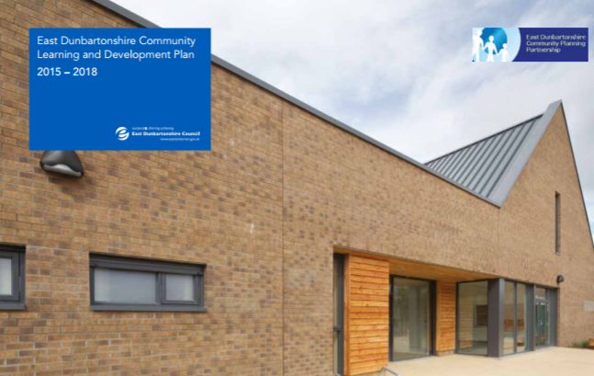
East Dunbartonshire CL&D Plan
Working together to achieve the best with the people of East Dunbartonshire.
East Dunbartonshire Local Outcomes
Improvement Plan

Slide 3
Defining CL&D
A common defining feature is that programmes and activities are developed in dialogue with communities and participants…[CLD's] main aim is to help individuals and communities tackle real issues in their lives through community action and community-based learning.
Working and Learning Together (SG, 2004)
Community Learning and Development includes programmes of learning and activities designed with individuals and groups to promote the educational and social development of those individuals and groups.
CLD (Scotland) Regulations 2013

Slide 4
Defining CL&D – Strategic Guidance for CPPs
Community development (building the capacity of communities to meet their own needs, engaging with and influencing decision makers)
Youth work, family learning and other early intervention work with children, young people and families
Community-based adult learning, including adult literacies and English for speakers of other languages (ESOL)
Volunteer development;
Learning for vulnerable and disadvantaged groups in the community, for example, people with disabilities, care leavers or offenders;
Learning support and guidance in the community.

Slide 5
Strategic Guidance for CPPs – Policy Goals
Ensure communities across Scotland – particularly those who are disadvantaged – have access to the CLD support they need.
Strengthen coordination between full range of CLD providers, ensuring CPPs, Local Authorities and other providers of public services respond appropriately to the expectations set by the CLD Strategic Guidance.
Make the role and contribution of CLD more visible.

Slide 6

CLD Values
The CLD Standards Council has set the following values for CLD that have been adopted in the plan:
Self-determination
Inclusion
Empowerment
Working collaboratively
Promotion of learning as a lifelong activity

Slide 7
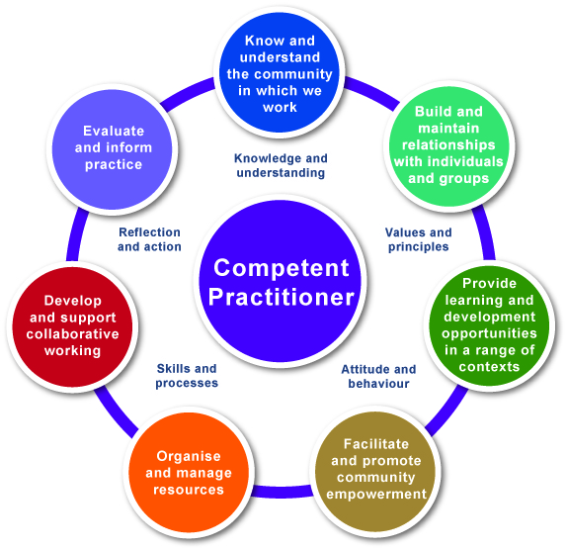
The Competent CLD Practitioner

Slide 8
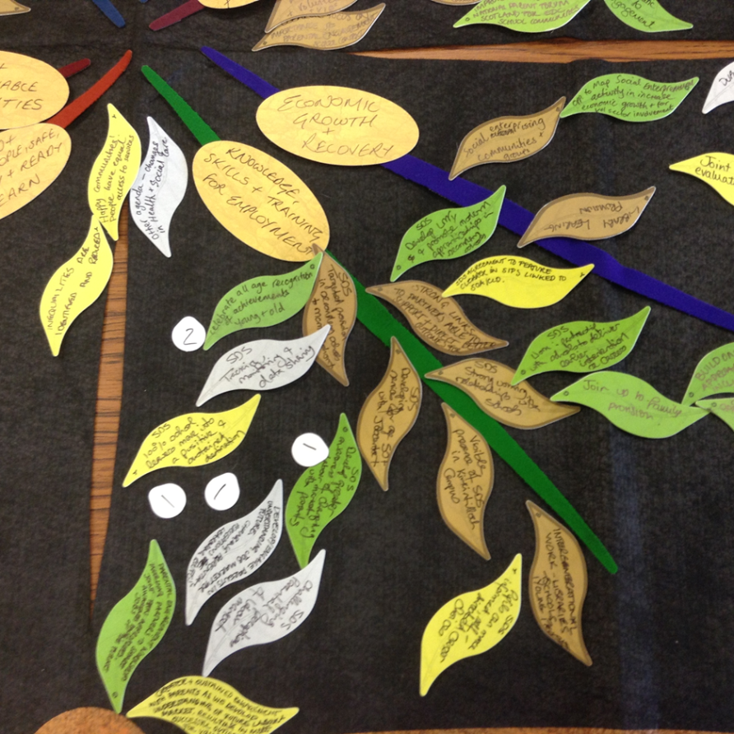
How the Plan was Developed
CLD Partnership formed in August 2014
Community Audit with CLD Partnership undertaken using Ketso
Community Audit with CLD practitioners via focus group
CPD Sub Group and regular survey on learning needs / programme of integrated workforce development (CLD Learning Lunches)
Consultation on Action Plans

Slide 9
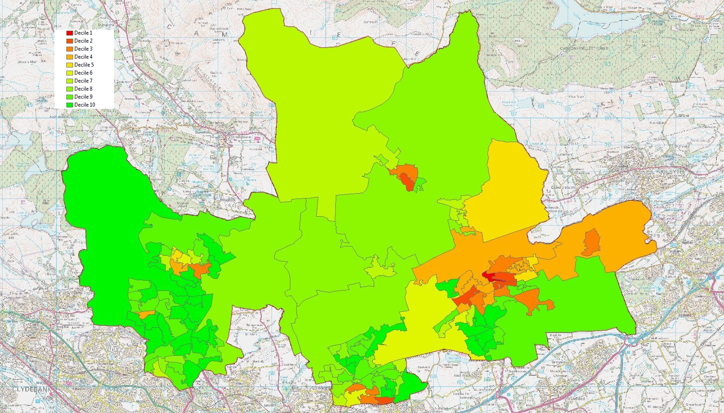
Socio Economic Disadvantage

Slide 10
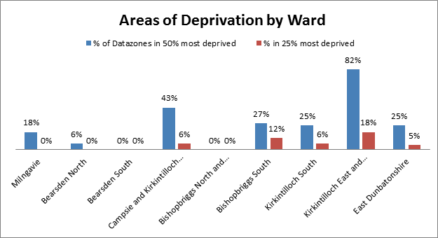
Socio Economic Disadvantage

Slide 11
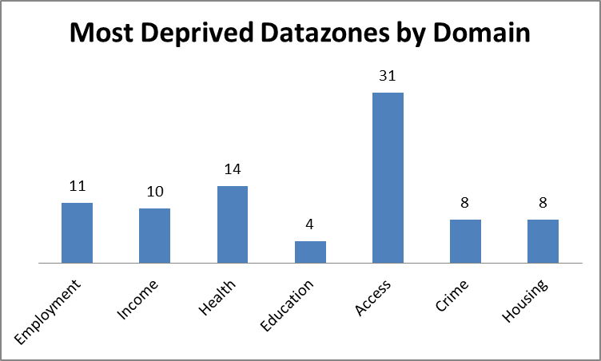
SIMD 2016
ED relatively less deprived in contrast to other Scottish local authorities - majority of datazones falling into the least deprived of the SIMD.
ED has the second highest proportion of areas in Scotland that are not deprived according to SIMD
Specific areas within East Dunbartonshire that fall below the Scottish average.
7 Datazones in the most deprived 25% in Scotland, these are located in Hillhead, Auchinairn, Lennoxtown and Kirkintilloch West

Slide 12
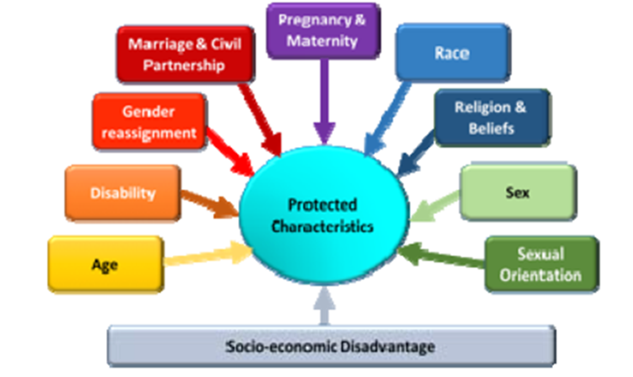
Overcoming Barriers to Participation

Slide 13
Community Bodies as Partners
Community Planning Partners must consider which community bodies are likely to be able to contribute to community planning having regard in particular to which of those bodies represent interests of persons who experience inequalities of outcome which result from socio-economic disadvantage
Notes:
In this section community bodies don’t need to be formally constituted and cam include communities of interest or place. Section 4 (6) (b)

Slide 14
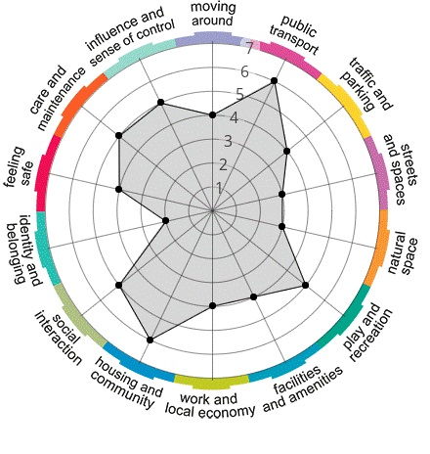
Place Plans
Engagement for place plans ongoing in areas of most need ‘Place areas’ using variety of methods e.g. Place Standard Tool
Looking for communities to identify solutions as well as raise issues
Council and partners supporting communities to identify potential projects / reach vulnerable groups / build community cohesion
Annual Reporting

Slide 15
Action Plans
CLD Partnership working
Place Approach to Joint Resourcing
Community Capacity Building
Improving Employability
Skills for Learning, Life and Work
Financial Inclusion
Early Years and Supporting Families
8. Reducing Health Inequalities

Slide 16




Consultation
Engagement
Do you want pizza or pasta? (closed)
What would you like for dinner? (open)
Co-production
Sustainability
Let’s make a meal together
Let me show you how to cook.

Slide 17
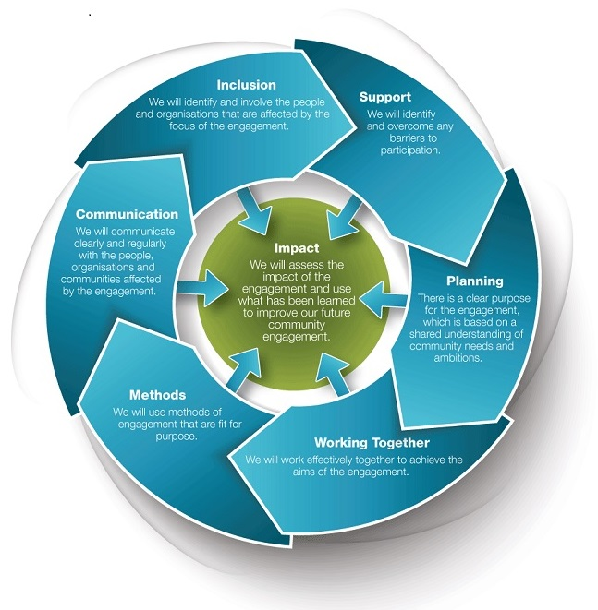


Slide 18

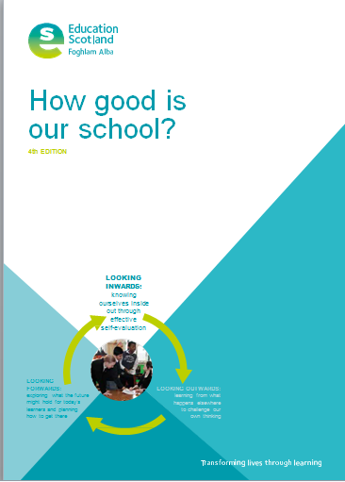

How Good is the Learning and Development in our Community?
Questions:
What difference are you making?
How do you know?
Who do you ask?
Are you capturing all of the significant impacts you make?

Slide 19
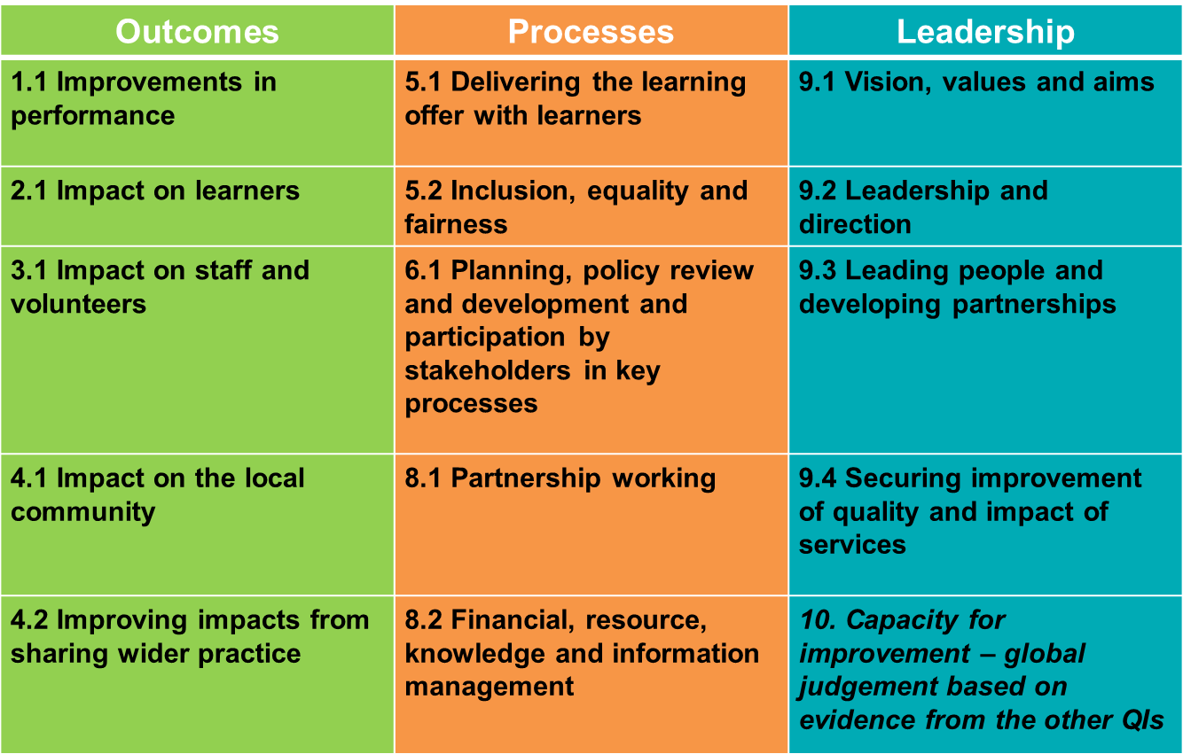
Reduced Number of QIs
Notes:
How good is the Strategic Leadership of CLD? Includes Impact on Staff / Volunteers
Place Based Inspection:
1.1 Improvements in Performance
4.1 Impact on the Local Community
5.1 Delivering the Learning Offer with Learners

Slide 20


Capacity Building
Research: Survey of Community groups and Support Agencies – Skills and Involvement
Assessment: Findings and Conclusions on Levels of Capacity and Support
Planning: Outcomes and Action Planning

Slide 21
Next Steps
Engagement for 2018 CLD Plan (builds on place plans)
Community Engagement Strategy / Participation Model for Council / CPP
Community Empowerment (Scotland) Act 2015 – participatory budgeting / participation requests / asset transfer requests.
SCDC Pilot – take stock and roll out to all Community Councils – peer support network / up-skilling
Keys to Learn Programme / Youth Voice
CLD Learning Lunches into Partnership Workforce Development Programme
Improving / Joining-up CLD Communications e.g. Newsletters

Slide 22
Any Questions?
Kirsty.Anderson@eastdunbarton.gov.uk
KIRSTY ANDERSON
Policy Adviser (CLD)
Community Planning and Partnerships Team

