Slide 1

Quality matters and blended learning
Dr John Laird HMI
Ann Kivlin HMI
Notes:
This is a front cover page and can only be used once. Use the corresponding green internal and back pages if you are using this page. You may add a title and a subtitle if needed only. Do not add anything else or move elements around.

Slide 2
Purpose/Aims
  Participants will
  have a clearer view of some helpful lessons from research
  understand some techniques to support engagement
  be aware of more tools for evaluating sessions or short strands of work
  be more confident about longer term evaluation of impact
  see some useful and simple apps and frameworks to support the work
Notes:
This is an internal page in green and can be duplicated to create additional pages. Always keep the heading and footer as shown. Use the corresponding green front and back pages if you are using this page.

Slide 3
Starting point…
  In the chat, try to rate your level of confidence in the key areas we will be looking at, scale of 1 – 10 with
  1 being NOT CONFIDENT AT ALL,
  10 being ENTIRELY CONFIDENT
  A - Engagement
  B - Evaluation of sessions with clients
  C - Evaluating the longer term work
  D - Useful apps that might support your work
Notes:
This is an internal page in green and can be duplicated to create additional pages. Always keep the heading and footer as shown. Use the corresponding green front and back pages if you are using this page.

Slide 4
Your responses
  So your response in the chat will look like this (…with your own ratings…)
  A 6 , B 2 , C 4 , D 7
Notes:
This is an internal page in green and can be duplicated to create additional pages. Always keep the heading and footer as shown. Use the corresponding green front and back pages if you are using this page.

Slide 5
Starting point…
  In the chat, try to rate your level of confidence in the key areas we will be looking at, scale of 1 – 10 with
  1 being NOT CONFIDENT AT ALL,
  10 being ENTIRELY CONFIDENT
  A - Engagement
  B - Evaluation of sessions with clients
  C - Evaluating the longer term work
  D - Useful apps that might support your work
Notes:
This is an internal page in green and can be duplicated to create additional pages. Always keep the heading and footer as shown. Use the corresponding green front and back pages if you are using this page.

Slide 6
Lessons from research - summary
  Longer term, remote, distance or blended learning has the potential to be as effective as traditional campus based learning
  There are different approaches to planning, so although pedagogy/andragogy is similar, elements of learning design help make the engagement better
  Younger, disadvantaged or less motivated learners in all instances engage less readily, and are more likely to drop out
Notes:
This is an internal page in green and can be duplicated to create additional pages. Always keep the heading and footer as shown. Use the corresponding green front and back pages if you are using this page.

Slide 7
Lessons from research - delivery
  Sessions should generally be shorter, and broken up into different activities
  It should be a mixture of synchronous and asynchronous activity
  Simpler explanations, clear personal feedback and good and regular questioning supports learning
  Creating a social experience is helpful for motivation, retention and genuine learning
  Active engagement is key
Notes:
This is an internal page in green and can be duplicated to create additional pages. Always keep the heading and footer as shown. Use the corresponding green front and back pages if you are using this page.

Slide 8
Engagement – techniques for more
  Plan activities, not just input, and share the plan at the beginning or ideally in advance
  Support as much co-creation as practical
  Model assignments or tasks by showing examples so they see what they are working toward
  Use as many questions in your interactions as practical – even simple ones
  Build in feedback within your session
Notes:
This is an internal page in green and can be duplicated to create additional pages. Always keep the heading and footer as shown. Use the corresponding green front and back pages if you are using this page.

Slide 9
Engagement – practical tips
  Be aware of the physical, social or family circumstances of participants, clients may not be able to talk easily, text may in some cases be easier
  Encourage camera use if practical
  Use the chat – often, and ideally with closed or short answer questions (yes/no, agree/disagree, rate 1-10)
  Explore wellbeing, general development
  … How do you feel/what do you think.. Use wordclouds but if you are using apps, tell them in advance
Notes:
This is an internal page in green and can be duplicated to create additional pages. Always keep the heading and footer as shown. Use the corresponding green front and back pages if you are using this page.

Slide 10
Summary of key points
  Research tells us planning your engagement is different, and is more focused on the whole experience rather than the one session
  Planning should include shorter sessions or sessions broken up into activities
  Successful approaches rely on active engagement
  Build feedback and evaluation techniques into your planning
Notes:
This is an internal page in green and can be duplicated to create additional pages. Always keep the heading and footer as shown. Use the corresponding green front and back pages if you are using this page.

Slide 11
Thoughts…
  In the chat box now, rate from 1 to 10 how useful this initial input has been as an introduction to research, planning and engagement,
  1 - being not useful or already known
  10 - being insightful and has things I can use
Notes:
This is an internal page in green and can be duplicated to create additional pages. Always keep the heading and footer as shown. Use the corresponding green front and back pages if you are using this page.

Slide 12
Evaluation of sessions/events

Slide 13
Important health warning…
  The following good practice ideas and technologies can be useful, however, guidance/agreement must be sought from appropriate local authority or governing body, and with due recognition of all safeguarding issues. The examples used have all been seen in use in practice, and are likely to be regarded as safe and appropriate, however, you should check.
  The varied responses to Zoom are a good example…
Notes:
This is an internal page in green and can be duplicated to create additional pages. Always keep the heading and footer as shown. Use the corresponding green front and back pages if you are using this page.

Slide 14
Evaluation of sessions/activities
  As always, evaluation and feedback - both ways, to clients and from clients - needs built into your planning
  Ideally you want some mechanism that evaluates satisfaction and learning/progress, and ideally wellbeing
  Online questions/assessment gives greater options for checking learning/progress
  Monitoring satisfaction will give an insight into motivation and engagement
Notes:
This is an internal page in green and can be duplicated to create additional pages. Always keep the heading and footer as shown. Use the corresponding green front and back pages if you are using this page.

Slide 15
Evaluation/feedback – simple ideas
  Red / Amber / Green
  Whilst in a session get the participants to go find a red, amber and green item (cushion, toy, book…whatever). When you gave covered an explanation of a topic, ask them to hold up Green if its clear, Amber of not sure, Red if they still don’t follow. Prize for the most novel coloured item…?
  This approach also encourages camera use.
Notes:
This is an internal page in green and can be duplicated to create additional pages. Always keep the heading and footer as shown. Use the corresponding green front and back pages if you are using this page.

Slide 16
Evaluation/feedback – simple tech
  Use the chat function to ask questions. Ask a few that are yes/no, true/false….
  Prize/recognition for the fastest answer. Ask the question on a slide, tell them its coming, flick to it and see who answers quickest
  Example to follow
Notes:
This is an internal page in green and can be duplicated to create additional pages. Always keep the heading and footer as shown. Use the corresponding green front and back pages if you are using this page.

Slide 17
Question – answer in chat NOW
  Which type of learning means taking place without the tutor present in your own time?
  A - Synchronous
  B - Asynchronous
  Answers in the chat now!
Notes:
This is an internal page in green and can be duplicated to create additional pages. Always keep the heading and footer as shown. Use the corresponding green front and back pages if you are using this page.

Slide 18
For feedback – use emoji's…
  If your platform accommodates them, most people are familiar with emojis and what they mean. They are often called reactions on the more formal platforms.
  There are lots of sites to copy and paste emojis
  Windows key and full stop is often a short cut to bring up the emoji keyboard on PCs, but varies by machine, check the machine your clients are using and google it.
Notes:
This is an internal page in green and can be duplicated to create additional pages. Always keep the heading and footer as shown. Use the corresponding green front and back pages if you are using this page.

Slide 19
Feedback on sessions…post-it style…
  Most platforms have a ‘whiteboard’, sometimes called other things like Jamboard
  There are free versions which can be used for a variety of reasons but one good example is giving post-it style comments
  A simple free version is www.whiteboard.fi
  Allows anonymity, easy to use on a range of devices, responses can be saved
  This can be used for “post-it” style feedback
Notes:
This is an internal page in green and can be duplicated to create additional pages. Always keep the heading and footer as shown. Use the corresponding green front and back pages if you are using this page.

Slide 20
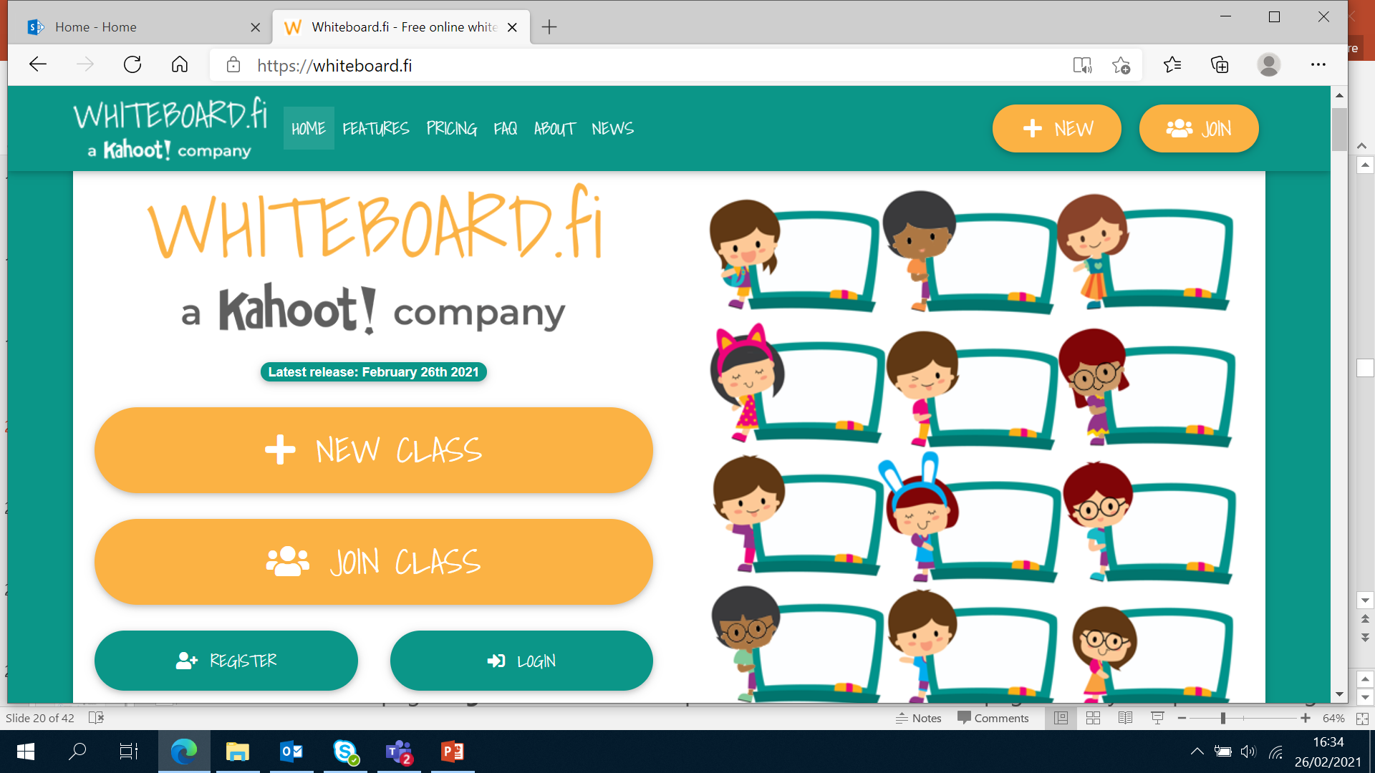
Using a whiteboard…
  Google – whiteboard.fi
Notes:
This is an internal page in green and can be duplicated to create additional pages. Always keep the heading and footer as shown. Use the corresponding green front and back pages if you are using this page.

Slide 21
Live example (brave … huh!)
  Google whiteboard.fi
  Hit “Join Class”
  Put in the code a95h2
  You will then have a whiteboard that the tutor can see, and can chose to share
Notes:
This is an internal page in green and can be duplicated to create additional pages. Always keep the heading and footer as shown. Use the corresponding green front and back pages if you are using this page.

Slide 22
Evaluation – checking understanding
  There are a range of different ways depending upon the platform being used. There are also some useful, often free, and safe platforms that can be used to send questions to laptops / tablets / phones. One example is Socrative. ( www.Socrative.com ) Like several other platforms, it can keep anonymity (GDPR), work on all devices, have a range of functions like questions, votes, wordclouds etc. Functionality is similar to Mentimeter or Kahoot. Its free to use, with reasonable functionality and participant limits.
Notes:
This is an internal page in green and can be duplicated to create additional pages. Always keep the heading and footer as shown. Use the corresponding green front and back pages if you are using this page.

Slide 23
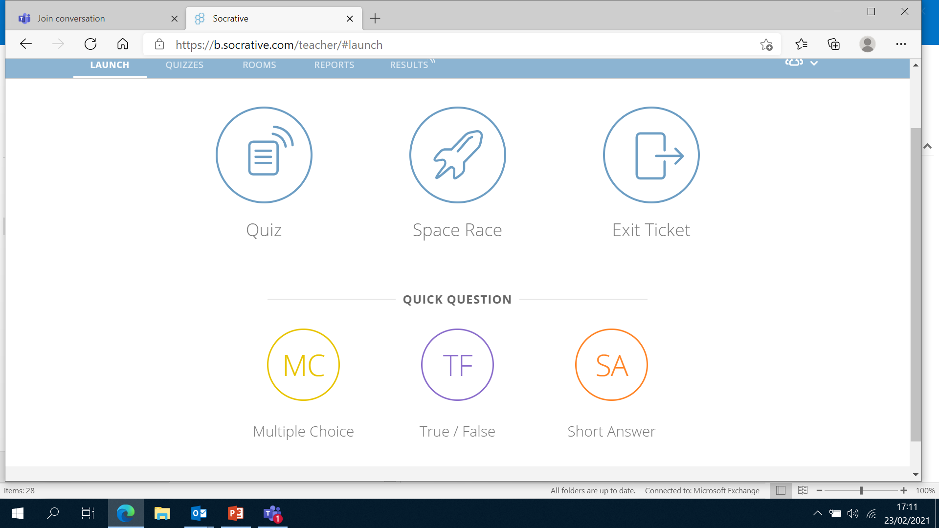
Purpose/Aims
  Participants will
Notes:
This is an internal page in green and can be duplicated to create additional pages. Always keep the heading and footer as shown. Use the corresponding green front and back pages if you are using this page.

Slide 24
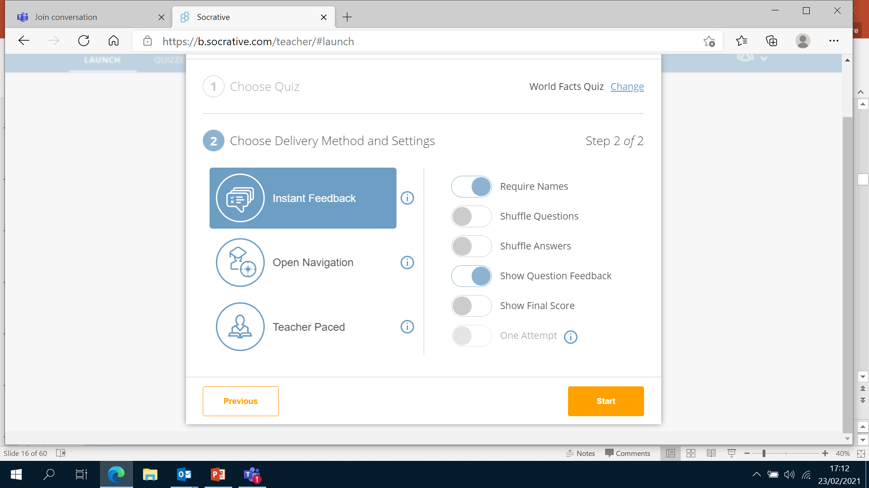
Purpose/Aims
  Participants will
Notes:
This is an internal page in green and can be duplicated to create additional pages. Always keep the heading and footer as shown. Use the corresponding green front and back pages if you are using this page.

Slide 25
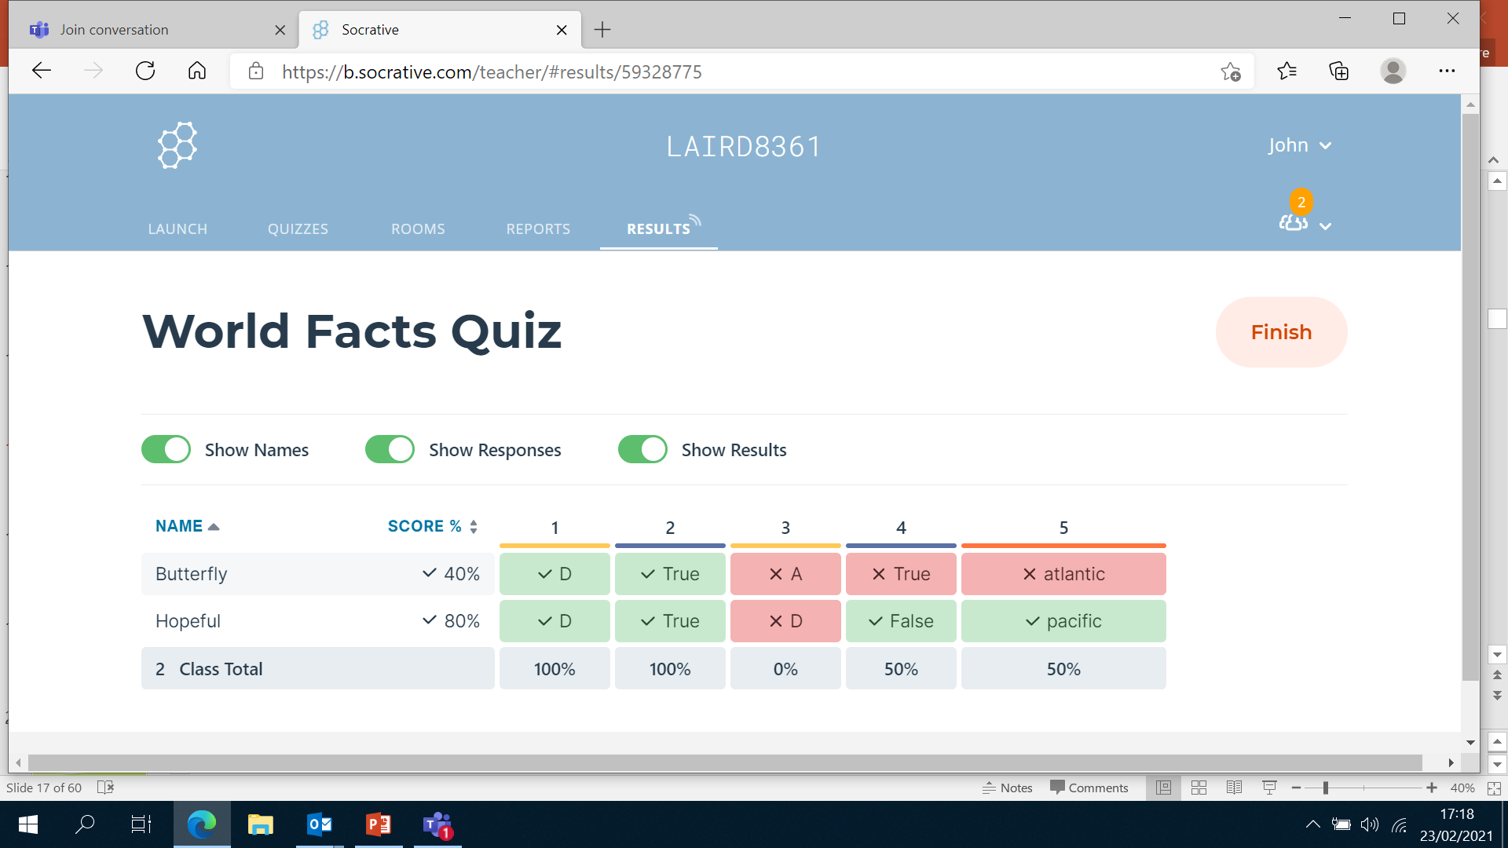
Purpose/Aims
  Participants will
Notes:
This is an internal page in green and can be duplicated to create additional pages. Always keep the heading and footer as shown. Use the corresponding green front and back pages if you are using this page.

Slide 26
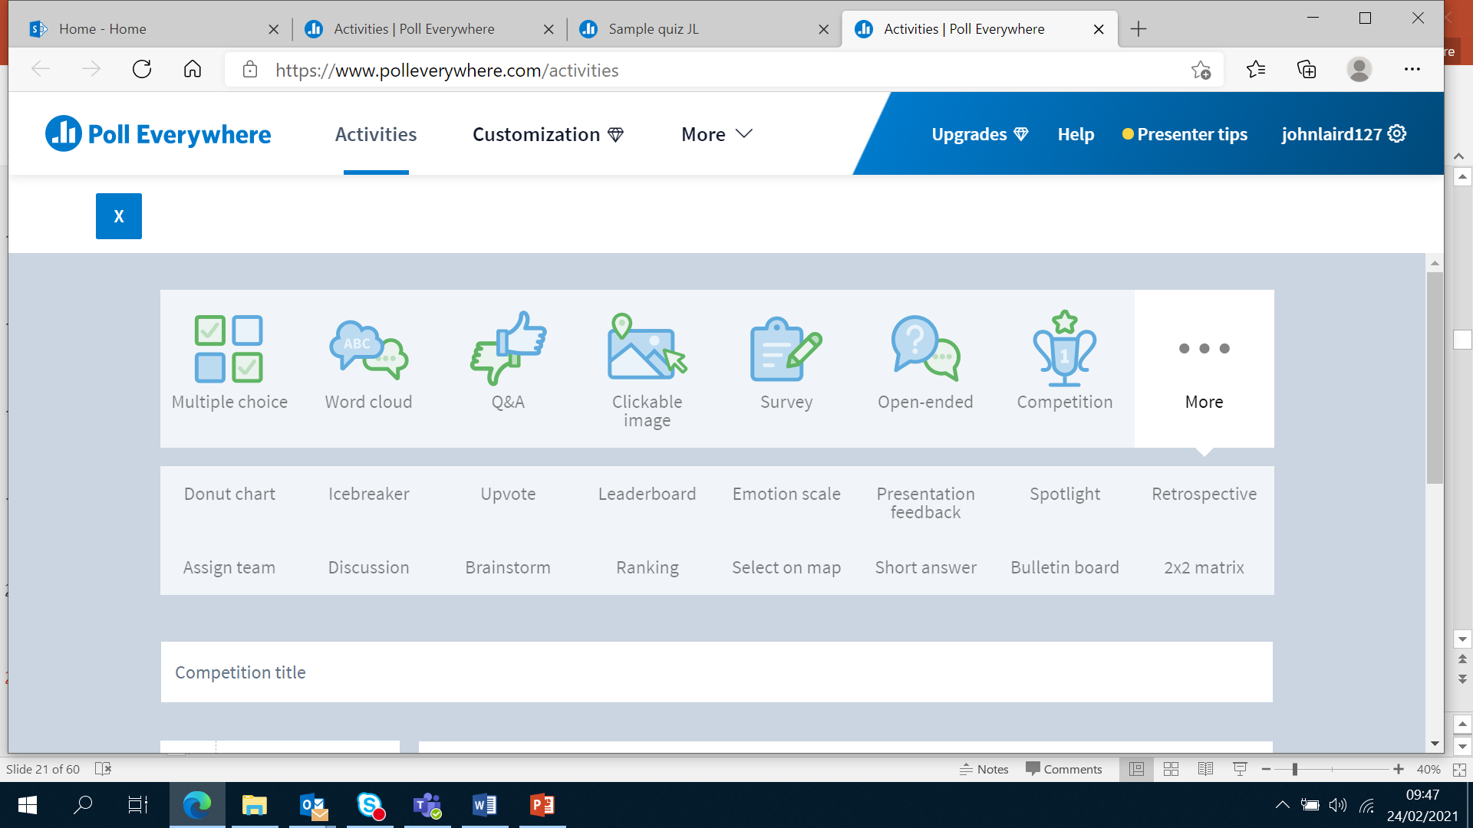
Session topic or course feedback
  Poll Everywhere
Notes:
This is an internal page in green and can be duplicated to create additional pages. Always keep the heading and footer as shown. Use the corresponding green front and back pages if you are using this page.

Slide 27
Feedback on sessions, topics, courses
  Example of apps/software that might help
  Socrative
  Mentimeter
  Kahoot
  Poll everywhere
  Miro
  Mural
Notes:
This is an internal page in green and can be duplicated to create additional pages. Always keep the heading and footer as shown. Use the corresponding green front and back pages if you are using this page.

Slide 28
Community development
  There are a range of other technologies that can support community engagement/development.
  Growing in popularity and being supported by Cosla is CONSUL (consulproject.org).
  A source of helpful resources and advice is Voice
    Support materials (voicescotland.org.uk)
    VOiCE is published by the Scottish Government and is supported by SCDC (www.scdc.org.uk)
  A excellent source of advice on technologies, what to do and what to use is Involve Digital tools for participation: Where to start? | involve.org.uk
Notes:
This is an internal page in green and can be duplicated to create additional pages. Always keep the heading and footer as shown. Use the corresponding green front and back pages if you are using this page.

Slide 29
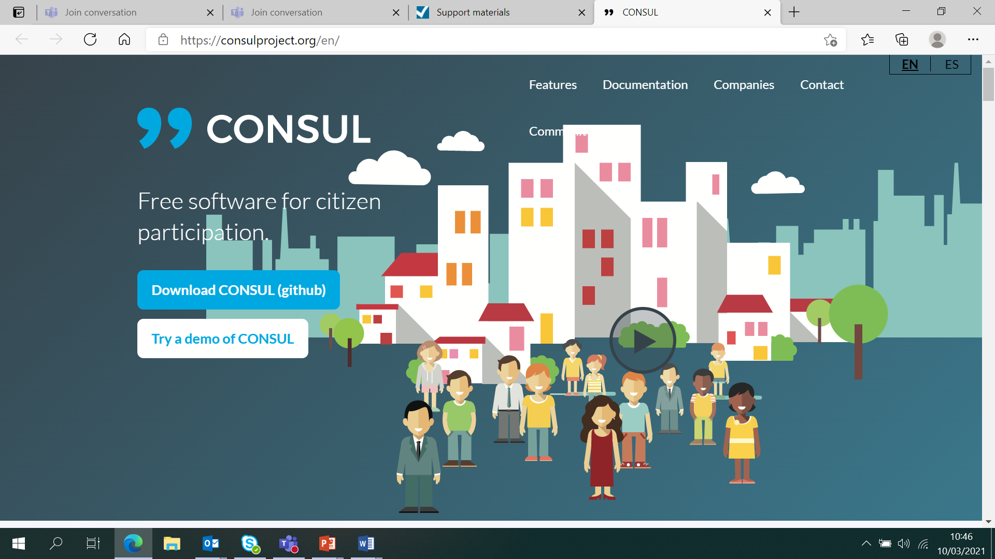
Feedback
  Example of apps/software that might help
Notes:
This is an internal page in green and can be duplicated to create additional pages. Always keep the heading and footer as shown. Use the corresponding green front and back pages if you are using this page.

Slide 30
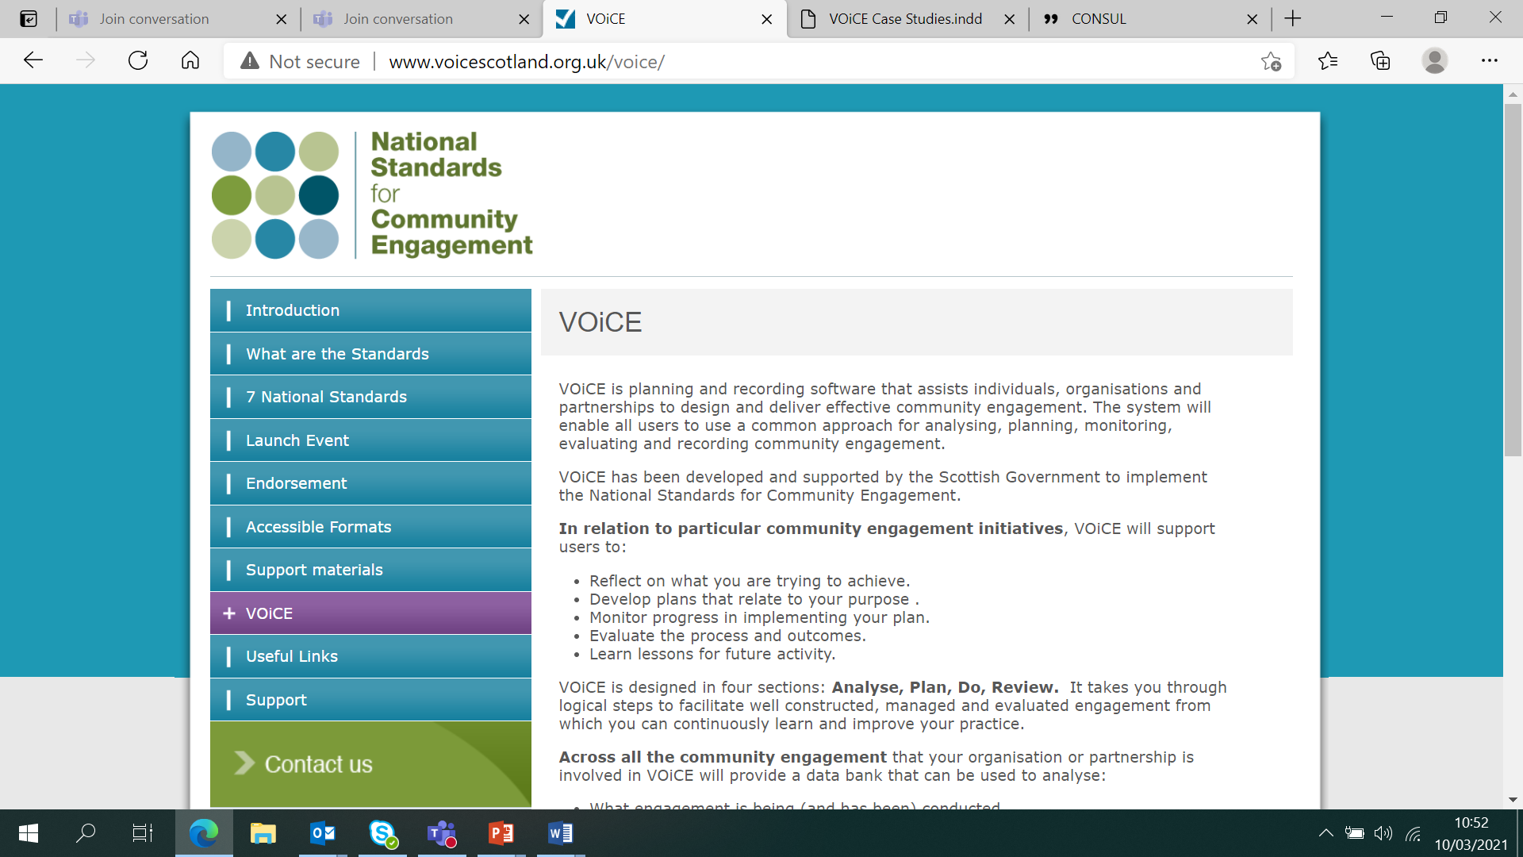
Feedback
  Example of apps/software that might help
Notes:
This is an internal page in green and can be duplicated to create additional pages. Always keep the heading and footer as shown. Use the corresponding green front and back pages if you are using this page.

Slide 31
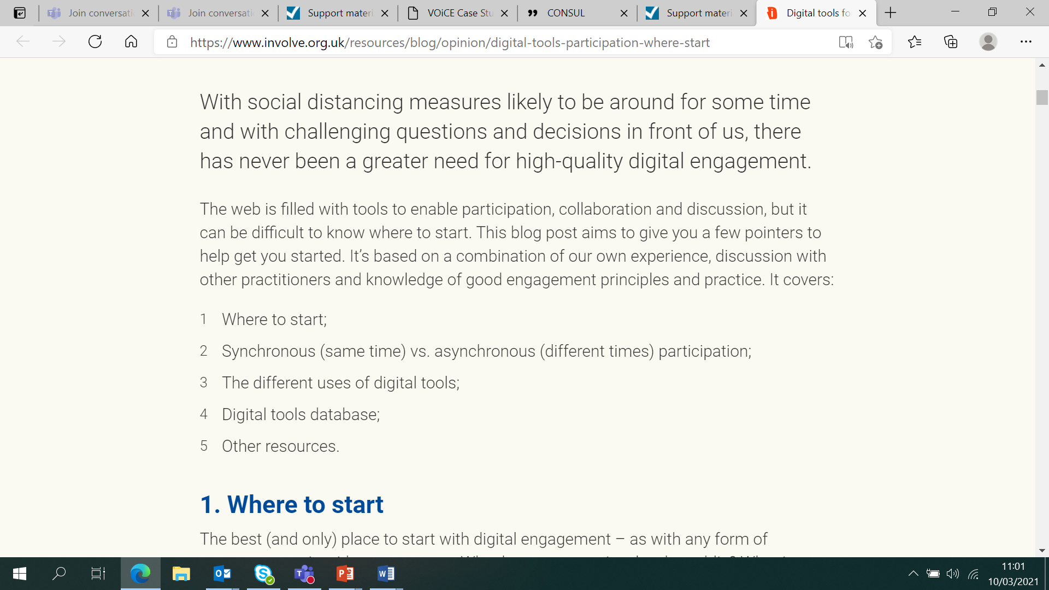
Feedback
  Example of apps/software that might help
Notes:
This is an internal page in green and can be duplicated to create additional pages. Always keep the heading and footer as shown. Use the corresponding green front and back pages if you are using this page.

Slide 32
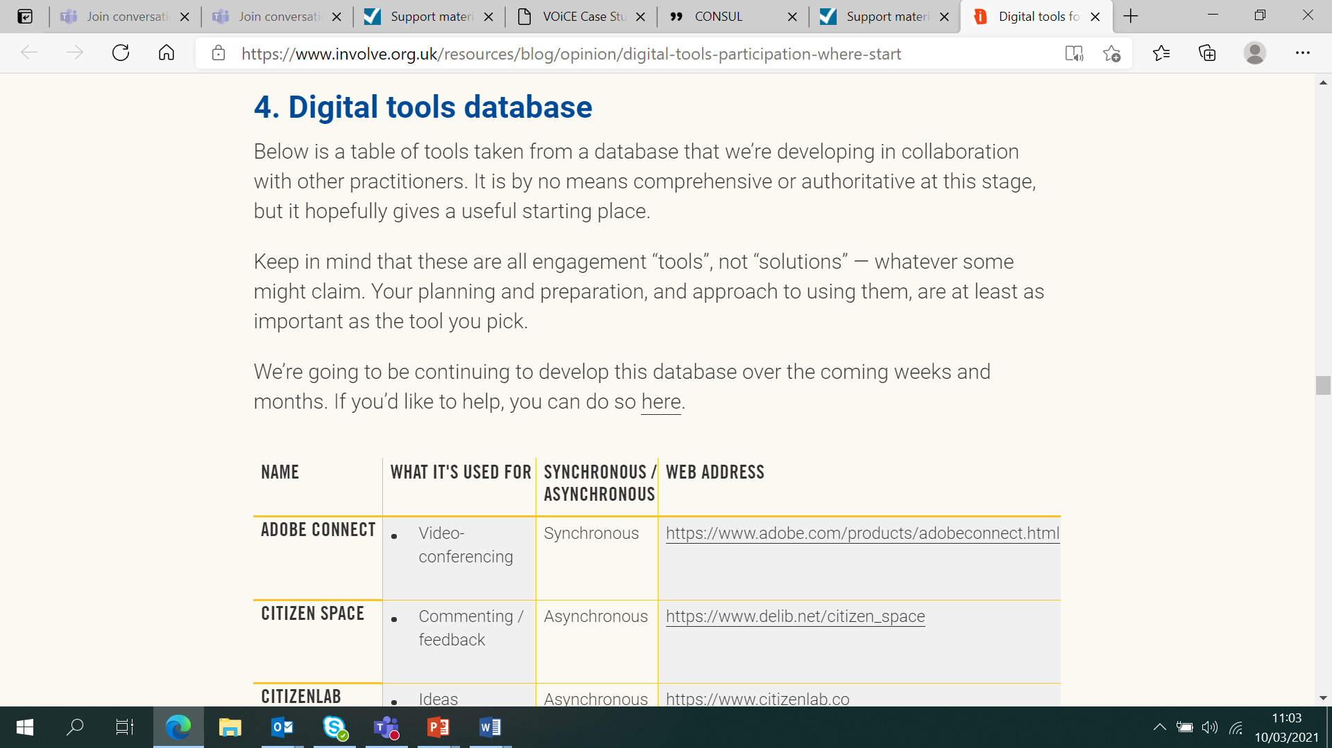
Fe
  Example of apps/software that might help
Notes:
This is an internal page in green and can be duplicated to create additional pages. Always keep the heading and footer as shown. Use the corresponding green front and back pages if you are using this page.

Slide 33
A few related considerations…
  Take guidance from your local authority about what you can/should use
  Generally, don’t be tempted to use common social media, like using facebook rooms – possibility of privacy, inclusion, safeguarding etc. risks
  Careful use of camera needed
  Remember it’s a social experience, engagement and retention rely on this
Notes:
This is an internal page in green and can be duplicated to create additional pages. Always keep the heading and footer as shown. Use the corresponding green front and back pages if you are using this page.

Slide 34
Feedback in the chat now please – just the number for your response
  I knew this feedback stuff already
  I was familiar with some, but these tips are helpful
  These tips are mainly new to me
  This is nearly all new to me and we could do with a little more detail
Notes:
This is an internal page in green and can be duplicated to create additional pages. Always keep the heading and footer as shown. Use the corresponding green front and back pages if you are using this page.

Slide 35
  Substantive evaluation
Notes:
This is an internal page in green and can be duplicated to create additional pages. Always keep the heading and footer as shown. Use the corresponding green front and back pages if you are using this page.

Slide 36
Substantive evaluation
  HGIOCLD? (4th Edition) Fit for purpose
  Being clear about your intentions and planned impact is still central to planning and evaluation
  Safeguarding, inclusion and access need to be considered in a different context
  There are, on the positive side, many simple ways to get feedback as you go along and evaluate wider experiences
Notes:
This is an internal page in green and can be duplicated to create additional pages. Always keep the heading and footer as shown. Use the corresponding green front and back pages if you are using this page.

Slide 37
How Good is our CLD? (4th edition) - DRAFT
  Updated quality improvement framework (draft)
  Currently 16 quality indicators (QIs) in three sections, under six core questions;
  Performance and outcomes
  Management and delivery
  Leadership and direction
  Each QI has three themes each with an illustration of very good and challenge questions.
Notes:
This is an internal page in green and can be duplicated to create additional pages. Always keep the heading and footer as shown. Use the corresponding green front and back pages if you are using this page.

Slide 38
Performance and Outcomes 1. How well does our performance demonstrate positive impacts?
1.1 Performance against aims and targets 1.2 Improvements in equality and equity
Management and Delivery 3. How well are services managed?
3.1 Management and support 3.2 Partnership working 3.3 Sustainable and effective use of resources
Leadership and Direction 5. How effective is leadership at all levels?
5.1 Vision, culture and direction 5.2 Leading people and developing partnerships 5.3 Governance for boards, management committees, trustees
2. How well are outcomes for stakeholders being achieved?
2.1 Empowered communities 2.2 Improving learning outcomes 2.3 Improving life chances 2.4 Impact on supported, funded or commissioned organisations
4. How good is the delivery of key services?
4.1 Delivery of community development 4.2 Delivery of lifelong learning
6. How effective is leadership in improving outcomes?
6.1 Raising standards 6.2 Securing improvement
For Scotland's learners, with Scotland's educators
Do luchd-ionnsachaidh na h-Alba, le luchd-foghlaim Alba

Slide 39
Performance and outcomes - some useful challenge questions:
  How well does our performance demonstrate positive impacts?
  1.1 Performance against aims and targets
  Overall, how well can we demonstrate the collective impact of our work on learners, groups, communities and the wider area? How systematic are we in using this data to inform planning for improvement?
  1.2 Improvements in equality and equity
  How well do we evidence increased life chances for learners including our contribution to closing the poverty-related attainment gap?
  How do we know that we are effectively identifying and addressing barriers to participation? How do we know what is improving and that those that we work with are included and progressing?
Notes:
This is an internal page in green and can be duplicated to create additional pages. Always keep the heading and footer as shown. Use the corresponding green front and back pages if you are using this page.

Slide 40
Some useful challenge questions:
  How well are outcomes for stakeholders being achieved?
  2.2 Improving learning outcomes
  How well is our learning offer for children, young people, adults and families based on their needs and interests?
  How well do we ensure learning programmes are safe and participants feel included and respected?
  2.3 Improving life chances
  How well is our CLD offer enhancing the physical, social and/or emotional wellbeing of participants?
  How successful are we in enabling participants to gain knowledge and skills which best met their aspirations, needs and goals for themselves and for their communities?
Notes:
This is an internal page in green and can be duplicated to create additional pages. Always keep the heading and footer as shown. Use the corresponding green front and back pages if you are using this page.

Slide 41
Leadership and direction - some useful challenge questions:
  How effective is leadership in improving outcomes?
  6.2 securing improvement
  How do we know outcomes for learners and communities are improving as a result of our quality assurance processes?
  How well do we support staff and volunteers to understand their role in quality assurance and engage in regular and robust self-evaluation practice?
  How well do we use research and sharing of effective practice to reflect on and improve our own practice and performance?
Notes:
This is an internal page in green and can be duplicated to create additional pages. Always keep the heading and footer as shown. Use the corresponding green front and back pages if you are using this page.

Slide 42
Further reflections to support improvement
  Do staff and volunteers know enough about…?
  Research and helpful evidence
  Using the technology
  Pedagogy/andragogy/learning design
  Learner analytics/using data
  Monitoring wellbeing
  Where to find guidance and advice
Notes:
This is an internal page in green and can be duplicated to create additional pages. Always keep the heading and footer as shown. Use the corresponding green front and back pages if you are using this page.

Slide 43
Finishing point…
  In the chat, try to rate your level of confidence in the key areas we have been looking at, scale of 1 – 10 with
  1 being NOT CONFIDENT AT ALL,
  10 being ENTIRELY CONFIDENT
  A - Engagement
  B - Evaluation of sessions with clients
  C - Evaluating the longer term work
  D - Useful apps that might support your work
Notes:
This is an internal page in green and can be duplicated to create additional pages. Always keep the heading and footer as shown. Use the corresponding green front and back pages if you are using this page.

Slide 44
Questions/discussion
  Do you have tips or experiences so far that others may find helpful?
Notes:
This is an internal page in green and can be duplicated to create additional pages. Always keep the heading and footer as shown. Use the corresponding green front and back pages if you are using this page.

