Slide 1
Good Morning Everyone “Inspiring Practice” A Conference for CLD Practitioners and Partners Thursday 29th May Leapark Hotel

Slide 2
Welcome to our Open Space Session Setting the scene Reflecting on key points from 20th March Conference “Inspiring Practice … Confidence to Inspire”

Slide 3
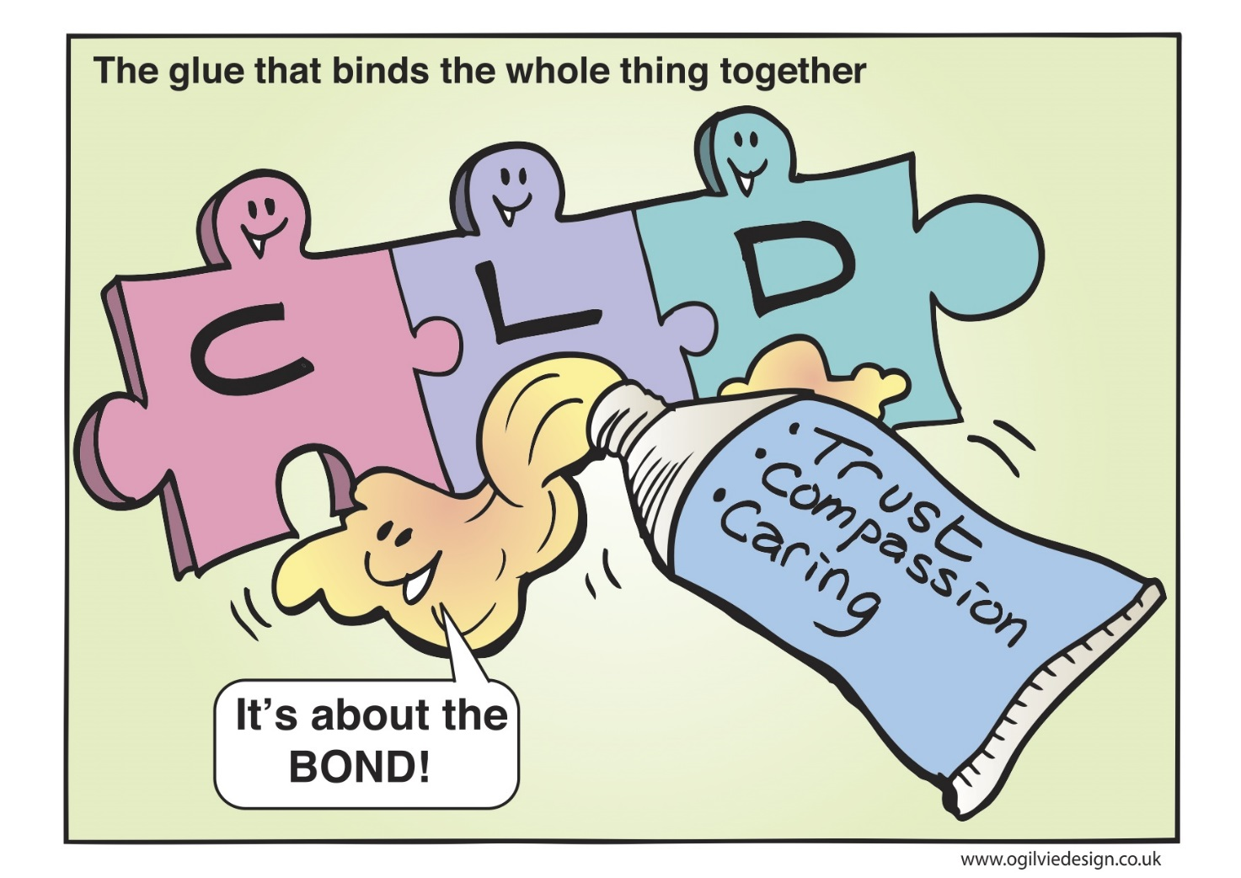
We need to be better at creating political support
Still no voice – Standards Council is crucial to informing the values and principals of CLD with employers and policy makers
University CLD courses are driven too much by academic qualifications – radicals are being kept out of courses.
We are agents of social change

Slide 4
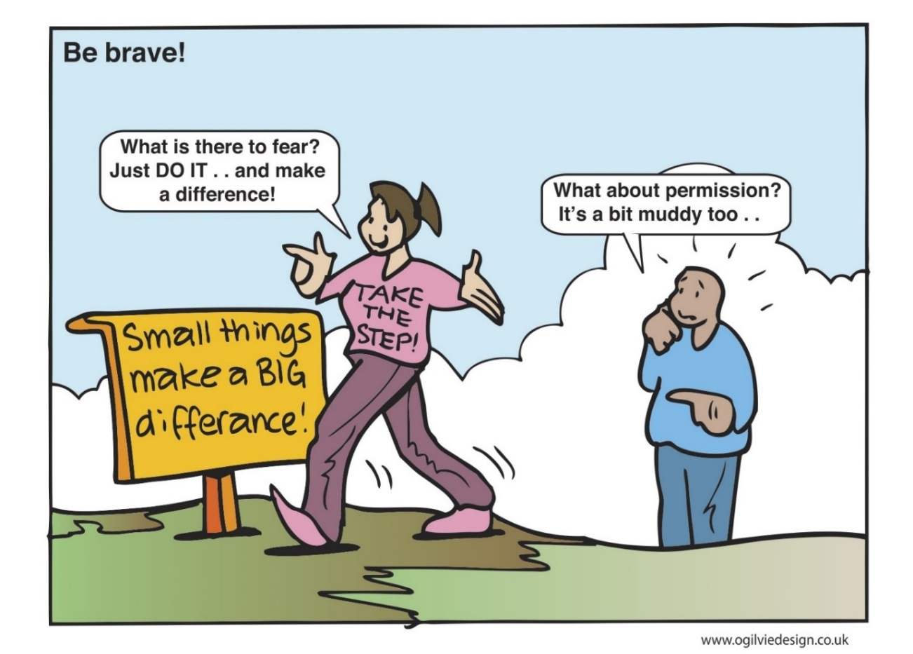
Are we being directed by others’ priorities … maybe we are we no different from everyone else
Frameworks such as Early Intervention, GIRFEC, preventative / upstream intervention – are imposed and can be barriers
Professional is driven by inspection, value for money and impact and “good practice” measures. Our curriculum has narrowed to meet Scottish Government priorities
ALN/ESOL/Adult learning has merged into Employability!

Slide 5
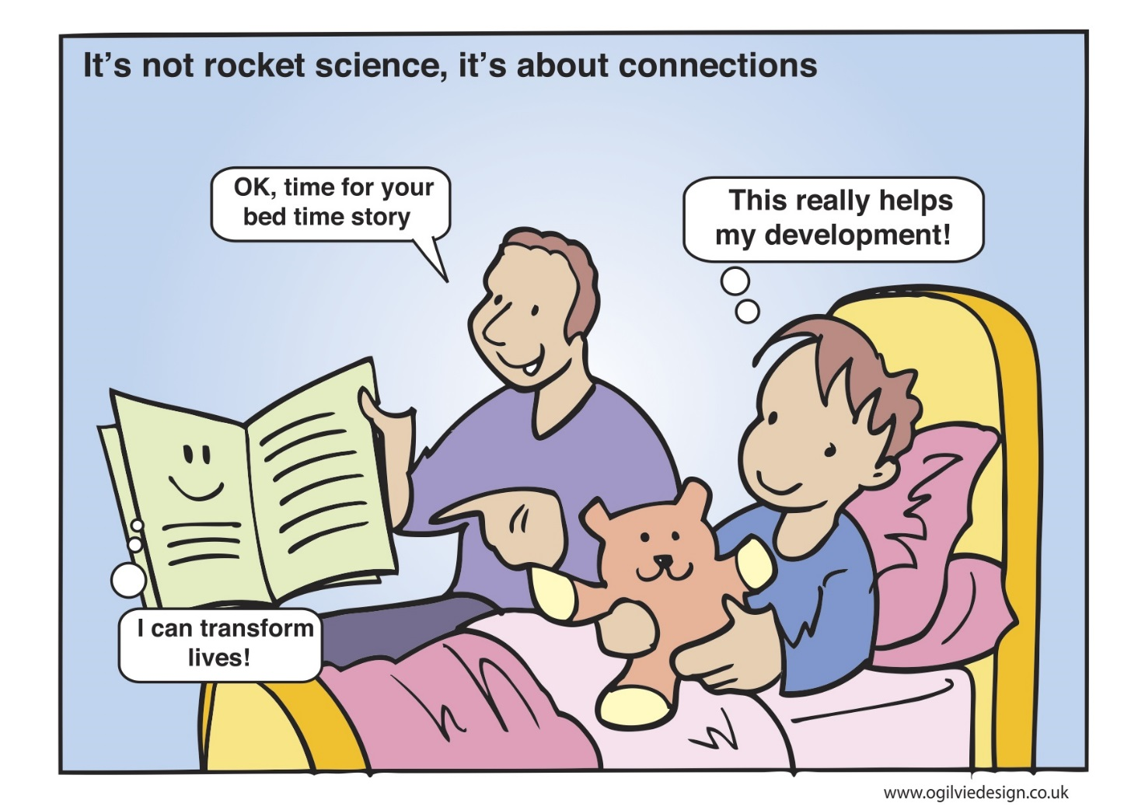
What makes CLD unique is how these values and principals translate through process and become meaningful
We have our values, and we enact them .. But is it just that people don’t listen and don’t understand them

Slide 6
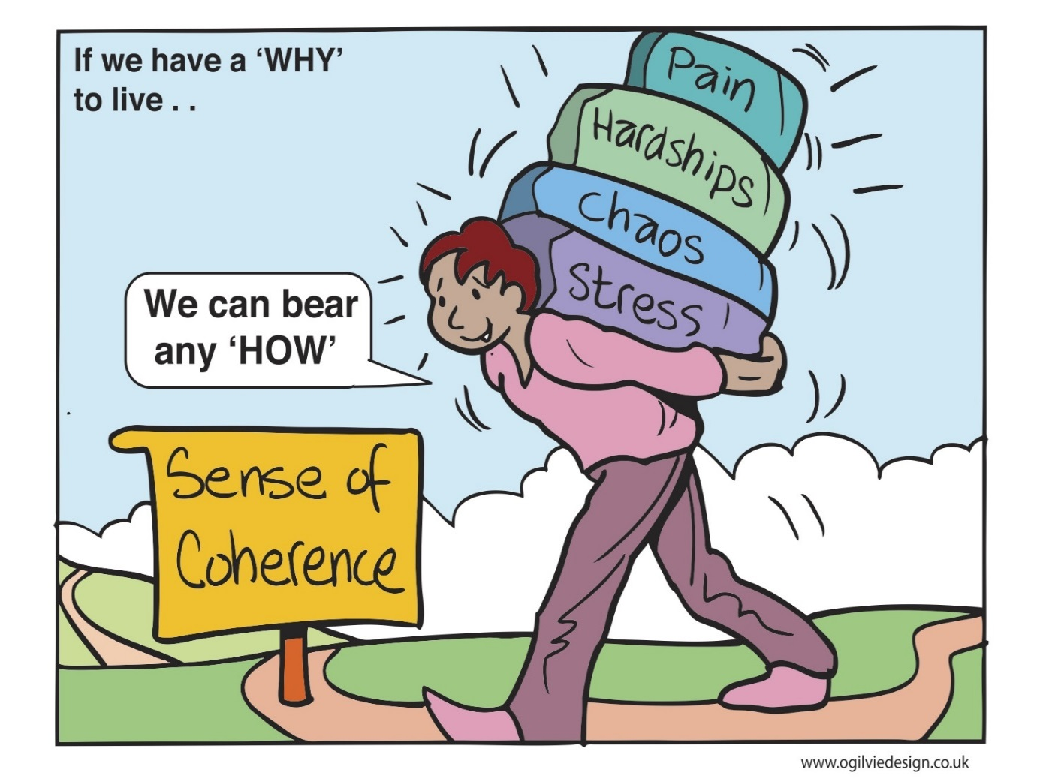
Being part of a community of practice helps us retain our values and principles
We seem to spend too much time fighting our corner
Our status has never been higher
At local level – e.g. authorities are shaky, uncertainty, low morale saps energy
If we don’t stick to our own priorities and belief we will remain as the “sticking plaster” profession
Workers now push more paper in common with others

Slide 7
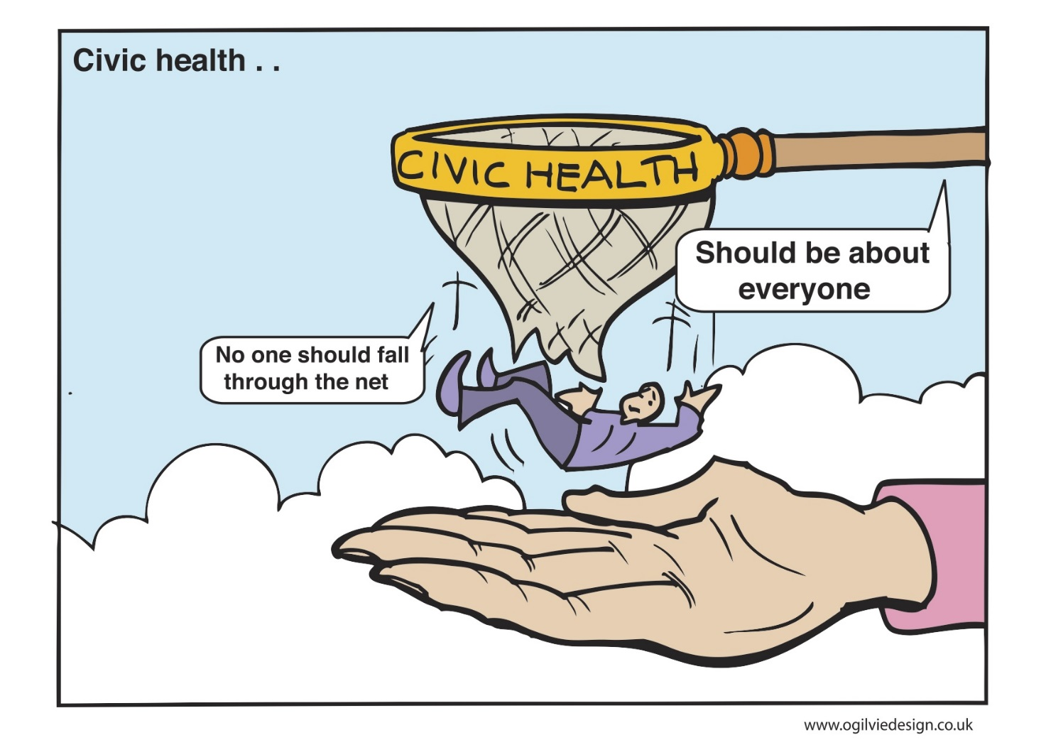
This is what we aspire to
When people are disenfranchised it is hard to get them involved
Create an open cultures of community conversations
We can make a difference is we work from the bottom up
Are we tampering at the edges or working at the core

Slide 8
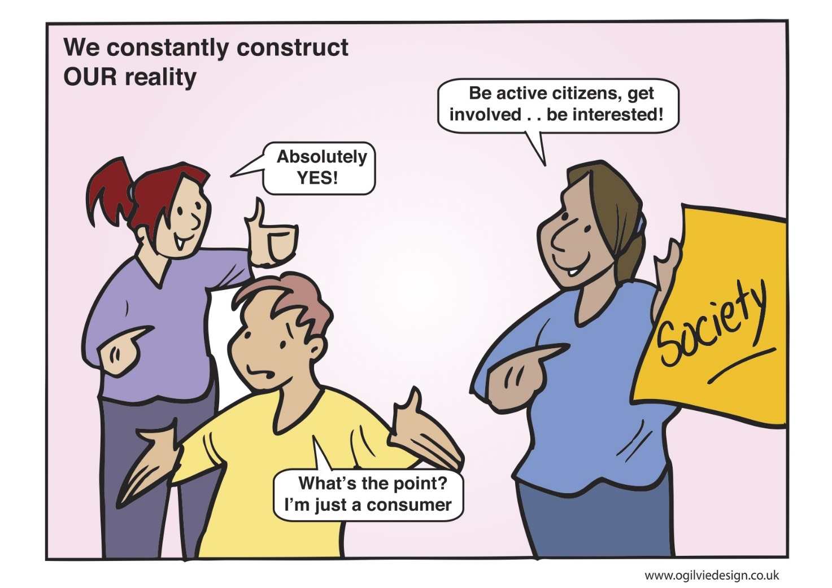
Value ideas from community members, support them to make a reality and celebrate success to encourage more
The Community Empowerment Bill opens up new opportunities
There used to be “Community Activism” in CLD job descriptions
We have lost our “activism”
People have such “shitty” lives that they can’t take part or be involved

Slide 9
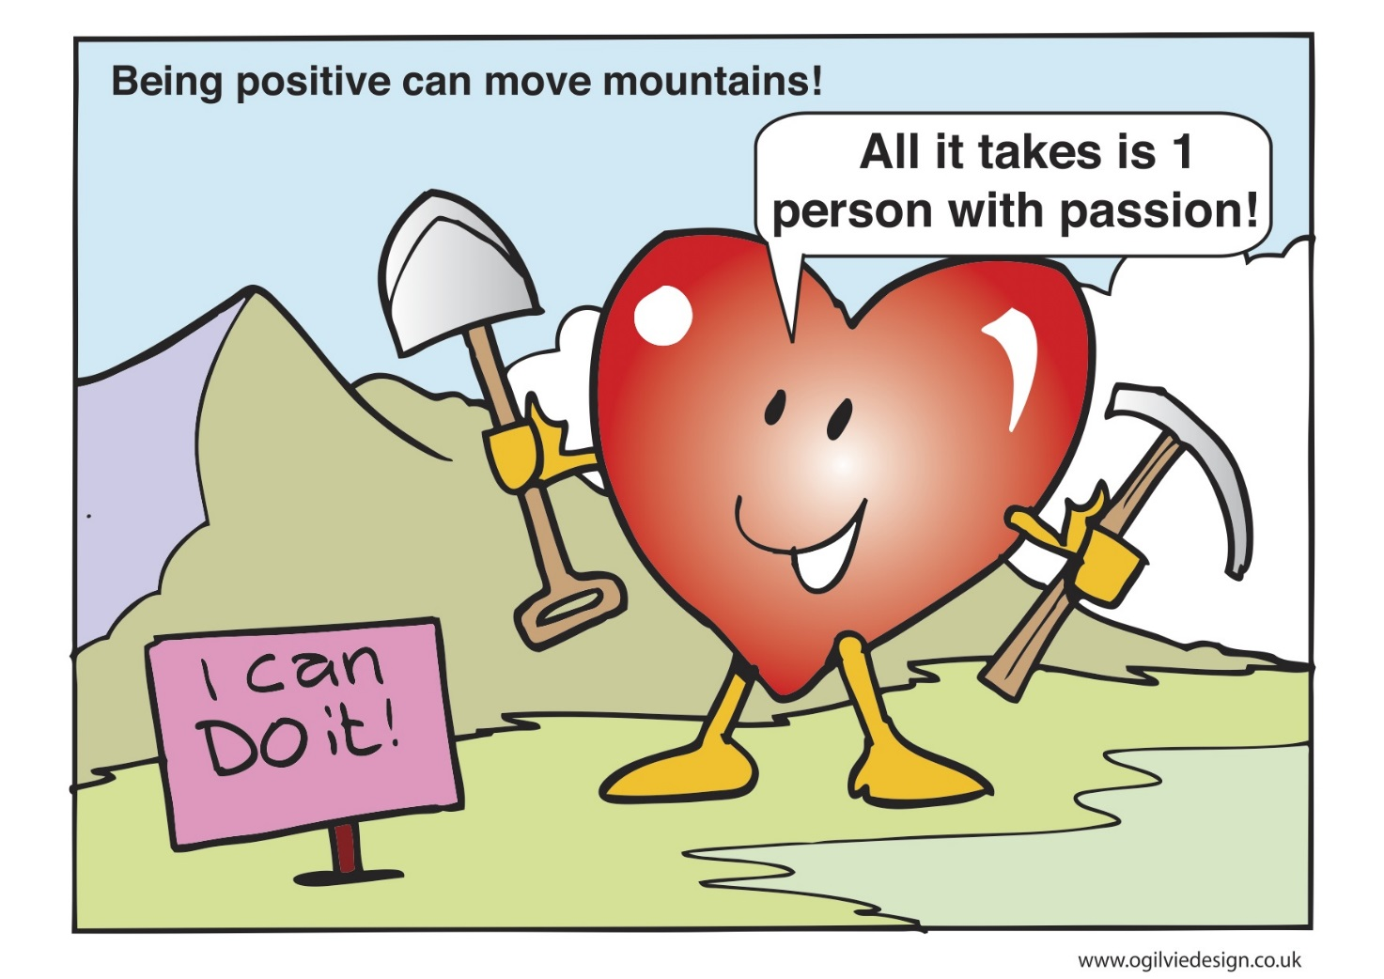
We need to get batter at challenging
Professionalism is a driver … but are we that unique – by emphasising our difference are we creating silos
We are an ageing profession now. We need young people to enter the workforce cultures as it is today
We can’t do it all on our own

Slide 10
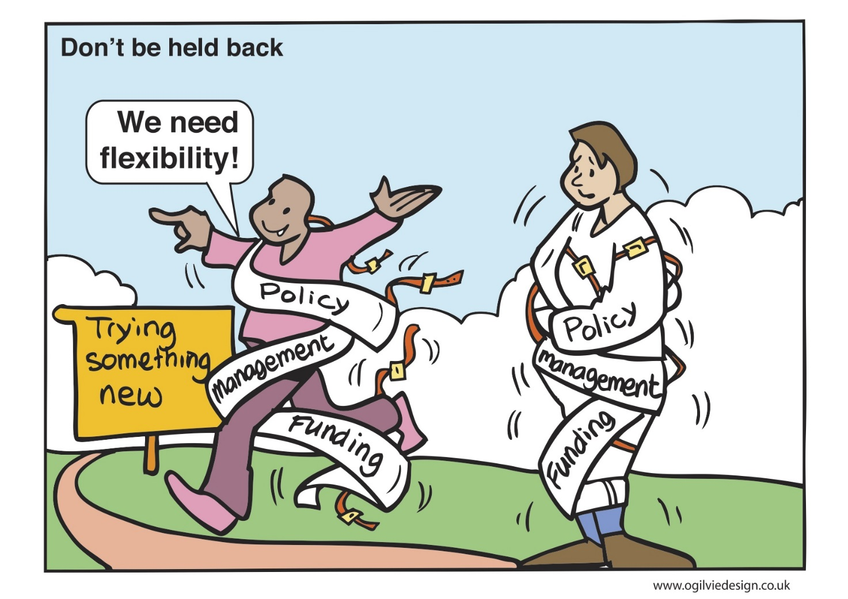
We have the flexibility to be creative – there is creativity out there we just need to harness it
Is it all about completing tasks now / driven by outcomes, numbers and funding?
Management need to create time for staff to be creative

Slide 11
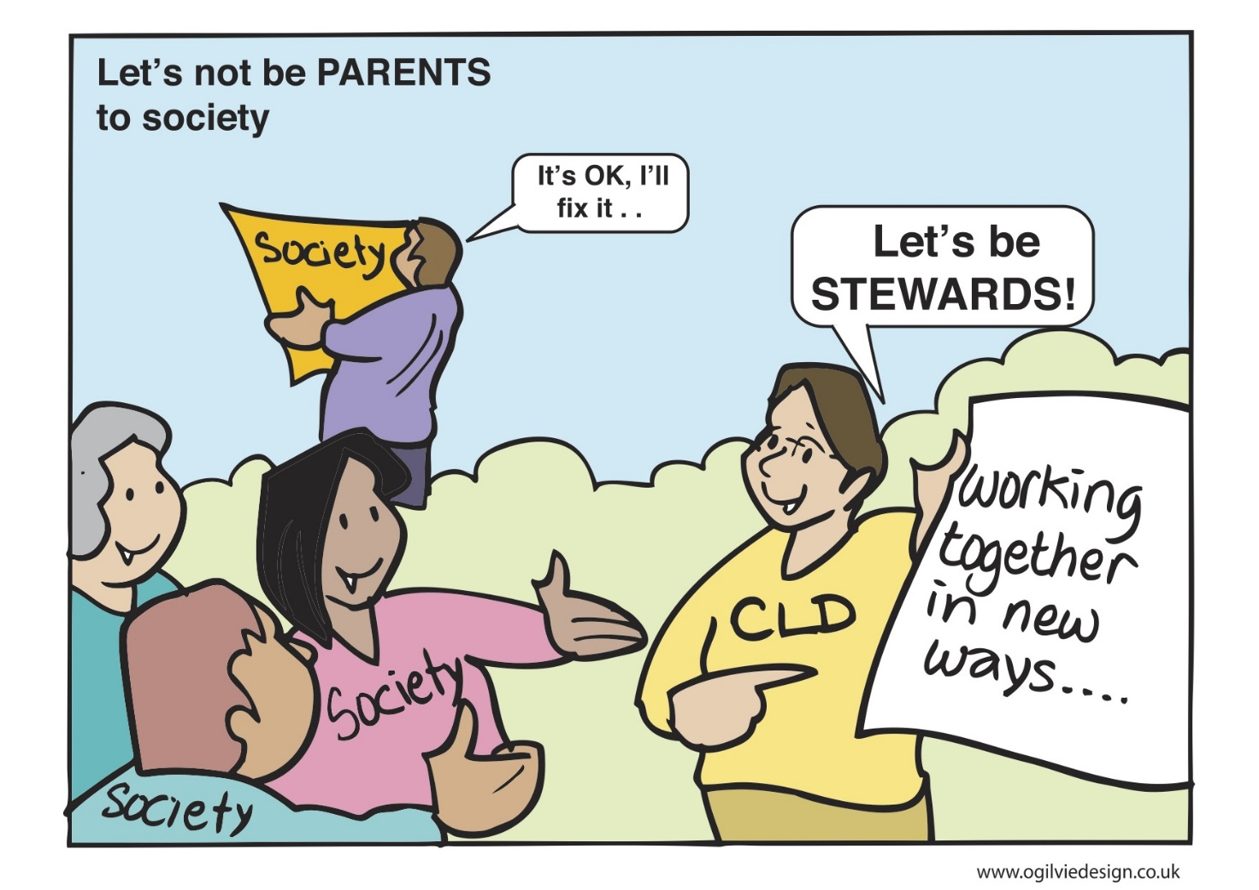
We are creative and find other ways round issues, that is our strength. Do we go underground and become more subversive, is this a comfortable position to be in, or should we be more transparent?

Slide 12
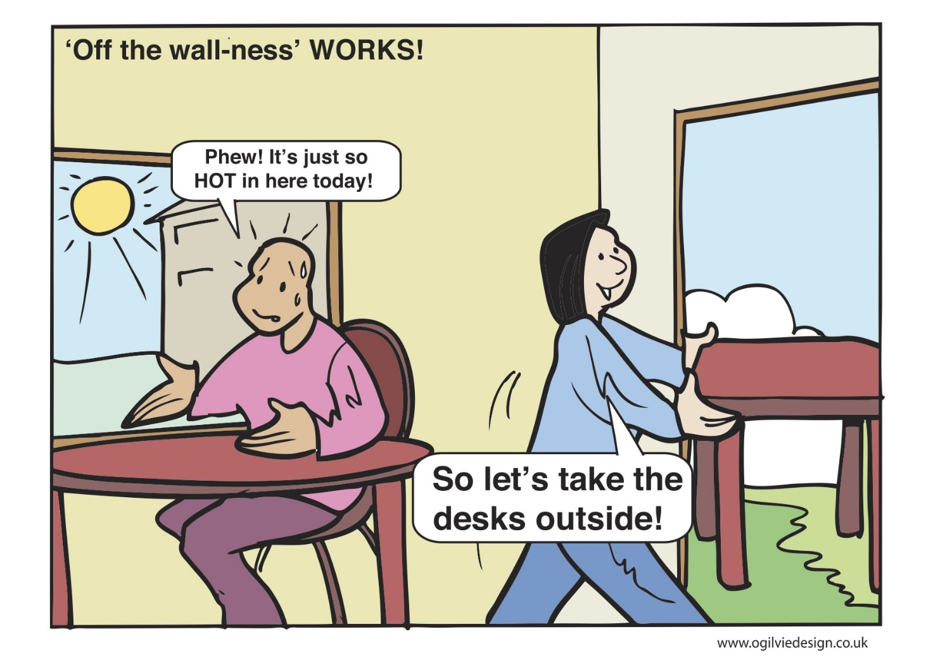
Why not try something new
What is wrong with taking a few risks
We are not allowed to take risks - is this just an excuse – do it until we are told to stop
We can be creative – who is actually stopping us trying new practice
WE still need up skilling to meet the needs of the new Strategic Guidance

Slide 13
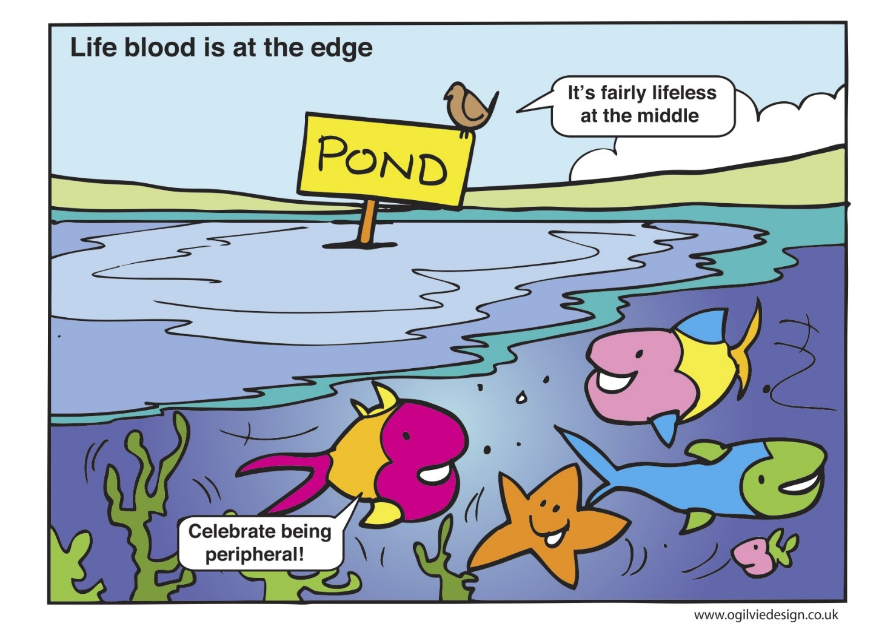
Being on the periphery bring opportunities as well as challenges

Slide 14
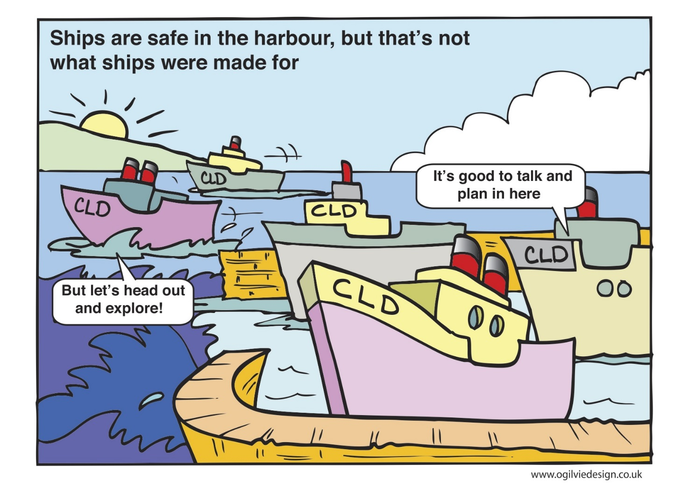
We need space to think
Finding like minded people to talk with
We can learn as much from “bad or problematic areas of practice – than the showcase practice”
WE need a harbour for reconstruction and deconstruction

