Slide 1
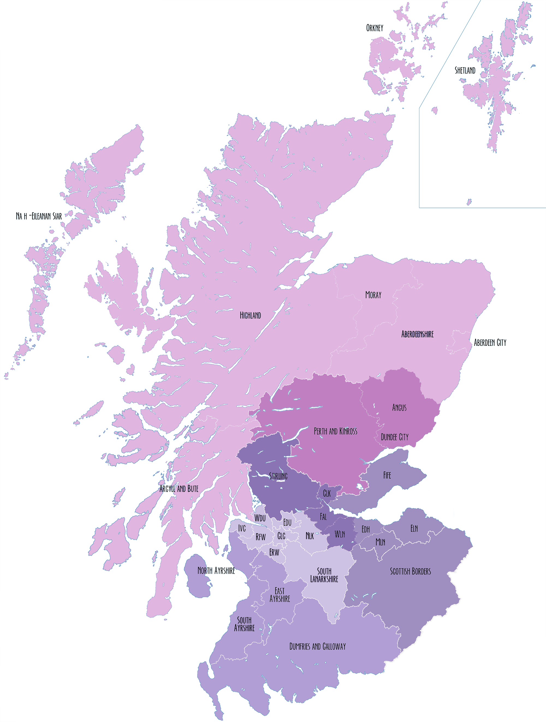
Scotland’s Regional Improvement Collaboratives
Forth Valley & West Lothian Collaborative Clackmannanshire Council Falkirk Council Stirling Council West Lothian Council
The Northern Alliance Aberdeen City Council Aberdeenshire Council Argyll & Bute Council Comhairle nan Eilean Sar Highland Council Moray Council Orkney Islands Council Shetland Islands Council
South East Alliance Edinburgh City Council East Lothian Council Fife Council Midlothian Council Scottish Borders Council
South West Collaborative East Ayrshire Council North Ayrshire Council South Ayrshire Council Dumfries & Galloway Council
The Tayside Collaborative Angus Council Dundee City Council Perth & Kinross Council
The West Partnership East Dunbartonshire Council East Renfrewshire Council Glasgow City Council Inverclyde Council North Lanarkshire Council Renfrewshire Council South Lanarkshire Council West Dunbartonshire Council

Slide 2
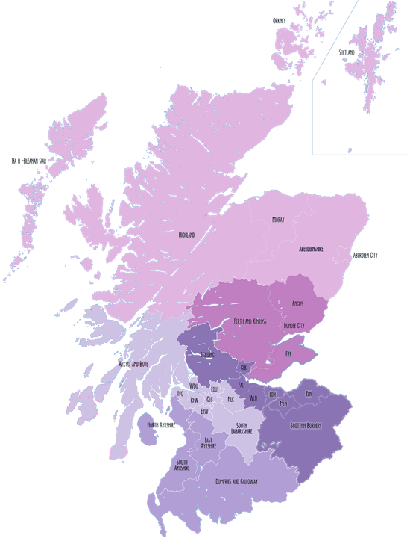
5 CLD Networks
South East and Central
Covering Clackmannanshire, East Lothian, Edinburgh, Falkirk, Midlothian, Scottish Borders, Stirling, West Lothian
Tayside and Fife
Covering Angus, Dundee, Perth and Kinross and Fife
North Alliance
Covering Aberdeen City, Aberdeenshire, Highland, Moray, Orkney, Shetland and the Western Isles
West CLD Alliance
Covering Argyll and Bute, East Dunbartonshire, East Renfrewshire, Glasgow, Inverclyde, North Lanarkshire, Renfrewshire, South Lanarkshire, West Dunbartonshire
South West Network
Covering Dumfries and Galloway, East Ayrshire, North Ayrshire and South Ayrshire
Fife is part of South East RIC
Argyll and Bute is part of Northern Alliance RIC
Clackmannanshire, Falkirk, Stirling and West Lothian are Forth Valley RIC

