Slide 1
An update on
Member Meet-ups
The story so far…

Slide 3
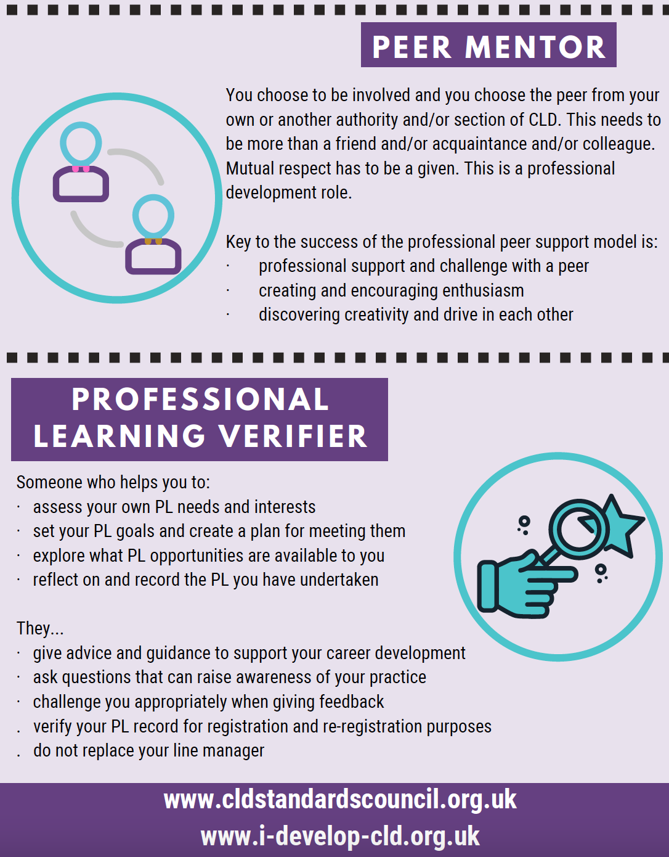

Slide 4
Background & context
Purpose
•Create an opportunity for CLDSC members to come together informally - to share and reflect on their practice experiences and the challenges they face
Context within wider CLDSC activity – support to members
•Professional learning activities linked to Growing the Learning Culture, Competent Practitioner Framework and i-develop
•New developments in Buddying & Mentoring

Slide 5
Success!?
7 member meet-ups hosted
289 members engaged
A blend of member and team hosting

Slide 6
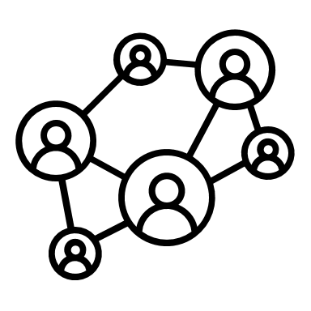
Topics and attendance
May - Creating connections, reinforcing relationships | 90
June - Digitally agile or digitally fragile? | 64
July - Sharing digital learning tools | 29
August – Engagement | 42
September – Get the kettle on | 20
October – Challenge Poverty Week | 20
November – Climate change | 24

Slide 7
So what does this mean?
Started off well attended by members - attendance has varied since, although sustained at no less than 20 attendees
Meet-ups are reaching different people, as the data shows it is not the same people attending each time – suggesting members register if a topic is interesting or relevant to their practice/job role
Lots we don’t know…

Slide 8
Some questions to think about…
Are the meet-ups valued and useful?
Are they sustainable in the current form?
Would more members be interested in ‘hosting’ and taking lead – a member-led support initiative
If so, what are the practical ways to do this that would work for the majority of members?
If not, are the member meet-ups something that should be:
A – Dropped altogether?
B – Frequency reduced?
C – Connections built and maintained in other ways?
Notes:
Share this link in the chat >
https://jamboard.google.com/d/1WW_wRgrjJHowv8kHDrVqSn8QHRRLg172_tp_PEmEUvI/edit?usp=sharing

