Slide 1
There are no Career Pathways in CLD … or are there?
Kirsty Gemmell & Steven Maclennan
Tuesday 7 November 2023
#CLDSCConf2023
Notes:
https://jamboard.google.com/d/11bWfhCuFo8rZKe5ceF4XwFGH_o1VtsUinzE7XtYXgkA/edit?usp=sharing

Slide 2
CLDSC – who are we?
Established in 2008 by Scottish Ministers.
Represents CLD practitioners who work in:
Adult Learning (including literacies & numeracies and ESOL)
Community Development
Youth Work
Chair appointed by Scottish Ministers. Our current chair is Alan Sherry OBE.
Only professional body for CLD in the world!
#CLDSCConf2023

Slide 3
CLDSC – who are we?
Vision
That the communities and people of Scotland are served by CLD practitioners that are recognised as competent, confident and committed to equality, empowerment and life-wide learning for all.
Mission
To drive high standards of professional practice in the CLD sector by the approval of professional learning, the registration of practitioners and the enabling of professional development, working with our members to be a voice for the profession.
#CLDSCConf2023

Slide 4
CLDSC – who are we?
5 strategic priorities
Deliver, maintain and further develop a professional Approvals structure for qualifications, courses and development opportunities for everyone involved in CLD
Maintain and develop the Registration system and establish members’ services for practitioners delivering and active in CLD
Maintain and develop models of Profession Learning and training opportunities for CLD practitioners
Improve and develop our organisational capability
Lead and contribute to relevant CLD policy and workforce information services.
#CLDSCConf2023

Slide 5
CLD in Scotland
Ministerial Support / Portfolio
Mr Graeme Dey MSP, Minister for Higher and Further Education; and Minister for Veterans
Tom Arthur MSP, Minister for Public Finance, Planning and Community Wealth
Legislation
Education Scotland Act 1980
The Requirements for Community Learning and Development (Scotland) Regulations 2013
Community Empowerment Act 2015
Community Planning Partnerships 2001
Policy
Adult Learning Strategy
Youth Work Strategy
Inspection Model
How Good is Our CLD 4?
Education Scotland
Improvement and Quality Management
Workforce Standards and Training
National Occupational Standards
Modern Apprenticeships
FE Programmes
HE Under and Post Grad
CLD Standards Council​
Funding​
International Recognition – OECD​
Research​
Fairer Work Policy / Volunteer Strategy​
Achieving a sustainable future: regeneration strategy
#CLDSCConf2023

Slide 6
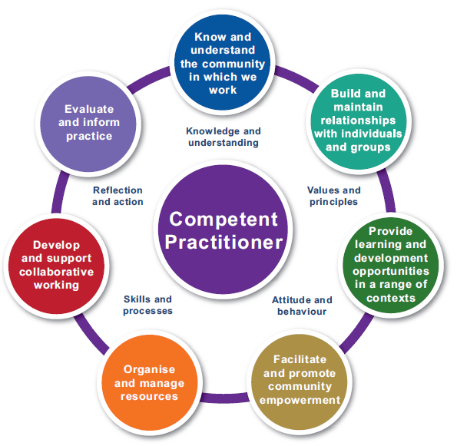
Professional CLD Practitioners
Competent Practitioner
Framework
Values & Principles
Code of Ethics
Primary Client​
Social Context​
Equity​
Empowerment​
Duty of Care​
Transparency​
Confidentiality​
Co-operation​
Professional Learning​
Self-awareness​
Boundaries​
Self-Care​
Knowledge & Understanding​
Values & Principles​
Attitudes and Behaviour​
Skills & Processes​
Reflection and Action
#CLDSCConf2023
Notes:
How do you use the Values, Ethics and Competencies in your practice, in your development?

Slide 7
Who is the CLD Workforce?
#CLDSCConf2023
Notes:
Working with Scotland’s Communities | CLD Standards Council for Scotland

Slide 8
Who is the CLD Workforce?
#CLDSCConf2023
Notes:
Planit : Job Profiles : Community Learning and Development Officer Community Education (planitplus.net)

Slide 9
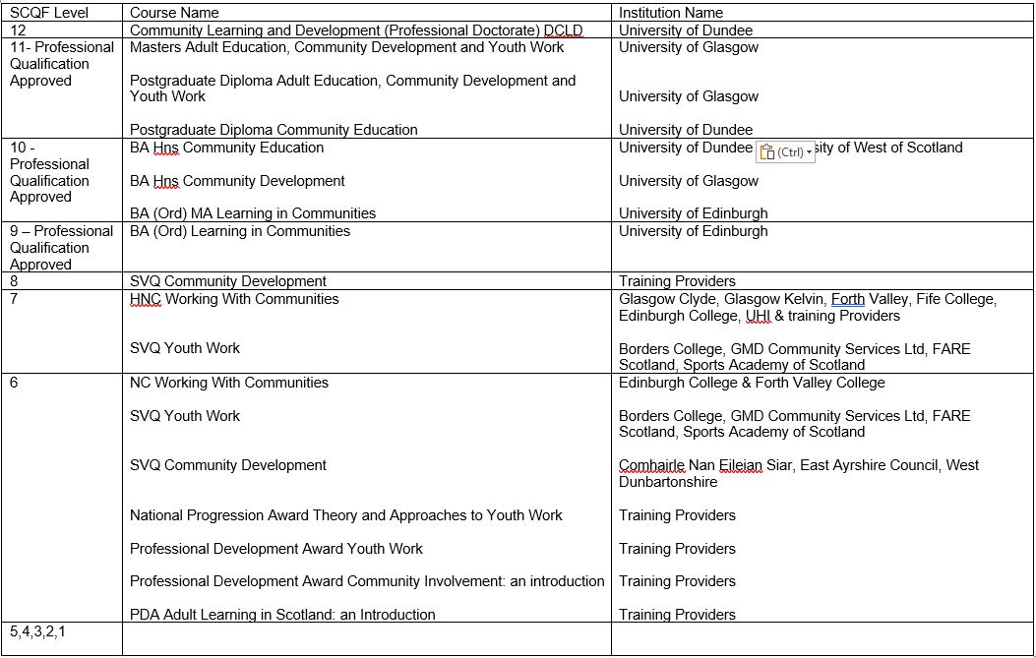
Qualifications on Offer
#CLDSCConf2023
Notes:
This is a snapshot of the most delivered courses on offer to CLD practitioners.

Slide 10
CLD Wicked Issues
Disparate workforce identity
Job Titles
Profession, Approach or Service
Competition or collaboration
Squeeze on Public Sector Finance
Over reliance on volunteers
Incoherent professional learning pathways
Disparate terms and conditions
Recruitment and retention issues
Leadership
Education Reform
Legislative Reform
#CLDSCConf2023

Slide 11
How can you help us to grow the CLD Workforce?
#CLDSCConf2023

Slide 12
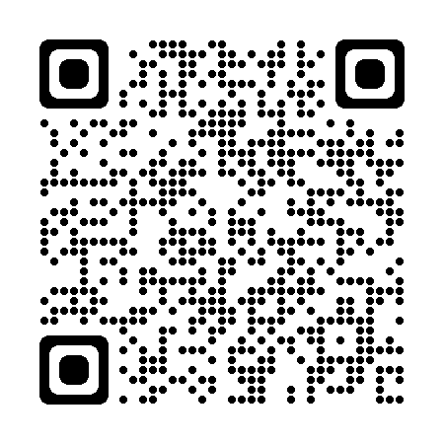
Find out more...
All information from today's event will be on our I-develop learning platform.
#CLDSCConf2023
Notes:
Registration | CLD Standards Council for Scotland

Slide 13
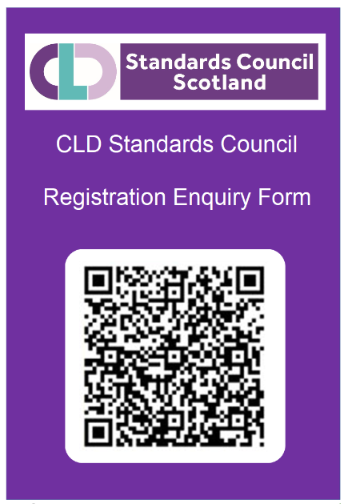
Are you a member?
Scan the code to register your interest in becoming a member.
Join us at the "More Members, More Clout" Registration Information session this afternoon 3-4pm!
#CLDSCConf2023
Notes:
Registration | CLD Standards Council for Scotland

Slide 14
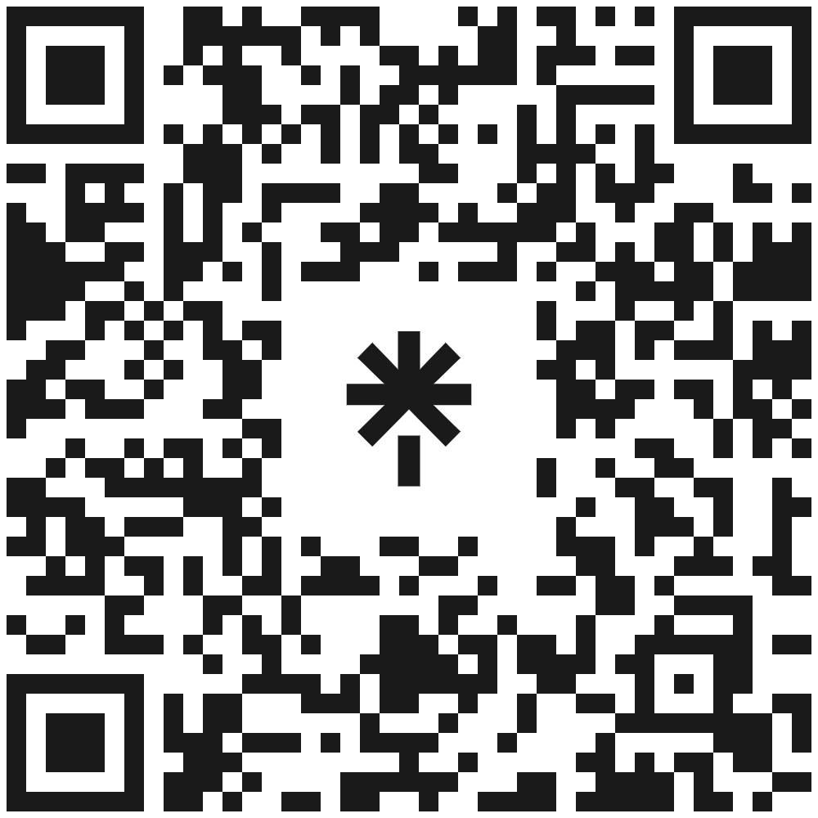
Scan the code to access our website and social channels
CLD Standards Council Scotland
The Optima
58 Robertson Street
Glasgow G2 8DU
T 0131 244 3444 E contact@cldstandardscouncil.org.uk
#CLDSCConf2023

