Slide 1
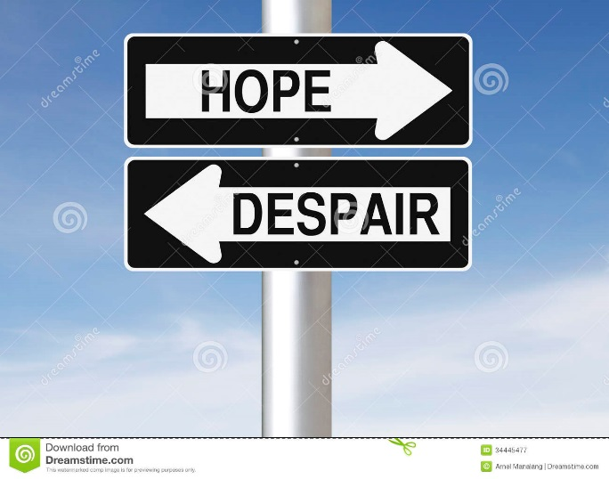
Thinking about Contemporary CLD in Scotland What Next?
The South East & Central CLD Consortium Networking Event
South Bridge Resource Centre
Thurs 8th Sept

Slide 2
Outline
Current political and policy context
What this has meant for CLD
Purposes of CLD
Fanning the flames of despair or igniting a spark of hope?

Slide 3
Current context
Spread of neoliberal ideology – a competitive market place is the best way to create economic wealth and ensure the freedom of the individual to succeed or not, dependent on their individual efforts
Individuals serving the interests of multi- national corporations are able to wield considerable economic and political power on the global stage (and influence national culture)
The financial crash caused by deregulated banks has been reconstructed as a problem of sovereign debt justifying austerity policies (cuts to public services disproportionately relied upon by the poor)
A massive shift in resources from poor to rich (62 people have as much wealth as 3.5 billion)

Slide 4
Poverty and Inequality in Scotland
In 2014/15, 58 per cent of working age adults in poverty were living in working households, as were 66 per cent of children in poverty. While employment remains the best route out of poverty, employment is no longer a protection against poverty
The top 10 per cent of the population had 15 per cent more income in 2014/15 than the bottom 40 per cent combined. (A disparity which has been growing year on year)

Slide 5
A social policy emphasis on community empowerment
For too long communities have not had a big enough say in what happens in their local area – whether it be about what happens to local amenities, how local services are delivered, or how new development is planned. (Localism Act 2011 – 2015)
“This bill is a momentous step in our drive to decentralise decisions and give people a stronger voice in their communities” (Marco Biagi MSP, Minister for Local Government and Community Empowerment)

Slide 6
What has this policy context meant for CLD provision?
Disappearing or reshaped statutory & third sector
provision
Struggle to address increasing poverty and social deprivation
Increased managerialism
A focus on employability
A key role in facilitating community involvement or engagement

Slide 7
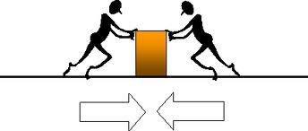
addressing maintaining disadvantage or social order inequality social (help people fit (contribute to in better?) social change?)
The Contradictory Purposes of CLD
– what is the problem to be solved?

Slide 8
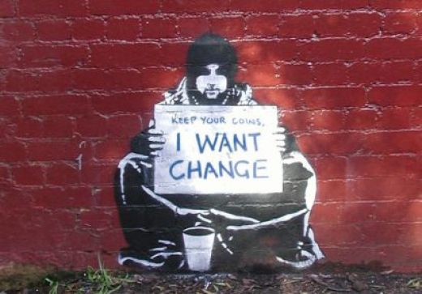
Addressing the context we are in – what next?
Praxis (theory
and practice) – increasing
need to be clear why we
are doing what we are
doing – what
problem are we addressing?
How do we contribute to promoting social justice and social solidarity?
How do we support people in the short term and contribute to addressing more central issues of social inequality in the long term?

Slide 9
Some Ideas
Use the policy rhetoric about community empowerment and engagement to our advantage highlighting our expertise in this field but choose to interpret it as a means to address the democratic deficit
Use newspaper articles, social marketing techniques, facebook, twitter etc to illustrate the impact of what we do, why it has value (See it as campaigning on social justice)
Marshall the evidence we have available to highlight social impact of service cuts, make evidence visible and challenge political commitment to address social inequality
Build alliances and promote solidarity, work to avoid groups being set against one another

