Slide 1
Review of Community Development National Occupational Standards
Feedback to stakeholders
March 2023

Slide 2
Agenda
Welcome and Introductions
Background to NOS
Consultation Process
Functional Map
Draft Standards
What next?

Slide 3
Project Outputs
A suite of up to date
National Occupational Standards for
Community Development

Slide 4
What are NOS?
A National Occupational Standard describes what an individual needs to do, know, and understand in order to competently carry out a particular job or function
Notes:
Applicable across the whole of the UK.

Slide 5
Potential Uses of NOS
Competency frameworks
Job descriptions / requirements
Qualifications
Key outcomes
Underpinning knowledge
Career planning & progression
Individual performance
& appraisal
Focused training & development

Slide 6
Functional Analysis
Key purpose
What needs to happen to achieve the Key Purpose?
Functional Areas
What needs to happen to achieve this functional area?
National Occupational Standards

Slide 7
Consultation process
Steering group
England – Sue Gill Northern Ireland – Anna Clarke
Scotland – Mick Doyle Wales – no representative
2 x Focus groups = 87 participants
2 x Surveys = 66 responses
Analysis of feedback informs revisions to NOS
1 x Feedback to Sector = today!
Final NOS sign off done by the Steering Group

Slide 8
Community Development
Functional Areas
1 Understand and practise community development
4 Collaborative and cross-sectoral working
2 Understand and engage with communities
3 Group work and collective action
5 Community learning for social change
Community development enables people to work collectively together in a structured and co-ordinated way to bring about positive social change to achieve equality, social justice, climate justice and human rights. It is underpinned by a clear set of values and ethical principles.
This long-term process starts with people’s own experience and enables communities* to work together to:
● identify the needs and actions they wish to address
● plan and take collective action
● build on and strengthen their confidence, skills and knowledge
● challenge unequal power relationships
● promote social justice, equality and participation
in order to improve the quality of their own lives, the communities in which they live and societies of which they are a part.
*Communities refer to those that can be defined by
geography, identity or interest.
6 Governance and organisational development
Notes:
Functional analysis is the main tool used to develop NOS. Functions are the main activities a person is expected to do as part of their job.
Key changes:
Make split between purpose and process explicit (parAgraphs)
NO change to functional areas.

Slide 9
Key Purpose
Community development enables people to work collectively together in a structured and co-ordinated way to bring about positive social change to achieve equality, social justice, climate justice and human rights. It is underpinned by a clear set of values and ethical principles.
This long-term process starts with people’s own experience and enables communities* to work together to:
● identify the needs and actions they wish to address
● plan and take collective action
● build on and strengthen their confidence, skills and knowledge
● challenge unequal power relationships
● promote social justice, equality and participation
in order to improve the quality of their own lives, the communities in which they live and societies of which they are a part.
*Communities refer to those that can be defined by
geography, identity or interest.

Slide 10
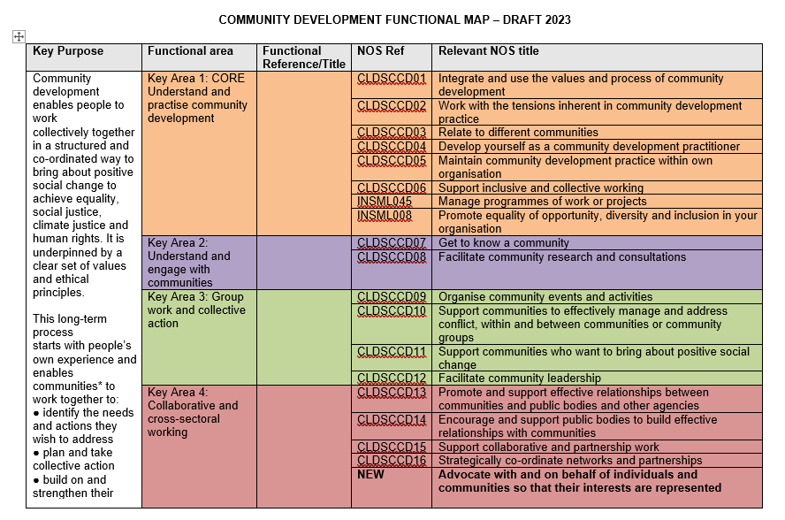
Community Development
Functional Map
Notes:
CD functional map
6 Functional Areas
30 standards
Including
2 new
3 from other sectors which are relevant to CD practice

Slide 11
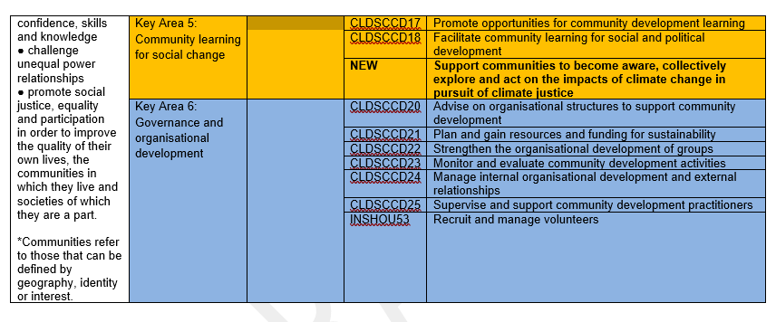
Community Development
Functional Map (cont)
Notes:
CD functional map
6 Functional Areas
30 standards
Including
2 new
3 from other sectors which are relevant to CD practice

Slide 12
Existing NOS
Key updates:
Recognition that not all CD practitioners are based within an organisation – wording amended to reflect that
Amalgamation of JETSCD08 and 09
Emphasis on supporting communities to know and use their legal rights
Updating of Glossary terms – Resources, Technology, Community and Community Engagement
Must follow NOS writing principles
Performance criteria would be what is used for assessment if the NOS were used in qualification development
Knowledge and Understanding is usually evidenced through questions and answers, reflective accounts or professional discussions

Slide 13
Imported NOS
INSML045 - Manage programmes of work or projects - 74% Agreed/Strongly Agreed
INSML008 - Promote equality of opportunity, diversity and inclusion in your organisation – 85% Agreed/Strongly Agreed
INSHOU53 - Recruit and Manage volunteers – 60% Agreed/Strongly Agreed
Must be imported entirely – no amendments can be made
Can contextualise in own setting
Notes:
NOS writing guide – if standard already exists and can be imported, do not create new.
Consensus from survey to import

Slide 14
New NOS
Advocate with and on behalf of individuals and communities so that their interests are represented
Support communities to become aware, collectively explore and act on the impacts of climate change in pursuit of climate justice
Must follow NOS writing principles
Performance criteria would be what is used for assessment if the NOS were used in qualification development
Knowledge and Understanding is usually evidenced through questions and answers, reflective accounts or professional discussions
Created in collaboration with the Steering Group
Notes:
Advocacy – strong feeling from focus groups to include this, but only 54% of survey respondents thought the suggested import was good enough. So this is where a new NOS was developed with the support of the Steering Group.
Climate Justice – Focus groups requested inclusion. 71% of respondents agreed. No suitable NOS to import, so new one created in collaboration with the steering group

Slide 15
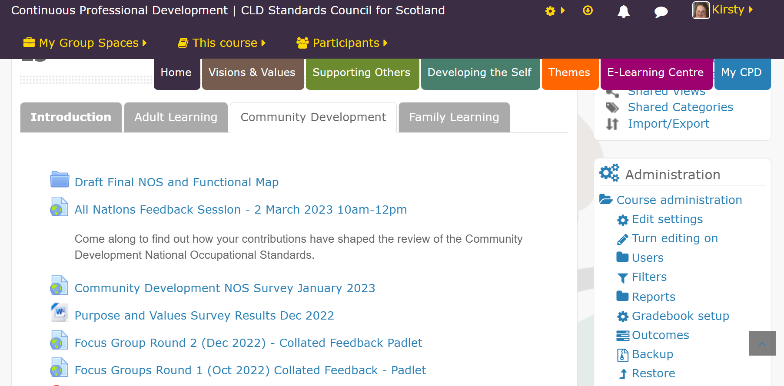
Things to consider…
Community Development Values
Sector skills council
Review documentation available:
National Occupational Standards 2022-23: Community Development
Notes:
Questions

Slide 16
Next Steps
Submission sign off by Steering Group
March 2023
Regulators review (NOS governance group)
March/April 2023
NOS published on NOS database
April 2023
Final NOS submitted
March 2023
Notes:
Questions

Slide 17
Contact Details
Kirsty Gemmell
Education Officer
Kirsty.Gemmell@cldstandardscouncil.org.uk
Steven Maclennan
Development Officer
Steven.maclennan@cldstandardscouncil.org.uk

